Slide 1
Development of a microprocessor project with LPC2388 development board

Slide 2
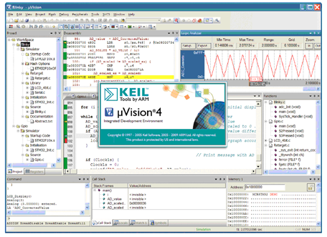
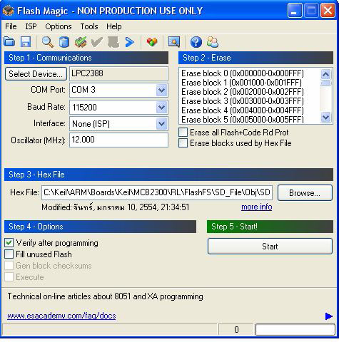
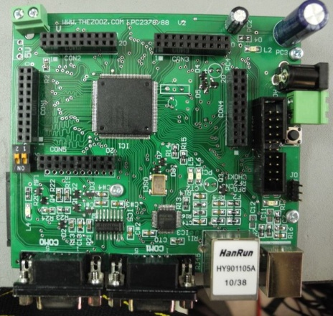
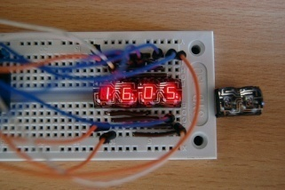
Development Cycle
2
3
Write your source code in C Language
Translate your source code into a HEX file format
Send your HEX file program to Flash Magic program
Write the HEX file program to program memory on the
board through Flash Magic program
Correct your program
1
4
5

Slide 3
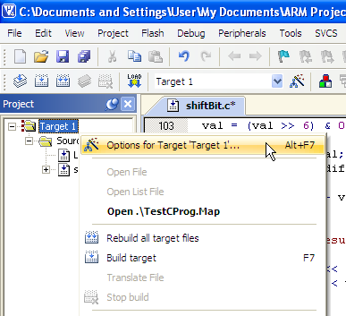
Creating a HEX File Format
1. After creating and adding your source code to the project, right click on the Target 1 folder and choose the Options for Target ‘Target 1’… menu.

Slide 4
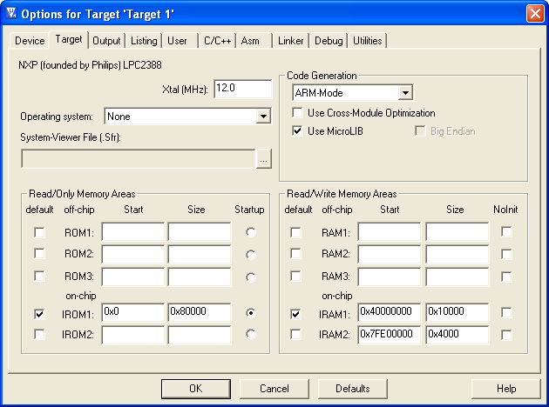
Creating a HEX File Format
2. Click on the Target tab and check on the Use MicroLIB box.

Slide 5
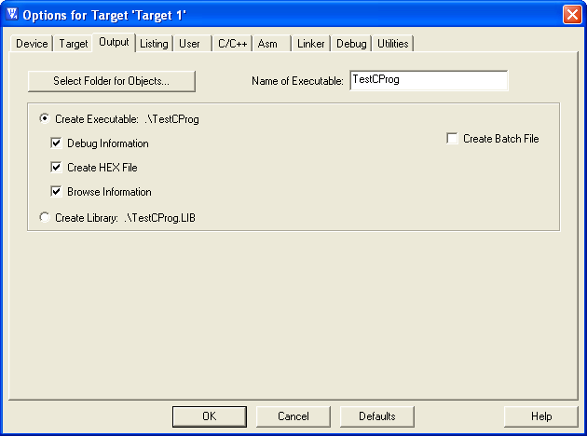
Creating a HEX File Format
3. Click on the Output tab and check on the Create HEX File.

Slide 6
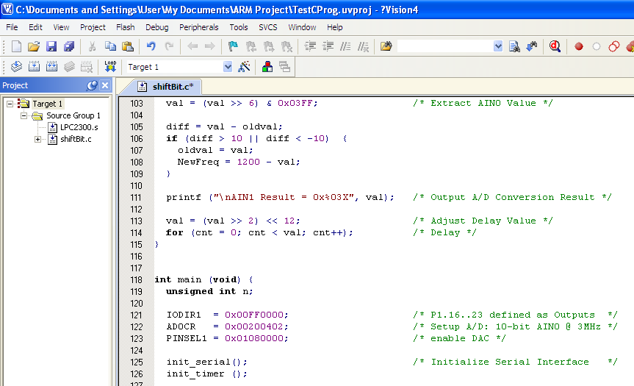

Creating a HEX File Format
5. Build or Rebuild your project as usual. Then you will see a HEX file in the folder where your project files are.

Slide 7
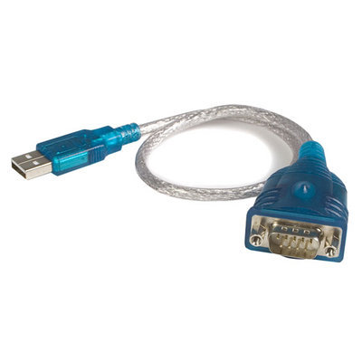
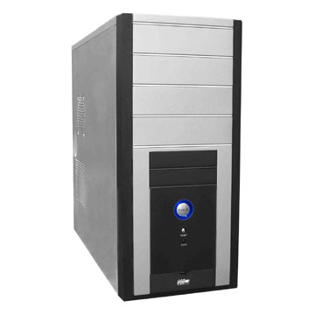

Burning a HEX File Program to LPC2388 Board
1. Connect one end of the USB to RS232 cable to a computer and another one to a LPC2388 board (COM0).
COM0

Slide 8
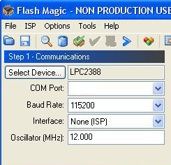
Burning a HEX File Program to LPC2388 Board
2. Run Flash Magic program, fill the information in the Stop 1-Communications as follows:
Choose it later

Slide 9
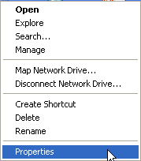

Burning a HEX File Program to LPC2388 Board
3. For the COM Port: , we can choose the COM port that the Flash Magic use to communicate with LPC2388 board as follows:
3.1 Right click on My Computer on the Desktop and choose Properties menu.

Slide 10
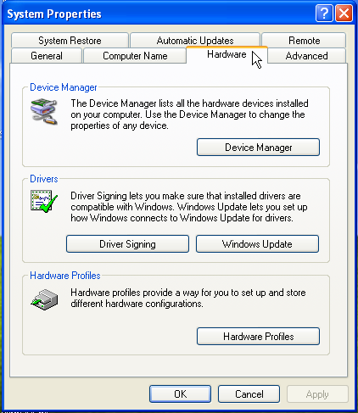
Burning a HEX File Program to LPC2388 Board
3.2 Click on the Hardware Tab and choose Device Manager Button.

Slide 11
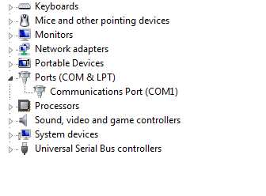
Burning a HEX File Program to LPC2388 Board
3.3 Click on Ports (COM & LPT). You will see the COM port that you can use.

Slide 12
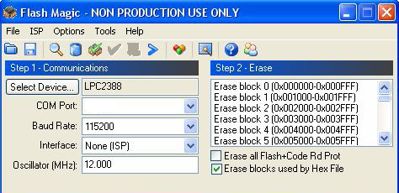
Burning a HEX File Program to LPC2388 Board
3.4 fill the COM port from stop 3.3 in the Flash Magic program .
com 1

Slide 13
Burning a HEX File Program to LPC2388 Board
4. In step 2-Erase, check on the Erase blocks used by Hex File box.
com 1

Slide 14
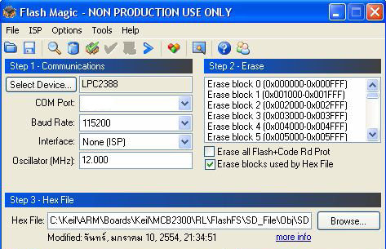
Burning a HEX File Program to LPC2388 Board
5. In step 3-Hex File, choose the HEX file program obtained from the KEIL program by using Browse… button.
com 1

Slide 15
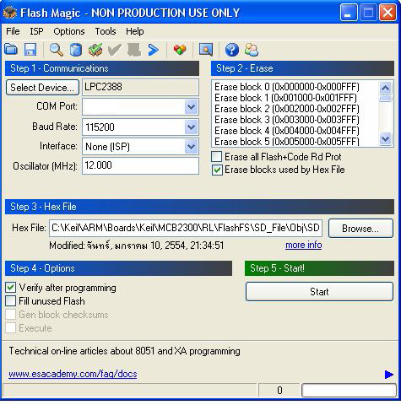
Burning a HEX File Program to LPC2388 Board
6. In step 4-Options, check on the Verify after programming box.
com 1

Slide 16
Burning a HEX File Program to LPC2388 Board
7. In step 5-Start!, press the Start Button.
com 1

