Slide 1
Memory hierarchy
353156 – Microprocessor
Asst. Prof. Dr. Choopan Rattanapoka and Asst. Prof. Dr. Suphot Chunwiphat

Slide 2
Two 7-Segments Display
Last week, we control a 7-segment
How about two 7-segments if you want to display a number “53” on two 7-segment
Suppose we define a local variable
unsigned int number = 53;
We can get the most significant digit (MSD) by
unsigned int MSD = number / 10;
We can get the least significant digit (LSD) by
unsigned int LSD = number % 10; OR
unsigned int LSD = (number – (MSD * 10))

Slide 3
Exercise 1
Suppose X = 1456;
6 as the first digit
5 as the second digit
4 as the third digit
1 as the fourth digit
How to write a program to store the first digit, the second digit, the third digit and the fourth digit of X in variable A, B, C, and D respectively ?

Slide 4
Memory Hierarchy
ALU
Registers
Load/Store
CPU
RAM
We have learnt that CPU need to load instructions from RAM to register (Fetch)
Then, CPU decodes the instruction (Decode)
Then Execute the instruction (Execute)
However, transfer data between CPU and RAM is slow comparing to CPU processing speed

Slide 5
Cache Level 1
The solution to fix the slow data transfer rate between CPU and RAM, The CPU manufacturer put a high speed memory called “cache” inside in CPU chip.
Thus, the set of instructions will be loaded from RAM to cache and then CPU can load instructions from cache
Cache L1 run at CPU clock speed, but it’s quite small
Intel core-i7 has
32 kB of instruction cache
32 kB of data cache
ALU
Registers
Load/Store
Cache L1
CPU
RAM

Slide 6
Cache Level 2
Only cache L1 is not enough to improve PC performance that much.
In the past, mainboard manufacturers put a faster memory as a buffer between CPU and RAM.
We call it “cache level 2” (cache L2)
ALU
Registers
Cache L1
CPU
Cache L2
RAM
As time goes by, The CPU manufacturers can make circuits inside CPU smaller and smaller. Thus, there is more space left on the CPU die.
CPU manufacturers put cache level2 inside CPU. (Normally cache L2 size is around 1 MB to 6 MB)
ALU
Registers
Cache L1
Cache L2
CPU
RAM

Slide 7
CPU Core
Since CPU technology develops very fast. The circuits inside CPU becomes smaller and smaller.
The CPU manufacturers decides to fill up the die with multiple ALU, cache, and registers (core)
In theory, CPU can do more than 1 instruction at a time
Core
Core
ALU
Registers
ALU
Registers
Cache L1
Cache L1
Cache L2
Cache L2
CPU

Slide 8
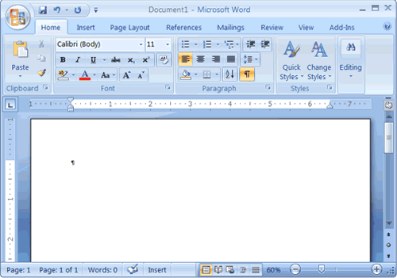
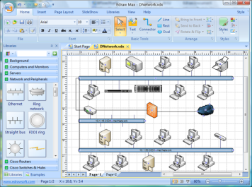
CPU : 1 core VS 2 cores
ALU
Registers
Core
Core
ALU
Registers
ALU
Registers
Cache L1
Cache L1
Cache L1
Cache L2
Cache L2
Cache L2
CPU
CPU

Slide 9
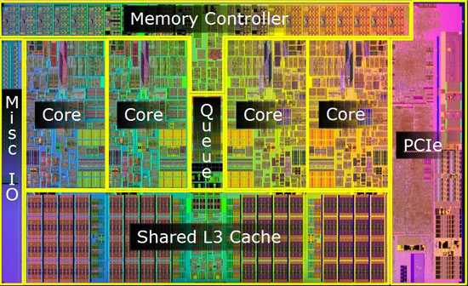
Cache Level 3
CPU core2 family (core2-duo, core2-quad) has only cache L2
However in core-i family (core-i3, core-i5, core-i7), Intel put cache L3 in CPU. This cache is shared for all the cores in chip
Cache L3 size is around 8MB

Slide 10
Virtual Memory
Remind you that programs need to be loaded to RAM.
CPU can’t read instruction or data from harddisk directly.
How about some software such as game ?
For example: Game size is 8 GB
But your PC has RAM only 4 GB (can you play this game?)
We need to extend RAM size to fit software size
Operating System (OS) use some part of harddisk to act as a RAM extension, we call it “Virtual Memory”
Normally Virtual Memory size is about 2 – 2.5 times of RAM size

Slide 11
Memory Conclusion (1)
RAM
Harddisk
Virtual Memory

Slide 12
Memory Conclusion (2)
Central Processor Unit (CPU)
Increasing Distance from CPU, Decreasing cost / MB
“Upper”
Levels in memory hierarchy
Cache L1
Cache L2
Cache L3
“Lower”
RAM
Virtual Memory
Size of memory at each level

