Slide 1
OUTPUT Interface
353156 – Microprocessor
Asst. Prof. Dr. Choopan Rattanapoka and Asst. Prof. Dr. Suphot Chunwiphat

Slide 2
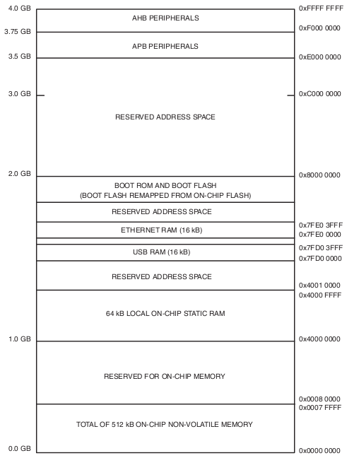
ARM Memory Structure
AHB = Advanced High-Performance Bus
Start at memory address 0xF000 0000
APB = Advanced Peripheral Bus
Start at memory address 0xE000 0000
Memory access also reading/ writing a sequence of bytes, so use loads for input, stores for output
Called “Memory Mapped Input/Output”
A portion of the address space dedicated to communication paths to Input or Output devices (no memory there)

Slide 3
GPIO
GPIO (General Purpose Input/Output)
We can use GPIO as an Input or an Output port
Input : input digital/analog signal to Microprocessor
Output : digital output signal to devices.
IN ARM7
2 legacy ports (Port 0, Port 1)
Each port has 32 pins (P0.4 means Port 0 pin 4)

Slide 4
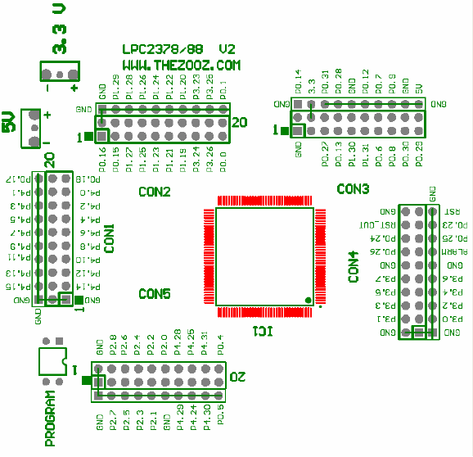
LPC 2388 Board

Slide 5
LPC 2388 Board (Available Port)
Port 0
P0.0, P0.1 (2 pins continuous)
P0.4 – P0.9 (6 pins continuous)
P0.12 – P0.18 (7 pins continuous)
P0.24 – P0.31 (8 pins continuous)
Port 1
P1.19 – P1.31 (13 pins continuous)

Slide 6
Control Register on GPIO Port
There are 4 abstract registers to control GPIO port
IODIR (GPIO Port Direction Control Register)
To control either GPIO port is an input port (0) or output port(1)
We use IODIR0 for Port0, and IODIR1 for Port1
IOPIN (GPIO Pin Value Register)
To read current port status
We use IOPIN0 for Port0, and IOPIN1 for Port1
IOSET (GPIO Port Output Set Register)
To write data “1” to the specific port to make output logic to “1”
IOSET0 for Port0, and IOSET1 for Port1
IOCLR (GPIO Port Output Clear Register)
To write data “1” to the specific port to make output logic to “0”
IOCLR0 for Port0, and IOCLR1 for Port1

Slide 7
Example 1 : Setting a port as output
Define a variable P0_9 to store value 0x00000100
unsigned int P0_9 = 0x00000100;
IODIR0 = P0_9;
IOSET0 = P0_9;
IOCLR0 = P0_9;
Set Port 0.9 as an output port
Set logic “1” as output of Port 0.9
Set logic “0” as output of Port 0.9

Slide 8
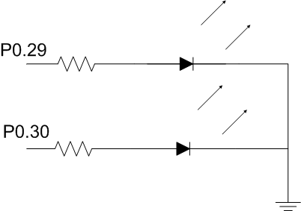
Example: 2 LEDs Blink (1)
2 LEDs
connected to P0.29
connected to P0.30
We want 2 LEDs blink at the same time.

Slide 9
Example: 2 LEDs Blink (2)
#include “LPC23XX.h”
int main(void) {
unsigned int P0_29 = (1 << 29);
unsigned int P0_30 = (1 << 30);
int i;
IODIR0 = P0_29 | P0_30;
while(1) {
IOSET0 = P0_29 | P0_30;
for(i = 0; i < 10000; i++);
IOCLR0 = P0_29 | P0_30;
for(i = 0; i < 10000; i++)
}
}

Slide 10
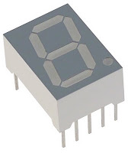
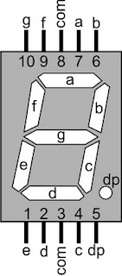
Example 3: 7-Segment (1)
Suppose, we use common cathode 7-segment
Logic 1 at either a, b, c, d, e, f, g or dp will light up that LED.
We will use
P1.31 for a
P1.30 for b
P1.29 for c
P1.28 for d
P1.27 for e
P1.26 for f
P1.25 for g
P1.24 for dp

Slide 11
Example 3: 7-Segment(2)
Display | P1.31 (a) | P1.30 (b) | P1.29 (c) | P1.28 (d) | P1.27 (e) | P1.26 (f) | P1.25 (g) | P1.24 (.) | Hex Value
0 | 1 | 1 | 1 | 1 | 1 | 1 | 0 | 0 | 0xFC000000
1 | 0 | 1 | 1 | 0 | 0 | 0 | 0 | 0 | 0x60000000
2
3
4
5
6
7
8
9
.
Let’s complete the table

Slide 12
Example 3 : 7-Segment (3)
Code for displaying “0” on 7-segment.
#include “LPC23XX.h”
int main(void) {
unsigned int P1_24TO31 = 0xFF000000;
IODIR1 = P1_24TO31;
IOCLR1 = P1_24TO31;
IOSET1 = 0xFC000000;
while(1);
}

Slide 13
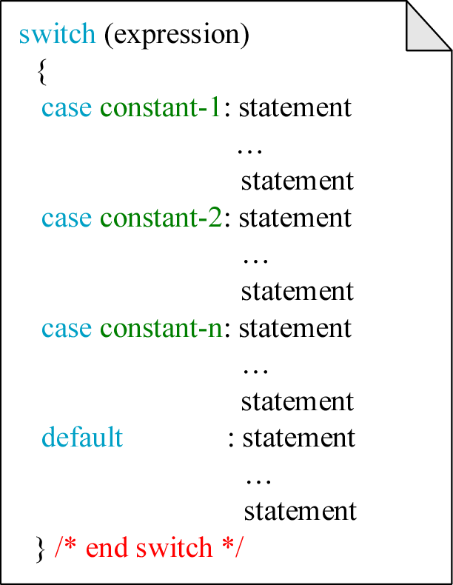
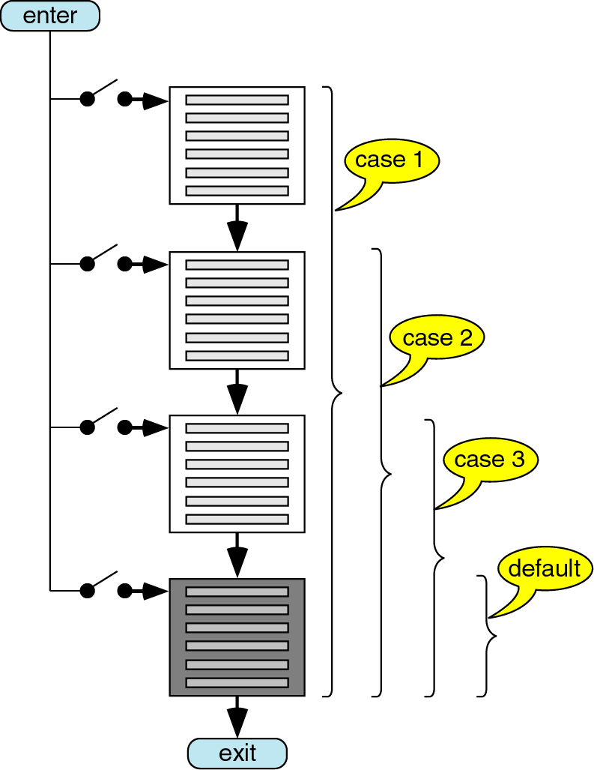
SWITCH-CASE
SWITCH-CASE in C is used for selecting a multiple (constant) choices.

Slide 14
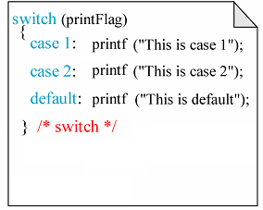
Example : SWITCH-CASE

Slide 15
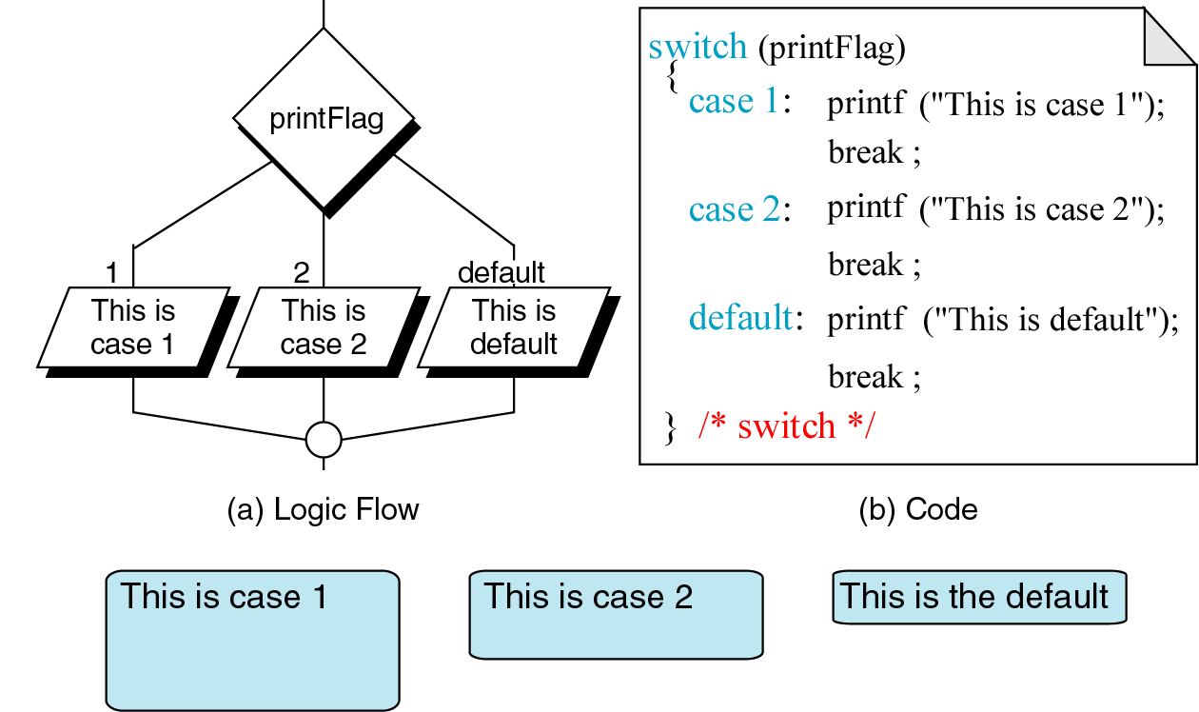
Example : SWITCH-CASE with Break

Slide 16
Example : 7-Segment with SWITCH
#include “LPC23XX.h”
int main(void) {
unsigned int P1_24TO31 = 0xFF000000;
int num = 0;
IODIR1 = P1_24TO31;
IOCLR1 = P1_24TO31;
switch(num) {
case 0 : IOSET1= 0xFC000000; break;
case 1 : IOSET1 = 0x60000000; break;
…
}
while(1);
}

Slide 17
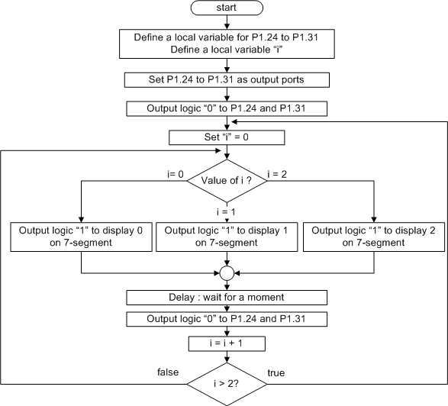
Assignment 9
Write a program in C for microcontroller to display a number on
7-segment as a
following sequence
“0” → “1” → “2” → “0” → “1” → “2” → “0” → …
Don’t forget to wait for a moment before moving to the next number
Don’t forget to clear last output before setting the new one
Use “switch-case” and some loop statements for this program

