Slide 1
Review : C Programming Language
353156 – Microprocessor
Asst. Prof. Dr. Choopan Rattanapoka and Asst. Prof. Dr. Suphot Chunwiphat

Slide 2
Assembly VS C
Up until now, you have learnt a lot about assembly instruction to control your microprocessor/controller
Assembly depends on microprocessor architecture
Pro : your programs run fast
Con: If you change your platform from ARM to Intel, you have to re-write your assembly code
For C, if your microprocessor model has a C compiler, you can program in C and let C compiler compiles your program to assembly language
Pro :
You don’t need to worry about registers inside microprocessor
You can use your old code and compile it on other architectures without the need to modify.

Slide 3
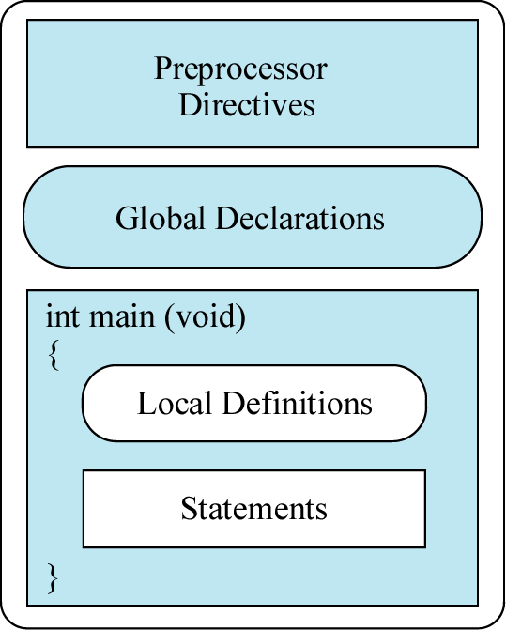
C Program Structure
C compiler parses them before
compiles a program.
#include
#define
Define global variables which all of
the functions in C can see and use.
Main program in C start in { }
of main function

Slide 4
Basic Data Types in C
Data types | Memory Consumption (bit) | Range of stored data
char | 8 | -128 to 127
unsigned char | 8 | 0 to 255
int | 32 | -2,147,483,648 to 2,147,483,647
unsigned int | 32 | 0 to 4,294,967,295
long | 32 | -2,147,483,648 to 2,147,483,647
unsigned long | 32 | 0 to 4,294,967,295
float | 32 | 3.4 x 10⁻³⁸ to 3.4 x10³⁸
double | 64 | 1.7 x 10⁻³⁰⁸ to 1.7 x 10³⁰⁸

Slide 5
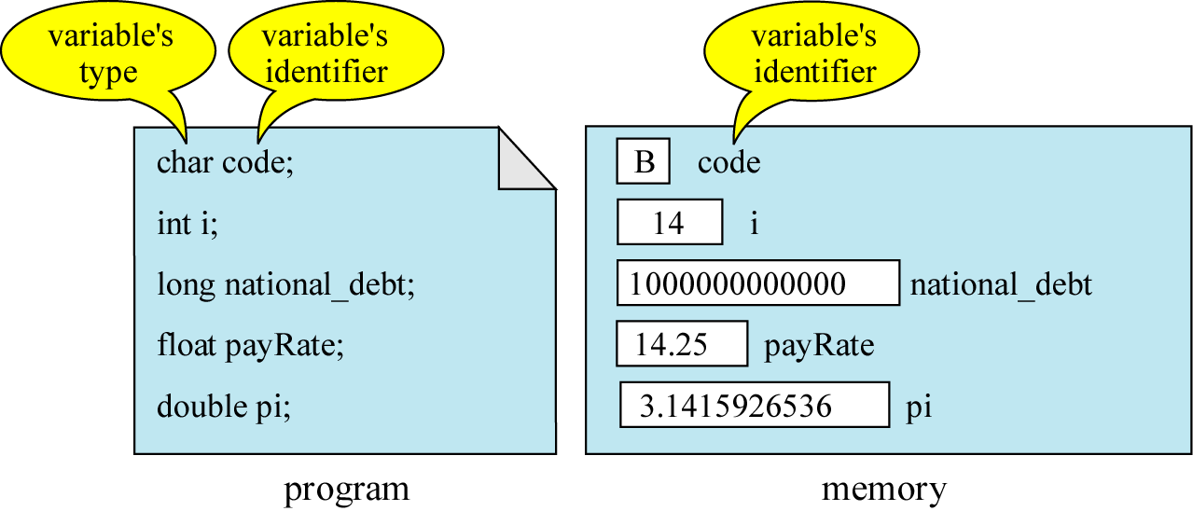
How to define a variable in C

Slide 6
Example 1
int main(void) {
int A;
int B;
int C, D, E;
int F = 0, G = 10, H = 0x20;
unsigned int K, L = 10;
A = 50;
B = 100;
}

Slide 7
Mathematic Operations
Symbol | Definition | Example
+ | Addition | A + B
- | Subtraction | A - B
* | Multiplication | A * B
/ | Division | A / B
% | Modulo | A % B
int main(void) {
int A = 10, B = 4;
int C, D, E, F, G;
C = A + B;
D = A - B;
E = A * B;
F = A / B;
G = A % B;
}
What is the value inside the variable C, D, E, F, and G ?
int A = 10, B = 3, C;
C = A % B;
What is the value inside the variable C ?

Slide 8
Bitwise Operations
int main(void) {
unsigned int A, B, C, D, E, F, G, H;
A = 0xCD;
B = 0x88;
C = A & B;
D = A | B;
E = A ^ B;
F = !A;
G = A << 2;
H = A >> 2;
}
What is the value inside the variable C, D, E, F, G and H ?
Symbol | Definition | Example
& | AND | A & B
| | OR | A | B
^ | XOR | A ^ B
! | NOT | !A
<< | Shift Left | A << B
>> | Shift Right | A >> B
Mostly, we use bitwise operations with unsigned data type.

Slide 9
Logical Operations
Symbol | Definition
== | EQUAL
!= | NOT EQUAL
> | Greater than
>= | Greater than or equal to
< | Less than
<= | Less than or equal to
Suppose, A = 100 and B = 50
Expression | Truth value
A == B
A != B
A > B
A < B
(A == 50) && (A == 100)
(A == 50) || (A == 100)
(A != B) && (B != A)
(A == B) || (B == 50)
!(A == B) && (B != 40)
Symbol | Definition
&& | AND
|| | OR
! | NOT

Slide 10
Condition
3 kinds of if statement in C
if statement
if - else statement
if – else if – else statement

Slide 11
Condition: IF statement
A == 5 ?
A == 5 ?
false
false
true
true
A = A + 5
A = A + 5
A = A * 10
int main(void) {
int A = 5;
if ( A == 5 ) {
A = A + 5;
A = A * 10;
}
}
int main(void) {
int A = 5;
if ( A == 5 )
A = A + 5;
}

Slide 12
Condition: IF-ELSE statement
A == 5 ?
A == 5 ?
false
true
true
false
A = A + 10
A = A - 10
A = A + 10
A = A - 10
A = A * 10
A = A / 10
int main(void) {
int A = 5;
if ( A == 5 ) {
A = A + 10;
A = A * 10;
} else {
A = A – 10;
A = A / 10;
}
}
int main(void) {
int A = 5;
if ( A == 5 )
A = A + 5;
else
A = A – 10;
}

Slide 13
Condition: IF- ELSE IF - ELSE statement
int main(void) {
int A = 4;
if ( A == 1 ) {
A = A + 10;
} else if ( A == 2 ){
A = A – 10;
} else if (A == 3) {
A = A * 2;
} else if (A == 4) {
A = A / 4;
} else {
A = (A + 2) * 3;
}
}
true
Condition 1
false
true
Condition 2
false
True action
Condition N
True action
true
false
True action
False action

Slide 14
Example 1
int main(void) {
int A, B;
if ( (A + 5) <= 6 ) {
B = A + 10;
} else if ( A == 2 || A == 5 ){
B = A – 10;
} else if (A == 3 || A > 7) {
B = A * 2;
} else if (A == 4) {
B = A / 4;
} else {
B = (A + 2) * 3;
}
B = B + 1;
}
What is the value stored in a variable B at the end of program
If A =
-1
1
2
4
5
7
10

Slide 15
Iteration Statement
Iteration statement sometimes called “Loop” is the part of code that repeat itself as long as the condition is valid.
In C : we have 3 types of iteration statement
while
do-while
for

Slide 16
WHILE statement
false
while (condition) { statement-1; statement-2; … statement-n; }
true
while (condition) statement;

Slide 17
Example 2
int main(void)
{
int count = 0;
while (count <= 3)
{
count = count + 1;
}
}
What is the value stored in a variable count at the end of program ?

Slide 18
DO-WHILE statement
do { statement-1; statement-2; … statement-n; } while (condition);
do statement; while (condition);

Slide 19
Example 3
int main(void)
{
int count = 0;
do
{
count = count + 1;
} while (count <= 3);
}
What is the value stored in a variable count at the end of program ?

Slide 20
Example 4
int main(void)
{
int count = 0;
do
{
count = count + 1;
} while (count < 0);
}
int main(void)
{
int count = 0;
while (count < 0)
{
count = count + 1;
}
}
What is the value stored in a variable count at the end of program ?

Slide 21
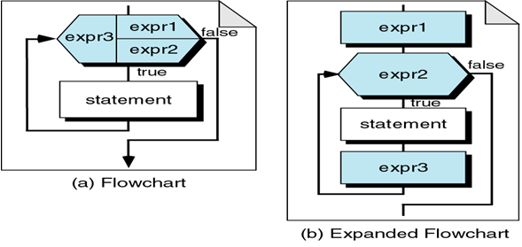
FOR Statement
for(expr1; expr2; expr3) { statement-1; statement-2; … statement-n; }
for(expr1; expr2; expr3) statement;
EXPR1 = Initialize
EXPR2 = Loop Condition
EXPR3 = Updater

Slide 22
Example 5
int main(void)
{
int i, A = 0;
for( i = 1; i <= 3; i=i+1) {
A = A + i;
}
}
i
?
1
2
3
4
A
0
6
1
3

Slide 23
Assignment 8
(1)
int main(void)
{
int A, B = 5, SUM = 0;
for(A = 1; A <= B; A++) {
if(A <= 2) {
SUM = SUM + 10;
} else {
SUM = SUM + 1;
}
}
}
What is the value stored in variables A, B, and SUM at the end of program ?

Slide 24
Assignment 8
(2)
int main(void)
{
unnsigned int A = 0x1;
int B, C;
for(B = 0; B < 4; B++) {
A = A << 1;
C = A + 1;
}
}
What is the value stored in variables A, B, and C at the end of program ?

