Slide 1
Function
353156 – Microprocessor
Asst. Prof. Dr. Choopan Rattanapoka and Asst. Prof. Dr. Suphot Chunwiphat

Slide 2
What is Function ?
Sometimes, you need to do an operation that involve many instructions and you want to use that operation often.
For example : you want to compute an equation f(N, R)
f(N, R) = N! + R! – (N – R)!
You need to compute
N!
(N – R)!
R!
So, you need to code instructions to find factorial 3 times.

Slide 3
Factorial
Factorial of n = n * (n – 1)!
= n * (n – 1) * (n – 2)!
= n * (n – 1) * (n – 2) *…* 1
Remind : 0! = 1
Example :
5! = 5 * 4 * 3 * 2 * 1 = 120

Slide 4
Code for Computing Factorial
int Factorial = 1, i;
i = N;
while (i >= 1) {
Factorial = Factorial * i;
i = i – 1;
}
We use 3 variables. Thus, assume we map
Factorial → a1
i → a2
N → v1
Factorial = 1
i = N
i >= 1
true
false
Factorial = Factorial * i
MOV a1, #1
MOV a2, v1
LOOP CMP a2, #1
BLT DONE
MUL a1, a2, a1
SUB a2, a2, #1
B LOOP
DONE
i = i - 1

Slide 5
Code for Computing f(N,R) without using function
Example : Assume that we fix N = 5 and R = 3, f(N, R) = N! + R! – (N – R)!
;Compute N!(5!), A1(Factorial), A2(i), N = 5, Result in A1
MOV a1, #1 ; Factorial = 1
MOV a2, #5 ; i = 5 (=N)
LOOP1 CMP a2, #1 ; Compare i and 1
BLT DONE1 ; if i < 1, jump to DONE1
MUL a1, a2, a1 ; Factorial = Factorial * i
SUB a2, a2, #1 ; i = i - 1
B LOOP1 ; jump to Loop1
DONE1
MOV v1, a1 ; V1 stores result of 5!
;Compute R!(3!) A1(Factorial), A2(i), R = 3, Result in A1
MOV a1, #1 ; Factorial = 1
MOV a2, #3 ; i = 3 (=R)
LOOP2 CMP a2, #1 ; Compare i and 1
BLT DONE2 ; if i < 1, jump to DONE2
MUL a1, a2, a1 ; Factorial = Factorial * i
SUB a2, a2, #1 ; i = i - 1
B LOOP2 ; jump to Loop2
DONE2
MOV v2, a1 ; V2 stores result of 5!
;Compute (N-R)! -> (2!), A1(Factorial), A2(i),
;(N-R) = 2, Result in A1
MOV a1, #1 ; Factorial = 1
MOV a2, #2 ; i = 2 (=(N-R))
LOOP3 CMP a2, #1 ; Compare i and 1
BLT DONE3 ; if i < 1, jump to DONE1
MUL a1, a2, a1 ; Factorial = Factorial * i
SUB a2, a2, #1 ; i = i - 1
B LOOP3 ; jump to Loop1
DONE3
ADD v1, v1, v2 ; N! + R!
SUB a1, v1, a1 ; (N! + R!) – (N – R)!
Wow, lot of code, isn’t it ?

Slide 6
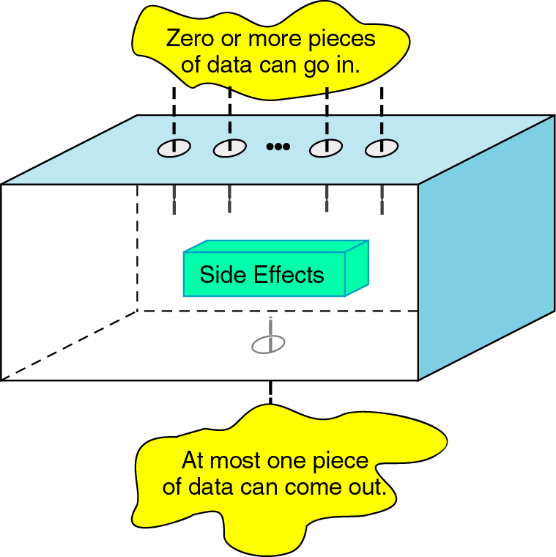
Function : How does it work
Input
Function
Output

Slide 7
Define a Function in C
Type of function
Function name
Function input (parameters or arguments)
int power2(int x)
{
int y;
y = x * x;
return(y);
}
Local variable
Function instructions
Return value from Function

Slide 8
Review : C function (1)
#include <stdio.h>
int power3(int x) {
return( x * x * x);
}
int main(int argc, char **argv)‏ {
int num;
num = power3(2);
printf(“2^3 = %d\n”, num);
}
power3
x
8
Main
num
?
2
2^3 = 8

Slide 9
Review : C function (2)
#include <stdio.h>
int sum(int x, int y)
{
return(x + y);
}
int main(int argc, char **argv)‏
{
int a = 5, b = 10, f;
f = sum(a, b);
printf(“Summation of %d and %d = %f\n”,
a, b, f);
}
average
x
15
y
Main
a
5
5
b
10
10
f
?
Summation of 5 and 10 = 15

Slide 10
Review : C function (3)
Example : Assume that we fix N = 5 and R = 3, f(N, R) = N! + R! – (N – R)!
int main(int argc, char **argv)‏ {
int N = 5, R = 3, N_R = 2;
int factorialN = 1, factorialR = 1;
int factorialN_R = 1, result;
//Compute N!
i = N;
while (i >= 1) {
factorialN = factorialN * i;
i = i – 1;
}
//Compute R!
i = R;
while (i >= 1) {
factorialR = factorialR * i;
i = i – 1;
}
//Compute (N-R)!
i = N_R;
while (i >= 1) {
factorialN_R = factorialN_R * i;
i = i – 1;
}
//Compute the result of equation
result = factorialN + factorialR
– factorialN_R;
}

Slide 11
Review : C function (4)
Example : Assume that we fix N = 5 and R = 3, f(N, R) = N! + R! – (N – R)!
Factorial Function
Main Function
int Factorial(int x) {
int i, factorial = 1;
i = x;
while (i >= 1) {
factorial = factorial * i;
i = i – 1;
}
return factorial;
}
int main(int argc, char **argv)‏ {
int N = 5;
int R = 3;
int N_R = 2;
//Compute the result of equation
result = Factorial(N) +
Factorial(R) -
Factorial(N_R);
}
Call Functions

Slide 12
Basic of Function Call
Caller
Set up arguments
Jump to function
Access result
.
.
.
Callee
Access arguments
Compute
Set up return value
Jump back to caller

Slide 13
ARM Procedure Call Standard (APCS)
Conventions for use of register simplification
Register name | Software name | Usage
R0 – R3 | a1 – a4 | Arguments and Result of Function
R4 – R10 | v1 – v7 | Local variables
R9 | SB | Static variable base
R10 | SL | Stack limit
R11 | FP/v8 | Frame pointer/Local variables
R12 | IP | Intra procedure call
R13 | SP | Stack pointer
R14 | LR | Return Address
R15 | PC | Program Counter

Slide 14
Instruction Support for Function Call
..... sum(a, b); .....
int sum(int x, int y)
{
return(x + y);
}
Address | Instructions | Comment
1000 | MOV a1, v1 | Prepare argument a1
1004 | MOV a2, v2 | Prepare argument a2
1008 | MOV LR, #0x1010 | Set Return Address 1010
100C | B SUM | Jump to Label SUM
1010 | …..
…….. | ……
2000 | SUM : ADD a1, a1, a2 | Compute SUM
2004 | MOV PC, LR | Set program counter with LR
Assume
a stores value in V1 register
b stores value in V2 register
How do you know the return address ??
MOV LR, #0x1010
New version of ARM assembler recommends to use BX LR instead of MOV PC, LR
ARM helps you with BL instruction
BL SUM ← MOV LR, return_address and then B SUM

Slide 15
Example 1: ARM calculation without function
We want to compute 2³ + 3³ - 1³
Output will be stored in register a1
AREA ex1_no_func, CODE, READONLY
ENTRY
start
MOV a1, #2 ; Set a1 = 2
MUL v1, a1, a1 ; v1 = a1 * a1
MUL v1, a1, v1 ; v1 = a1 * v1 = 2³
MOV a1, #3 ; Set a1 = 3
MUL v2, a1, a1 ; v2 = a1 * a1
MUL v2, a1, v2 ; v2 = a1 * v2 = 3³
MOV a1, #1 ; Set a1 = 1
MUL v3, a1, a1 ; v3 = a1 * a1
MUL v3, a1, v3 ; v3 = a1 * v3 = 1³
ADD a1, v1, v2 ; a1 = v1 + v2 = 2³ + 3³
SUB a1, a1, v3 ; a1 = a1 – v3 = (2³ + 3³)- 1³
END

Slide 16
Example 1: ARM calculation with function
We want to code a function called power3 which helps us to compute 2³ + 3³ - 1³
Output will be stored in register a1
AREA ex1_func, CODE, READONLY
ENTRY
start
MOV a1, #2 ; Set a1 = 2
BL POWER3 ; Call function
MOV a2, a1 ; a2 = 2³
MOV a1, #3 ; Set a1 = 3
BL POWER3 ; Call function
MOV a3, a1 ; a3 = 3³
MOV a1, #1 ; Set a1 = 1
BL POWER3 ; Call function a1 = 1³
ADD a2, a2, a3 ; a2 = 2³ + 3³
SUB a1, a2, a1 ; a1 = (2³ + 3³)- 1³
B Exit
Exit END
POWER3
MUL v1, a1, a1 ; v1 = a1 * a1
MUL a1, v1, a1 ; a1 = v1 * a1
BX LR ; return
ASM code for computing power3

Slide 17
Example 1: ARM calculation with function
We want to code a function called power3 which helps us to compute 2³ + 3³ - 1³
Output will be stored in register a1
AREA ex1_func, CODE, READONLY
ENTRY
start
MOV a1, #2 ; Set a1 = 2
BL POWER3 ; Call function
MOV a2, a1 ; a2 = 2³
MOV a1, #3 ; Set a1 = 3
BL POWER3 ; Call function
MOV a3, a1 ; a3 = 3³
MOV a1, #1 ; Set a1 = 1
BL POWER3 ; Call function a1 = 1³
ADD a2, a2, a3 ; a2 = 2³ + 3³
SUB a1, a2, a1 ; a1 = (2³ + 3³)- 1³
B Exit
Exit END
POWER3
MUL v1, a1, a1 ; v1 = a1 * a1
MUL a1, v1, a1 ; a1 = v1 * a1
BX LR ; return
ASM code for computing power3

Slide 18
Factorial Function in ARM Assembly
We use 2 variables.
a1 → result of factorial
a2 → input number
a1 = 1
a2 >= 1
true
false
FACTORIAL
MOV a1, #1 ;Set result = 1
LOOP CMP a2, #1 ; Compare a2 and 1
BLT DONE ; a2 < 1; jump to DONE
MUL a1, a2, a1 ; a1 = a1 * a2
SUB a2, a2, #1 ; a2 = a2 - 1
B LOOP ; jump to Loop
DONE BX LR ; return to caller
a1 = a1 * a2
a2 = a2 - 1

Slide 19
Computing f(N,R) by using function
Example : Assume that we fix N = 5 and R = 3, f(N, R) = N! + R! – (N – R)!
Area func, CODE, READONLY
Entry
START
MOV a2, #5 ; Set argument = 5
BL Factorial ; Call function
MOV v1, a1 ; Backup result to v1 (5!)
MOV a2, #3 ; Set argument = 3
BL Factorial ; Call function
MOV v2, a1 ; Backup result to v2 (3!)
MOV a2, #2 ; Set argument = 2
BL Factorial ; Call function a1 = 2!
ADD v1, v1, v2 ; v1 = 5! + 3!
SUB a1, v1, a1 ; a1 = (5! + 3!) – 2!
B EXIT ; End program
Factorial
MOV a1, #1 ;Set result = 1
LOOP CMP a2, #1 ; Compare a2 and 1
BLT DONE ; a2 < 1; jmp to DONE
MUL a1, a2, a1 ; a1 = a1 * a2
SUB a2, a2, #1 ; a2 = a2 - 1
B LOOP ; jump to Loop
DONE BX LR ; return to caller
EXIT END

Slide 20
Comparing code with and without function
AREA nofunc, CODE, READONLY
ENTRY
START MOV a1, #1
MOV a2, #5
LOOP1 CMP a2, #1
BLT DONE1
MUL a1, a2, a1
SUB a2, a2, #1
B LOOP1
DONE1 MOV v1, a1
MOV a1, #1
MOV a2, #3
LOOP2 CMP a2, #1
BLT DONE2
MUL a1, a2, a1
SUB a2, a2, #1
B LOOP2
DONE2 MOV v2, a1
MOV a1, #1
MOV a2, #2
LOOP3 CMP a2, #1
BLT DONE3
MUL a1, a2, a1
SUB a2, a2, #1
B LOOP3
DONE3 ADD v1, v1, v2
SUB a1, v1, a1
END
AREA func, CODE, READONLY
ENTRY
START MOV a2, #5
BL Factorial
MOV v1, a1
MOV a2, #3
BL Factorial
MOV v2, a1
MOV a2, #2
BL Factorial
ADD v1, v1, v2
SUB a1, v1, a1
B EXIT
Factorial MOV a1, #1
LOOP CMP a2, #1
BLT DONE
MUL a1, a2, a1
SUB a2, a2, #1
B LOOP
DONE BX LR
EXIT
END

Slide 21
Assignment 8
Write a program in ARM assembly to compute
5⁴ – 4⁴ + 3⁴
Define function called POWER4 to compute x⁴
Input argument of function prepares in register a2
Output of function stores in register a1
Output of Program stores in register a1

