Slide 1
Introduction to Computer Architecture and System
353156 – Microprocessor
Asst. Prof. Dr. Choopan Rattanapoka and Asst. Prof. Dr. Suphot Chunwiphat

Slide 2
Objective
To understand
What is the computer
Von Neumann Architecture
What is the microprocessors
MU0 – Processor
Instruction cycle
Mnemonic and Machine Code

Slide 3
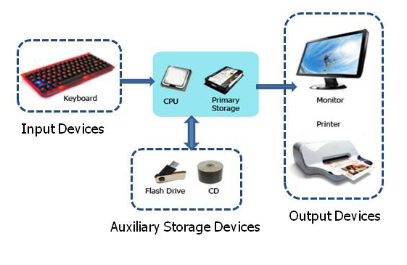
What is the Computer
A computer is a programmable machine designed to sequentially and automatically carry out a sequence of arithmetic or logical operations. The particular sequence of operations can be changed readily, allowing the computer to solve more than one kind of problem.
The basic functions of the computer are :
Inputting data
Outputting data
Processing data
Storing data

Slide 4
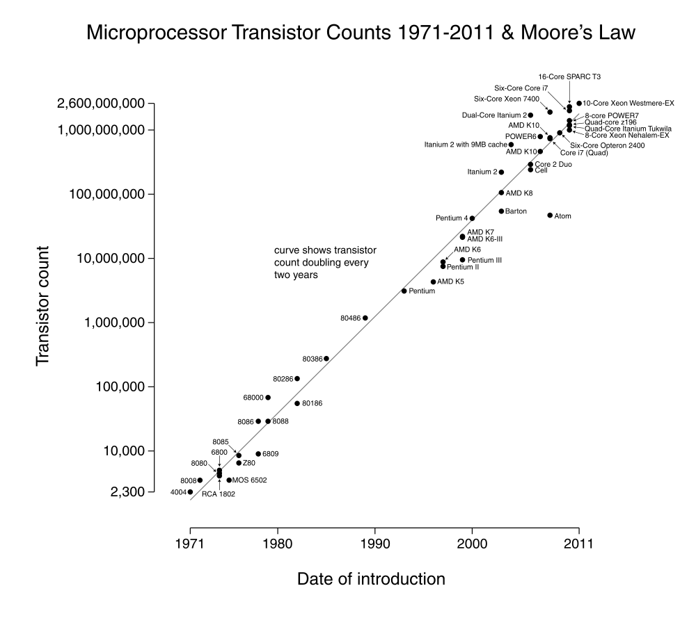
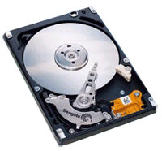
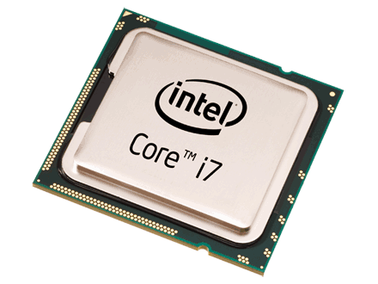
Computer Technology
Disk size increases 2x every year
Processor speed increases 2x every 18 months

Slide 5
Unit of Measurement in Computer System
Normally, we use International System of Units (SI : Système international d'unités) as unit of measurement. But in computer system, we use binary prefix.
Name | Abbr | Factor | SI size
Kilo | K/k | 2¹⁰ = 1,024 (K) | 10³ = 1,000 (k)
Mega | M | 2²⁰ = 1,048,576 | 10⁶ = 1,000,000
Giga | G | 2³⁰ = 1,073,741,824 | 10⁹ = 1,000,000,000
Tera | T | 2⁴⁰ = 1,099,511,627,776 | 10¹² = 1,000,000,000,000
Peta | P | 2⁵⁰ = 1,125,899,906,842,624 | 10¹⁵ = 1,000,000,000,000,000
Exa | E | 2⁶⁰ = 1,152,921,504,606,846,976 | 10¹⁸ = 1,000,000,000,000,000,000
Zetta | Z | 2⁷⁰ = 1,180,591,620,717,411,303,424 | 10²¹ = 1,000,000,000,000,000,000,000
Yotta | Y | 2⁸⁰ = 1,208,925,819,614,629,174,706,176 | 10²⁴ = 1,000,000,000,000,000,000,000,000
For Example : A 400GB harddisk
Manufacturer uses GB in SI unit, so the harddisk has 400,000,000,000 B capacity
In MS Windows, it use GB as 2^{30 ,} so the Windows can see the harddisk around 372 GB

Slide 6
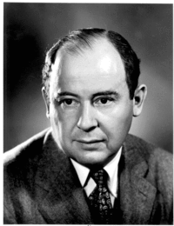
Von Neumann Architecture
The earliest computing machines had fixed programs. Changing the program of a fixed-program machine requires re-wiring, re-structuring, or re-designing the machine.
The idea of the stored-program computer changed all that: a computer that by design includes an instruction set and can store in memory a set of instructions (a program) that details the computation.
Characteristics of von Neumann machine
Both data and instructions are stored in a read/write memory.
Memory contents are addressable by location without regard for the type of data contained there
Execution occurs in a sequential fashion by reading consecutive instructions from memory
John Von Neumann
1948 : You insist that there is something a machine cannot do.
If you will tell me precisely what it is that a machine cannot do,
then I can always make a machine which will do just that!

Slide 7
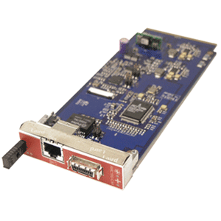
Main Components of a Computer
Main Memory
Microprocessor
System bus
Instruction
Instruction
I/O Module
Instruction
Data
Data
Data
buffer

Slide 8
What is the Microprocessor?
Microprocessor is a very large-scale integrated circuit (VLSI) that uses the architecture of the general-purpose digital computer.
Microprocessors are based on the von Neumann model of a stored program computer
The stored program computer, a microprocessor’s program is stored in memory along with its data

Slide 9
MPU, MCU, CPU
Microprocessor Units (MPU) tend to be aimed at computer applications; they tend to have minimal "extras" on-chip.
Intel Pentium
AMD opteron
Microcontroller Units (MCU) tend to be aimed at embedded control applications; they tend to consist of a processor plus a number of useful peripherals (internal I/O modules, memory, etc).
8051
PIC
ARM
Central Processing Unit (CPU) could refer to
the actual processor part of a microcontroller.
the microprocessor within a computer.

Slide 10
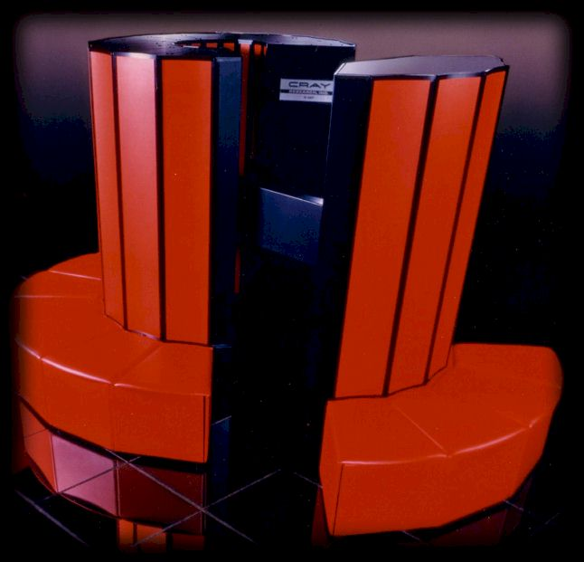
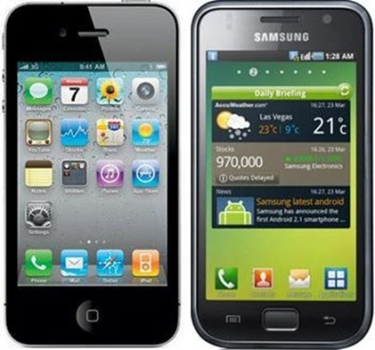
Where are the CPU ?
Supercomputer
Personal computer
Mobile phone
High computing speed
Embedded Devices
Low computing speed
High power consumption
Low power consumption
Size : big
Size : small

Slide 11
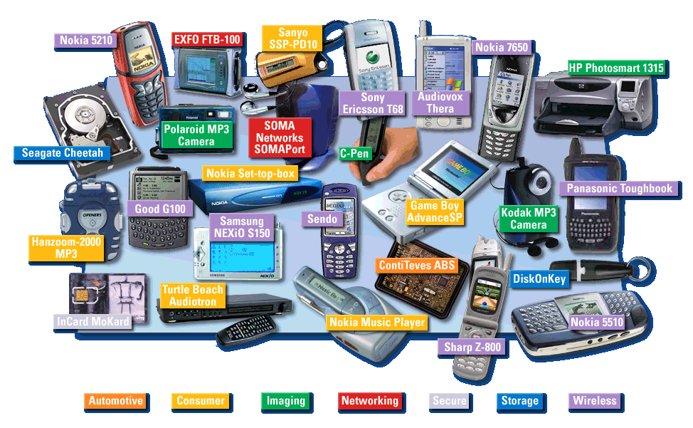
Embedded Devices

Slide 12
Central Processing Unit (CPU)
Central Processing Unit (CPU) contains :
ALU (Arithmetic Logic Unit)
The ALU performs computational functions such as Add, Subtract, AND, OR, Compare, Increment, and Decrement.
Control Logic
The control logic decodes and executes the program. It also controls the memory, input, and output operation of the microprocessor
Registers :
The registers (fast memory, local to CPU) use to store temporary data and instructions

Slide 13
Memory
The communication between microprocessor and memory has 3 types of signals (buses).
Address bus – determines the location of memory
Data bus – carries the contents of the location
Control bus – governs the information transfer
The width of the address bus determines the size of memory. (how many location)
The width of the data bus determines the size of content. (how many bits can each location store)
Control bus
R/W
Memory
Enable
Address bus
A11:0
Data bus
D15:0

Slide 14
Memory, Registers, and ALU
CPU
Memory
ALU
Registers
Address bus
A11:0
Data bus
D15:0
Address bus
A11:0
Data bus
D15:0
Control bus
Control bus

Slide 15
MU0 – A Very Simple Processor
MU0 processor is an abstract design for teaching purposes at University of Manchester.
MU0 is a simple processor with 16-bits instruction and minimal hardware.
address bus
Program Counter (PC)
Holds address of the next instruction to execute
Accumulator (ACC)
Holds data being processed
Arithmetic Logic Unit (ALU)
Performs operations on data
Instruction Register (IR)
Holds current instruction code being executed
PC
control
IR
Memory
ALU
ACC
data bus

Slide 16
Instructions
Instruction usually has 2 parts
Opcode determines what is to be done
Operand specifies where/what is the data
Opcode
Operand
1 word

Slide 17
The Instruction Cycle
An instruction cycle is the basic operation cycle of a computer, sometimes called
fetch-and-execute cycle
fetch-decode-execute cycle
FDX
Each computer's CPU can have different cycles based on different instruction sets, but will be similar to the following cycle:
Fetch instruction – Supply instruction address and read an instruction from memory on the data bus.
Decode instruction – Stored instruction is interpreted by CPU
Fetch Operand – Supply address of data and read data into CPU
Execution instruction - Perform the necessary action by CPU

Slide 18
Step 1: Fetch Instruction (1)
address bus
control
Memory
PC
IR
IR
ALU
ACC
data bus
CPU outputs value of program counter on address bus
Memory puts contents at the instruction address on the data bus
Instruction is stored in instruction register

Slide 19
Step 1: Fetch Instruction (2)
address bus
control
Memory
PC
PC
PC = PC + k
IR
ALU
ACC
data bus
Program counter value is pushed onto the address bus
The ALU increment this value by k and put it back into Program counter

Slide 20
Step 2: Decode Instruction
address bus
control
Memory
PC
IR
IR
ALU
ACC
data bus
The instruction word stored in IR is decoded by internal logic to provide control signals to ALU and other internal circuits inside CPU

Slide 21
Step 3: Fetch Operand
address bus
control
Memory
PC
IR
IR
ALU
ACC
data bus
The instruction register provides the address of the data to be processed
Memory supplies the operand data on the data bus to the CPU, ready for processing either by the ALU or the ACC

Slide 22
Step 4: Execution Instruction
address bus
control
Memory
PC
IR
ALU
ACC
ACC
data bus
Processing is performed on the operand by the ALU according to the instruction
The result is put back into the Accumulator (ACC)

Slide 23
MU0 – Instructions
Let us assume that the processor only has 8 instructions and can only access a maximum of 4k byte of memory. This implies that the address bus is only 12-bits wide
MU0 is a 16-bit microprocessor, Thus ALL instructions are 16-bits wide.
The 16-bit instruction code (machine code) has a format :
Top 4 bits define the operation code (opcode).
Next 12 bits define the memory address of the operand data.
4 bits
12 bits
Opcode
Operand

Slide 24
MU0 – Instruction Set
Instruction (mnemonic) | Opcode | Effect
LDA S | 0000 | ACC := mem16[S]
STO S | 0001 | Mem16[S] := ACC
ADD S | 0010 | ACC := ACC + mem16[S]
SUB S | 0011 | ACC := ACC – mem16[S]
JMP S | 0100 | PC := S
JGE S | 0101 | If ACC >= 0, PC := S
JNE S | 0110 | If ACC != 0, PC := S
STP | 0111 | stop
2 load/store instructions: LDA, STO
2 computation instructions: ADD, SUB
4 control flow instructions: JMP, JGE, JNE, STP

Slide 25
Example : First Program (1)
The simplest use of our microprocessor
Add two numbers
Let’s assume these numbers are stored at two consecutive locations in memory, with addresses 2E and 30
Let’s assume we wish to store the result back to memory address 32
Hint : we need to load accumulator with 1 value, add the other, and then store the result back into memory

Slide 26
Example : First Program (2)
Load accumulator with 1 value
LDA 2E
Add the other
ADD 30
Store the result back into memory
STO 32
Stop program
STP
Mnemonic | Machine code
LDA 2E | 0 02E
ADD 30 | 2 030
STO 32 | 1 032
STP | 7 000

Slide 27
Example : How program works
MU0
000
002E
Address bus
002
2030
004
1032
ALU
PC
000
006
7000
.
.
.
ACC
Data bus
02E
00AA
Control
IR
030
0012
032
.
.
.

Slide 28
Example : Fetch-Decode Instruction
MU0
000
002E
Address bus
002
2030
004
1032
ALU
PC
000
006
7000
.
.
.
ACC
Data bus
02E
00AA
Control
IR
002E
IR
030
0012
032
.
.
.

Slide 29
Example : Fetch-Decode Instruction
MU0
000
002E
Address bus
002
2030
004
1032
PC
002
ALU
PC
000
006
7000
ALU
.
.
.
ACC
Data bus
02E
00AA
Control
IR
002E
030
0012
032
.
.
.

Slide 30
Example : Fetch Operand
MU0
000
002E
Address bus
002
2030
004
1032
ALU
PC
002
006
7000
.
.
.
ACC
00AA
ACC
Data bus
02E
00AA
Control
IR
002E
030
0012
032
.
.
.

Slide 31
Example : Execution Instruction
MU0
000
002E
Address bus
002
2030
004
1032
ALU
PC
002
006
7000
.
.
.
ACC
00AA
Data bus
02E
00AA
Control
IR
002E
030
0012
032
.
.
.

Slide 32
Example : Fetch-Decode Instruction
MU0
000
002E
Address bus
002
2030
004
1030
ALU
PC
002
006
7000
.
.
.
ACC
00AA
Data bus
02E
00AA
Control
IR
002E
IR
2030
030
0012
032
.
.
.

Slide 33
Example : Fetch-Decode Instruction
MU0
000
002E
Address bus
002
2030
004
1032
PC
002
ALU
PC
004
006
7000
ALU
.
.
.
ACC
00AA
Data bus
02E
00AA
Control
IR
2030
030
0012
032
.
.
.

Slide 34
Example : Fetch Operand
MU0
000
002E
Address bus
002
2030
004
1032
ALU
PC
004
006
7000
ALU
0012
.
.
.
ACC
00AA
Data bus
02E
00AA
Control
IR
2030
030
0012
032
.
.
.

Slide 35
Example : Execution Instruction
MU0
000
002E
Address bus
002
2030
004
1032
ALU
0012
PC
004
006
7000
ALU
0012 + 00AA
.
.
.
ACC
00BC
ACC
00AA
Data bus
02E
00AA
Control
IR
2030
030
0012
032
.
.
.

Slide 36
Example : Fetch-Decode Instruction
MU0
000
002E
Address bus
002
2030
004
1032
ALU
PC
004
006
7000
.
.
.
ACC
00BC
Data bus
02E
00AA
Control
IR
2030
IR
1032
030
0012
032
.
.
.

Slide 37
Example : Fetch-Decode Instruction
MU0
000
002E
Address bus
002
2030
004
1032
PC
004
ALU
PC
006
006
7000
ALU
.
.
.
ACC
00BC
Data bus
02E
00AA
Control
IR
1032
030
0012
032
.
.
.

Slide 38
Example : Execute Instruction
MU0
000
002E
Address bus
002
2030
004
1032
ALU
PC
006
006
7000
.
.
.
ACC
00BC
Data bus
02E
00AA
Control
IR
1032
030
0012
032
00BC
.
.
.

Slide 39
Example : Fetch-Decode Instruction
MU0
000
002E
Address bus
002
2030
004
1032
ALU
PC
006
006
7000
.
.
.
ACC
00BC
Data bus
02E
00AA
Control
IR
1032
IR
7000
030
0012
032
00BC
.
.
.

Slide 40
Example : Fetch-Decode Instruction
MU0
000
002E
Address bus
002
2030
004
1032
PC
006
ALU
PC
008
006
7000
ALU
.
.
.
ACC
00BC
Data bus
02E
00AA
Control
IR
7000
030
0012
032
00BC
.
.
.

Slide 41
Example : Execute Instruction
MU0
000
002E
Address bus
002
2030
004
1032
ALU
PC
008
006
7000
.
.
.
ACC
00BC
Data bus
02E
00AA
Control
IR
7000
030
0012
032
00BC
.
.
.
END

Slide 42
Assignment 2
1. Write a program in mnemonic code for processor MU0 to calculate
A + B + C - D
where the value of
A stores at address 2E0
B stored at address 2E2
C stored at address 2E4
D stored at address 2E6
The result will be store at address 2F0
2. Write the machine code for processor MU0 from the mnemonic code in question 1

