Slide 1
Karnaugh MAP
350151 – Digital Circuit 1
Choopan Rattanapoka

Slide 2
Introduction to Karnaugh Map
We can simplify boolean expression by using simplification theorem. However, 2 problems arise
The procedures are difficult to apply in a systematic way
It is difficult to tell when you have arrived at a minimum solution
Karnaugh map overcome these difficulties by providing systematic methods for simplifying Boolean expression
Generally, Karnaugh map method is faster and easier to apply than other simplification methods.
Karnaugh map is good for simplifying 2-4 inputs

Slide 3
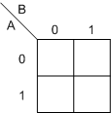
A 2-Variable Karnaugh map
A = 0, B = 1
A = 0, B = 0
A = 1, B = 1
A = 1, B = 0

Slide 4
Using Karnaugh map
A’B’
A’B
A | B | F
0 | 0 | 1
0 | 1 | 1
1 | 0 | 0
1 | 1 | 0
1
1
0
0

Slide 5
Simplifying with Karnaugh map
1
1
F = A’
0
0

Slide 6
Exercise 1
From this truth table, simplify it by using karnaugh map
A | B | F
0 | 0 | 1
0 | 1 | 1
1 | 0 | 1
1 | 1 | 0

Slide 7
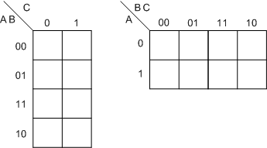
A 3-variable Karnaugh map

Slide 8
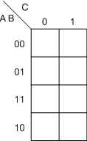
Using Karnaugh Map
F = A’B + BC’ + AC’
A | B | C | F
0 | 0 | 0 | 0
0 | 0 | 1 | 0
0 | 1 | 0 | 1
0 | 1 | 1 | 1
1 | 0 | 0 | 1
1 | 0 | 1 | 0
1 | 1 | 0 | 1
1 | 1 | 1 | 0
0
0
1
1
A’B
BC’
1
0
AC’
1
0

Slide 9
Possibility to simplify
C’
A’
B’C’
B’

Slide 10
Exercise 2
From this truth table, simplify it by using karnaugh map
A | B | C | F
0 | 0 | 0 | 0
0 | 0 | 1 | 1
0 | 1 | 0 | 0
0 | 1 | 1 | 0
1 | 0 | 0 | 1
1 | 0 | 1 | 1
1 | 1 | 0 | 1
1 | 1 | 1 | 1

Slide 11
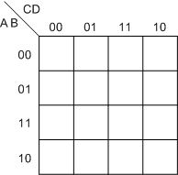
A 4-variable Karnaugh Map

Slide 12
Using Karnaugh Map

Slide 13
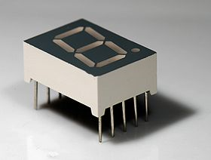
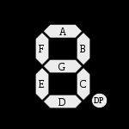
7-SEGMENT

Slide 14
TODO
Design a digital circuit that takes 3-bit binary number(B₂B₁B₀) as input and it has 7 output (a,b,c,d,e,f,g) to display decimal number on 7-segment display
Digital circuit must be SIMPLIFIED by using Karnaugh map
7-segment can display decimal number from 0 to 7
a
3-bit Binary to 7-segment encoder
B₂
b
c
B₁
d
e
B₀
f
g

