Slide 1
Minterm and MAXTERM Expansions
350151 – Digital Circuit 1
Choopan Rattanapoka

Slide 2
Combinational Logic Design Using a Truth Table
A
B
f
C
A | B | C | f
0 | 0 | 0 | 0
0 | 1 | 1 | 0
0 | 0 | 0 | 0
0 | 1 | 1 | 1
1 | 0 | 0 | 1
1 | 1 | 1 | 1
1 | 0 | 0 | 1
1 | 1 | 1 | 1

Slide 3
Minterm
Minterm or Sum of Product (SOP)
For output → 1
We do the product (AND) of input (0 = inverse)
For output → 0
We ignore them
Then, we do sum (OR) of all product
A | B | C | f
0 | 0 | 0 | 0
0 | 0 | 1 | 0
0 | 1 | 0 | 0
0 | 1 | 1 | 1
1 | 0 | 0 | 1
1 | 0 | 1 | 1
1 | 1 | 0 | 1
1 | 1 | 1 | 1
A’BC
AB’C’
AB’C
A’BC + AB’C’ + AB’C
+ ABC’ + ABC
+
ABC’
ABC

Slide 4
Simplification
A’BC + AB’C’ + AB’C + ABC’ + ABC
A’BC + AB’ + AB
A’BC + A
A + BC (X + X’Y = X+Y)

Slide 5
Maxterm
Maxterm or Product of Sum (POS)
For output → 0
We do the sum (OR) of input (1 = inverse)
For output → 1
We ignore them
Then, we do product (AND) of all sum
A | B | C | f
0 | 0 | 0 | 0
0 | 0 | 1 | 0
0 | 1 | 0 | 0
0 | 1 | 1 | 1
1 | 0 | 0 | 1
1 | 0 | 1 | 1
1 | 1 | 0 | 1
1 | 1 | 1 | 1
A+B+C
A+B+C’
(A+B+C)(A+B+C’)(A+B’+C)
A+B’+C

Slide 6
Simplification
(A+B+C)(A+B+C’)(A+B’+C)
(A+B)(A+B’+C)
A + B(B’ +C)
A + BC

Slide 7
Example1
Design a digital circuit from this truth table
Minterm = A’B + AB = B
Maxterm = (A + B)(A’ + B) = B
A | B | F
0 | 0 | 0
0 | 1 | 1
1 | 0 | 0
1 | 1 | 1
B
F

Slide 8
Example 2
Design a binary adder that add two 1-bit binary
Minterm of C = AB
Minterm of D = A’B + AB’ = A B
A | B | C(Carry-out) | D(sum)
0 | 0 | 0 | 0
0 | 1 | 0 | 1
1 | 0 | 0 | 1
1 | 1 | 1 | 0

Slide 9
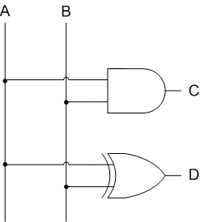
Example 2 : Wiring Diagram

Slide 10
More than 1-bit binary adder
A₂
S₂
Example : 2-bit binary adder
Input : A₂A₁ , B₂B₁
Output : S₂S₁ , Cout
A₁
B₂
S₁
B₁
Cout
A₂ | A₁ | B₂ | B₁ | S₂ | S₁ | Cout
0 | 0 | 0 | 0 | 0 | 0 | 0
0 | 0 | 0 | 1 | 0 | 1 | 0
0 | 0 | 1 | 0 | 1 | 0 | 0
0 | 0 | 1 | 1 | 1 | 1 | 0
0 | 1 | 0 | 0 | 0 | 1 | 0
0 | 1 | 0 | 1 | 1 | 0 | 0
0 | 1 | 1 | 0 | 1 | 1 | 0
0 | 1 | 1 | 1 | 0 | 0 | 1
1 | 0 | 0 | 0 | 1 | 0 | 0
1 | 0 | 0 | 1 | 1 | 1 | 0
1 | 0 | 1 | 0 | 0 | 0 | 1
1 | 0 | 1 | 1 | 0 | 1 | 1
1 | 1 | 0 | 0 | 1 | 1 | 0
1 | 1 | 0 | 1 | 0 | 0 | 1
1 | 1 | 1 | 0 | 0 | 1 | 1
1 | 1 | 1 | 1 | 1 | 0 | 1
COMPLICATE !!

Slide 11
Full Adder (1)
1-bit at a time
A
Sum
B
Cout
Cin
A | B | Cin | Sum | Cout
0 | 0 | 0 | 0 | 0
0 | 0 | 1 | 1 | 0
0 | 1 | 0 | 1 | 0
0 | 1 | 1 | 0 | 1
1 | 0 | 0 | 1 | 0
1 | 0 | 1 | 0 | 1
1 | 1 | 0 | 0 | 1
1 | 1 | 1 | 1 | 1
Minterm of Sum
A’B’Cin + A’BC’in + AB’C’in + ABCin
Minterm of Cout
→ A’BCin + AB’Cin + ABC’in + ABCin

Slide 12
Full Adder (2)
Minterm of Sum
A’B’Cin + A’BC’in + AB’C’in + ABCin
A’(B’Cin + BC’in) + A(B’C’in + BCin)
A’(B Cin) + A(B Cin)’
A B Cin
Minterm of Cout
A’BCin + AB’Cin + ABC’in + ABCin
(A’Bcin + ABCin) + (AB’Cin + ABCin) + (ABC’in + ABCin)
BCin + ACin + AB

Slide 13
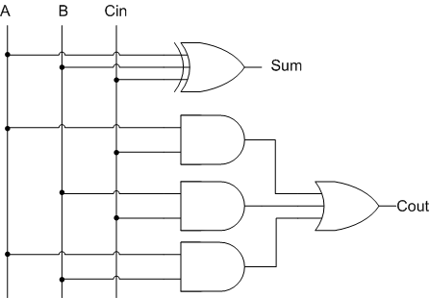
Full Adder (3)
A
Sum
Sum = A B Cin
Cout = BCin + ACin + AB
FA
B
Cout
Cin

Slide 14
Full Adder Application
2-bit binary adder
2-bit binary adder using full adder
A₂
S₂
A₁
B₂
S₁
B₁
Cout
A₂
B₂
A₁
B₁
Cout
FA
Cin
Cout
FA
Cin = 0
S₂
S₁

Slide 15
TODO
From the truth table, find the simplified digital circuit from input (A,B,C) to get an output (F) (both boolean expression and wiring diagram)
USE only 1 AND gate and
1 OR gate
Draw a wiring diagram using full adder modules and not gates to perform binary to 2’s complement conversion
A | B | C | F
0 | 0 | 0 | 0
0 | 0 | 1 | 0
0 | 1 | 0 | 0
0 | 1 | 1 | 1
1 | 0 | 0 | 0
1 | 0 | 1 | 0
1 | 1 | 0 | 1
1 | 1 | 1 | 1

