Slide 1
Binary Code
350151 – Digital Circuit 1
Choopan Rattanapoka

Slide 2
Binary Code Decimal
Most computer works internally with binary numbers, However, the input-output generally uses decimal number.
Most logic circuits only accept two-valued signal, the decimal number must be coded in terms of binary signals.

Slide 3
B.C.D. (4-bit code) : 8-4-2-1 (1)
8-4-2-1 Code
Sometime calls BCD code.
Each decimal digit is represented by 4-bit binary number
N = 8b₄ + 4b₃ + 2b₂ + b₁
Ex : 5 → 8x0 + 4x1 + 2x0 + 1 → 0101
Example : 58₁₀
Binary equivalent → 111010₂
8-4-2-1 Code → 5 8
0101 1000 → 01011000

Slide 4
B.C.D. (4-bit code) : 8-4-2-1 (2)
Convert 8-4-2-1 back to decimal number
Ex : 1001000100000001
1001 0001 0000 0001
9 1 0 1
Answer : 1001000100000001 = 9101₁₀

Slide 5
B.C.D (4-bit code) : Excess-3
Excess-3 or XS3 based on 8-4-2-1 code but add 3 on each decimal digit before convert it to with 8-4-2-1 style
N + 3 = 8b₄ + 4b₃ + 2b₂ + b₁
Example : 58₁₀
5 8
Add 3 on each decimal digit → 8 11
8-4-2-1 Code → 1000 1011
Thus, Excess-3 of 58₁₀ is 10001011

Slide 6
Exercise 1
Convert these decimal numbers to binary number, 8-4-2-1 binary code, and Excess-3 binary code:
25
128
200
From these binary codes(8-4-2-1 code, and Execess-3), convert them to decimal numbers:
10001111
10110010
100000010101

Slide 7
Other B.C.D. codes
5-bit code
2-out-of-5
51111
Shift counter
86421
More than 5-bit code
Biquinary code
543210 code
Ring counter code

Slide 8
Gray Code
To represent D decimal values, a Gray code of N bits is required.
where N >= log₂ D
Example : To represent 16 values of decimal number we need at least
N >= log₂ 16
N >= 4
Gray code is also called a minimum changed code because only 1 bit changes value between any two consecutive Gray codes.

Slide 9
Generating Gray Code : 1st method
Use alternative mirroring of the pattern
Fill 0 on the first part and
Fill 1 on the second part
1 bit Gray Code
Alternative Mirror
0
1
0
1
00
01
1
0
11
10
2-bit Gray code

Slide 10
Generating Gray Code: 1st Method
2-bit Gray code
3-bit Gray code
00
01
00
01
000
001
11
10
11
10
011
010
10
11
110
111
01
00
101
100

Slide 11
Generating Gray Code: 2nd method
4-bit Binary
b₃ b₂ b₁ b₀
4-bit Gray code
g₃ g₂ g₁ g₀
g₀ = b₀ b₁
g₁ = b₁ b₂
g₂ = b₂ b₃
g₃ = b₃
= Exclusive-OR
0 0 = 0
0 1 = 1
1 0 = 1
1 1 = 0

Slide 12
Generating Gray Code: 2nd method
Example: Convert a decimal number 60₁₀ to Gray code.
N >= log₂ 60 approx. N = 6
We need 6-bit Gray code ( g₅ g₄ g₃ g₂ g₁ g₀ )
Binary equivalent of 60₁₀ → 111100
g₀ = b₀ b₁ = 0 0 = 0
g₁ = b₁ b₂ = 0 1 = 1
g₂ = b₂ b₃ = 1 1 = 0
g₃ = b₃ b₄ = 1 1 = 0
g₄ = b₄ b₅ = 1 1 = 0
g₅ = b₅ = 1
Ans : Grey code of 60₁₀ is 100010

Slide 13
Gray Code to Binary
Example : Convert Gray code100010 to Binary number
Gray code 1 0 0 0 1 0
Binary 1 1 1 1 0 0

Slide 14
Exercise 2
How many minimum bit do we need for Gray code in order to express 128 decimal values ?
Find Gray codes for the following decimal numbers:
4
20
65
90
120
Convert these gray codes to binary number
001
11100
10100
10101

Slide 15
ASCII
Many applications of computers require the processing of data which contains numbers, letters, and other symbols.
The common alphanumeric code is ASCII code
(American Standard Code for Information Interchange).
ASCII is 7-bit code

Slide 16
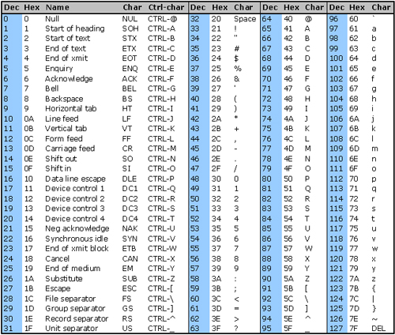
ASCII standard

Slide 17
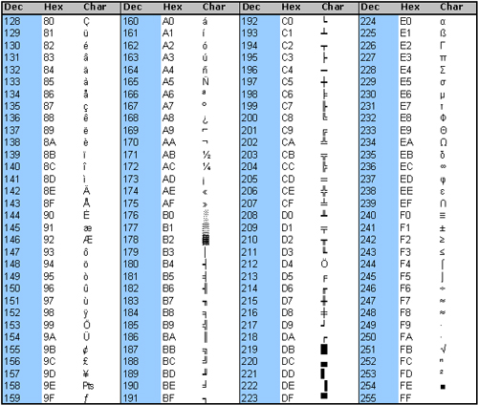
ASCII extension (8-bit)

Slide 18
Example :
What is the ASCII code for “Hi”.
H → 72₁₀ → 1001000
i → 105₁₀ → 1101001
Answer : Hi → 10010001101001

Slide 19
Exercise 3 (TODO)
Find binary, 8421BCD, and Excess-3 of the following decimal numbers:
32, 128, 210
Find decimal numbers of this 8421 BCD:
01000111, 10010011
Find decimal numbers of this Excess-3:
10010100, 10100111
Find Gray codes for the following decimal numbers:
10, 30, 85
Find decimal numbers of this Gray codes:
0100, 10001, 110010
Find the ASCII code (7-bit) for theses words :
L33T, OMG!, YaHoo
Find word from this ASCII code :
1001001 0010100 1001100 1110101 1110110 0010100 1010101

