Slide 1
User defined Functions
350142 - Computer Programming
Asst. Prof. Dr. Choopan Rattanapoka and Asst. Prof. Dr. Suphot Chunwiphat

Slide 2
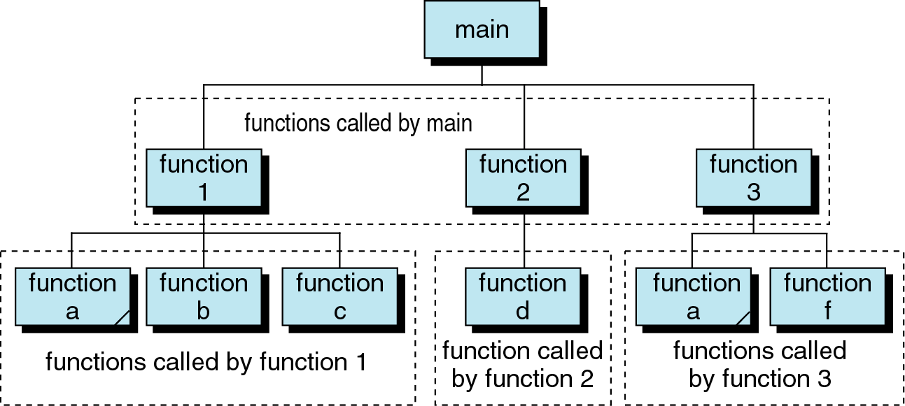
Structure of C Functions

Slide 3
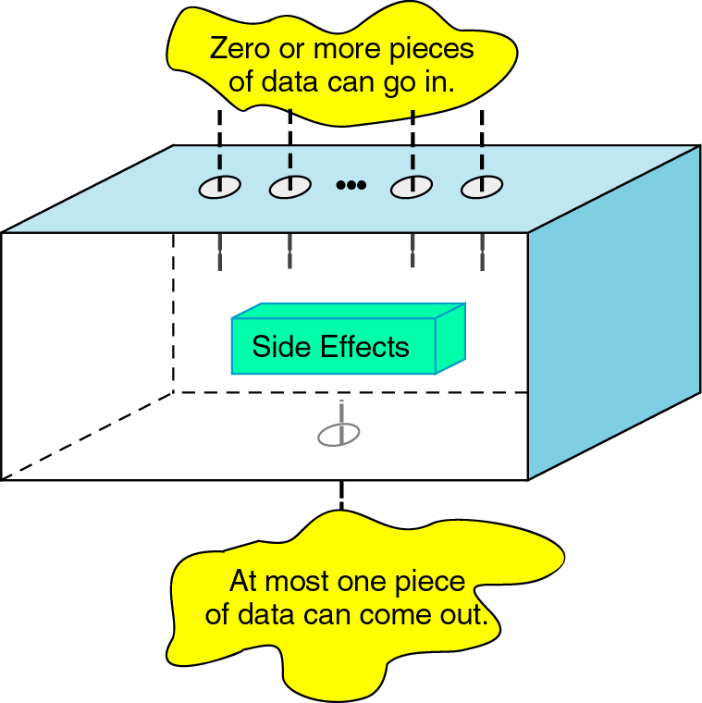
How function works
Input
Output

Slide 4
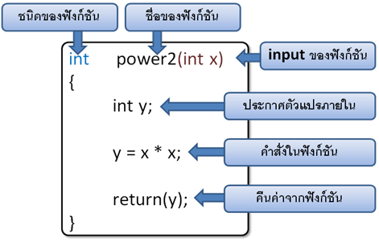
User-defined functions
type function-name (type arg-1, type arg-2, … ) { local variable declaration; statement-1; statement-2; …. statement-n; return(value); }
Function’s output data type
Function name
Function’s input
Local variable
Statement in function
Return statement

Slide 5
Function types
We can categorize functions in C by the way its take inputs and return outputs into 3 categories
Function that takes no input and returns nothing
Function that takes inputs and returns nothing
Function that takes inputs and returns an output

Slide 6
Function that takes no input and returns nothing
Function that takes no input and returns nothing means
Function does not take any arguments or parameters as input
Function does not return anything to user
It’s the easiest type of function that normally used for display some messages.
void showProgram( ) {
printf(“= Today Program =\n”);
printf(“1. Mummy\n”);
printf(“2. Star war\n”);
printf(“3. Spiderman\n\n”);
}

Slide 7
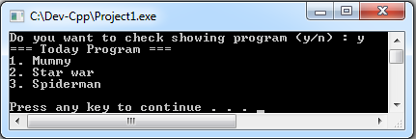
Example
#include <stdio.h>
void showProgram( ) {
printf(“=== Today Program ===\n”);
printf(“1. Mummy\n”);
printf(“2. Star war\n”);
printf(“3. Spiderman\n\n”);
}
int main(int argc, char **argv)‏ {
char ch;
printf("Do you want to check showing program (y/n) : ");
ch = getchar( );
if((ch == ‘Y’) || (ch == ‘y’)) {
showProgram( );
} else {
printf(“Thank you\n”);
}
}

Slide 8
Function that takes input and returns nothing
This type of function can accept 1 or more input parameters.
void average(int x, int y) {
printf(“Average of %d and %d = %f\n”, x,
y, (x + y)/2.0);
}

Slide 9
Example 1
#include <stdio.h>
void average(int x, int y)
{
printf(“Average of %d and %d = %f\n”, x,
y,
(x + y)/2.0);
}
int main(int argc, char **argv)‏
{
int a = 5, b = 10;
average(a, b);
}
average
x
y
Main
a
5
5
b
10
10

Slide 10
Example 2
#include <stdio.h>
void average(int b, int a)
{
printf(“Average of %d and %d = %f\n”, b,
a,
(b + a)/2.0);
}
int main(int argc, char **argv)‏
{
int a = 5, b = 10;
average(a, b);
}
average
b
a
Main
a
5
5
b
10
10

Slide 11
Example 3
#include <stdio.h>
void average(int x, int y)
{
printf(“Average of %d and %d = %f\n”, x,
y,
(x + y)/2.0);
}
int main(int argc, char **argv)‏
{
average((3+2), (100/10));
}
average
x
y
Main
5
3+2
100/10
10

Slide 12
Example 4
#include <stdio.h>
void average(int a, int b)
{
a = 10;
b = 20;
}
int main(int argc, char **argv)‏
{
int a = 5, b = 10;
average(a, b);
}
average
a
10
b
20
Main
a
5
5
b
10
10

Slide 13
QUIZ 1 : Find the output of program
#include <stdio.h>
void disp(int a)
{
int i;
for(i = 1; i <= 12; i++)
printf(“%d x %d = %d\n”, a, i, (a*i));
}
int main(int argc, char **argv)‏
{
disp(5);
}

Slide 14
QUIZ 2 : Find the output of program
#include <stdio.h>
void plus5(int x)
{
x = x + 5;
printf(“X in plus5 = %d\n”, x);
}
int main(int argc, char **argv)‏
{
int x = 10;
printf(“X in main before calling function = %d\n”, x);
plus5( x );
printf(“X in main after calling function = %d\n”, x);
}

Slide 15
QUIZ 3 : Find the output of program
#include <stdio.h>
void swap(int a, int b) {
int tmp;
tmp = a;
a = b;
b = tmp;
printf(“In swap : A = %d, B = %d\n”, a, b);
}
int main(int argc, char **argv)‏ {
int a = 5, b = 10;
printf(“Before swap A = %d, B = %d\n”, a, b);
swap(a, b);
printf(“After swap A = %d, B = %d\n”, a, b);
}

Slide 16
Function that takes inputs and returns an output
This type of function is mostly used for calculating mathematics expression and return the result back to user.
Return value must be the same data type as the type of function.
Function can return only 1 value
int power3(int x) {
return( x * x * x);
}

Slide 17
Example 1
#include <stdio.h>
int power3(int x) {
return( x * x * x);
}
int main(int argc, char **argv)‏ {
int num;
num = power3(2);
printf(“2^3 = %d\n”, num);
}
power3
x
8
Main
num
?
2

Slide 18
Example 2
#include <stdio.h>
float average(int x, int y)
{
return( (x + y)/2.0 );
}
int main(int argc, char **argv)‏
{
int a = 5, b = 10; float f;
f = average(a, b);
printf(“Average of %d and %d = %f\n”,
a, b, f);
}
average
x
7.5
y
Main
a
5
5
b
10
10
f
?

Slide 19
QUIZ 4
#include <stdio.h>
int multiply(int a, int b)
{
return (a * b);
}
int main(int argc, char **argv)‏
{
int a = 5, b = 10;
printf(“%d\n”, multiply(3,2));
printf(“%d\n”, multiply(a, 5));
printf(“%d\n”, multiply((3+2), (b – 6));
printf(“%d\n”, multiply( multiply(2,3), multiply(2, multiply(3, 2 -1))));
}

Slide 20
Function Prototype
Function prototype is the definition of function
We need to make C Compiler know the definition of functions before we can use them
Remember
#include <stdio.h>
In stdio.h file contains the definition of functions that are related to input and output functions.
That’s why, we can use printf(), scanf(), etc..

Slide 21
Example
#include <stdio.h>
int power3(int x) {
return( x * x * x);
}
int main(int argc, char **argv)‏ {
printf(“2^3 = %d\n”,
power3(2));
}
#include <stdio.h>
int main(int argc, char **argv)‏ {
printf(“2^3 = %d\n”,
power3(2));
}
int power3(int x) {
return( x * x * x);
}
Correct
Incorrect

Slide 22
Prototype Declaration
The way to write a prototype is like writing the first line of your function block
ตัวอย่าง
type function-name (type arg-1, type arg-2, … );
int power3(int x) {
return( x * x * x);
}
int power3(int x) {
;
Function
Prototype

Slide 23
Example
#include <stdio.h>
int power3(int x) {
return( x * x * x);
}
int main(int argc, char **argv)‏ {
printf(“2^3 = %d\n”,
power3(2));
}
#include <stdio.h>
int main(int argc, char **argv)‏ {
printf(“2^3 = %d\n”,
power3(2));
}
int power3(int x) {
return( x * x * x);
}
int power3(int x);
Correct
Incorrect
Correct

