Slide 1
Standard Functions
350142 - Computer Programming
Asst. Prof. Dr. Choopan Rattanapoka and Asst. Prof. Dr. Suphot Chunwiphat

Slide 2
Standard Functions
How will you do if you need to compute the cosine value of the angle 60°?
Write your own function to calculate it! ☹
Actually, C have prepared a lot of useful functions that cover almost every programming task and that are ready to use in your program.
Thus, the more you know about these predefined functions, the more effective your program will be.

Slide 3
Function Usage
Ex.
double sqrt (double x)
return value (output from the function
as the type double)
function’s name
parameter(input value(s) to the function
as the type double)
main(void)
{
double x = 4.0, result;
result = sqrt(x);
printf("The square root of %lf is %lf\n", x, result);
return 0;
}
Both are the types of double)

Slide 4
Math Function (1)
C standard math functions (trigonon) #include <math.h>
Function | Description
sin(x) | return sine value of angle x (x in radian)
cos(x) | return cosine value of angle x (x in radian)
tan(x) | return tangent value of angle x (x in radian)
asin(x) | return arcsin value in radian of x
acos(x) | return arccos value in radian of x
atan(x) | return arctan value in radian of x
All these functions take
double as inputs
return double as output
Remind:
180 angle in degree = π angle in radian (π is 3.14159)
Degree to radian transformation :
angle in radian = (angle in degree x π)/180
Radian to degree transformation:
angle in degree = (angle in radian x 180)/ π

Slide 5

Example
#include <stdio.h>
#include <math.h>
int main(int argc, char *argv[])
{
double result;
double x;
x = (60 * 3.14159)/180;
result = cos(x);
printf("The cosine of %.2f is %.2f\n", x, result);
return 0;
}
Transform an angle (60) in degree into an angle in radian.
Use of the function cos to compute the cosine of the angle x

Slide 6
Math Functions (2)
Function | Description
exp(x) | return value of e^{x} (e = 2.718..)
log(x) | return value of natural logarithm of x (ln)
log10(x) | return value of common logarithm (based 10) of x
log2(x) | return value of logarithm (based 2) of x
Be careful
Let’s study math for a bit ☺
What is the value of x (double):
x = log10(100);
x = log2(16);
x = log(exp(5));

Slide 7
Math Functions (3)
Function | Description
pow(x, y) | return value of x^{y}
sqrt (x) | return value of square root of x
fabs(x) | return value of absolute of x (for floating point data type)
abs(x) | return value of absolute of x (for integer data type)
What is the value of x
x = pow(5, 2);
x = sqrt(16);
x = fabs(-5.8);
x = sqrt(pow(20, 2));
x = (pow(2, 3) + sqrt(25) + fabs(-1)) / fabs(-2);

Slide 8
Math Functions (4)
Function | Description
floor(x) | return an integer which rounds down the value of x the largest integer number which is not > x
ceil(x) | return an integer which rounds up the value of x the smallest integer number which is not < x
round(x) | return an integer near the value of x - If the number after decimal point is greater than or equal to .5, then round up the number. - Otherwise round down
What is the value of x
x = floor(5.8);
x = ceil(6.1);
x = round(3.2);
x = round(3.6);
x = floor(-2.5);
x = ceil(-2.5);
x = round(-3.2);
x = round(-3.6);
Notes:
Floor(-2.5) = -3
Ceil(-2.5) = -3
Round(-3.2) = -3
Round(-3.6) = -4

Slide 9
Character Classification Functions (1)
All the following functions are defined in the library ctype.h
#include <ctype.h> is needed
Function | Description
tolower(ch) | Return a lowercase character of ch
toupper(ch) | Return a uppercase character of ch
char x = ‘A’, y;
y = tolower(x);
printf(“y = %c”, y);
char x = ‘a’, y;
y = toupper(x);
printf(“y = %c”, y);
a
A

Slide 10
Character Classification Functions (2)
Function | Description
islower(ch) | Return non-zero if ch is an lower-case character, otherwise return zero
isupper(ch) | Return non-zero if ch is an upper-case character, otherwise return zero
isalpha(ch) | Return non-zero if ch is a letter (A to Z, a to z), otherwise return zero
isdigit(ch) | Return non-zero if ch is a number digit (0 to 9), otherwise return zero
isalnum(ch) | Return non-zero if ch is a letter or a number digit (A to Z, a to z, 0 to 9) , otherwise return zero
char x = ‘A’;
islower(x);
isupper(x);
isalpha(x);
isdigit(x);
isalnum(x);
char x = ‘b’;
islower(x);
isupper(x);
isalpha(x);
isdigit(x);
isalnum(x);
char x = ‘5’;
islower(x);
isupper(x);
isalpha(x);
isdigit(x);
isalnum(x);
char x = ‘#’;
islower(x);
isupper(x);
isalpha(x);
isdigit(x);
isalnum(x);

Slide 11
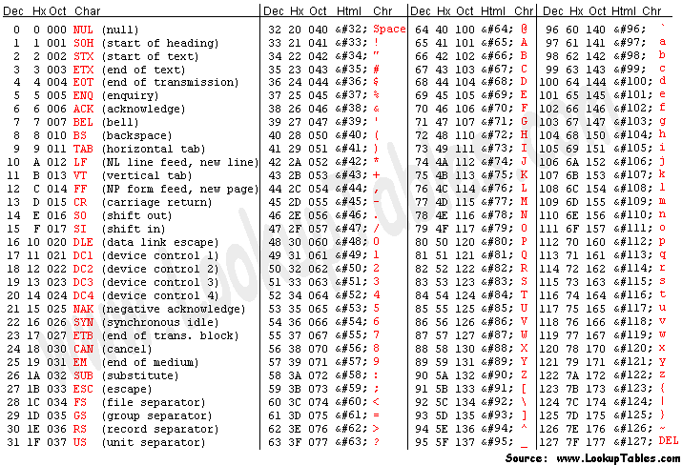
Review: ASCII table
Function | Description
islower(ch) | Return non-zero if ch is an lower-case character, otherwise return zero
isupper(ch) | Return non-zero if ch is an upper-case character, otherwise return zero
isalpha(ch) | Return non-zero if ch is a letter (A to Z, a to z), otherwise return zero
isdigit(ch) | Return non-zero if ch is a number digit (0 to 9), otherwise return zero
isalnum(ch) | Return non-zero if ch is a letter or a number digit (A to Z, a to z, 0 to 9) , otherwise return zero
char x = ‘A’;
islower(x);
isupper(x);
isalpha(x);
isdigit(x);
isalnum(x);
char x = ‘b’;
islower(x);
isupper(x);
isalpha(x);
isdigit(x);
isalnum(x);
char x = ‘5’;
islower(x);
isupper(x);
isalpha(x);
isdigit(x);
isalnum(x);
char x = ‘#’;
islower(x);
isupper(x);
isalpha(x);
isdigit(x);
isalnum(x);

Slide 12
Character Classification Functions (3)
Function | Description
isascii(ch) | Return non-zero if ch is an ASCII character (0x00 – 0x7F), otherwise return zero
iscntrl(ch) | Return non-zero if ch is a delete character (0x7F) or ordinary control character (0x00 – 0x1F) , otherwise return zero
isprint(ch) | Return non-zero if ch is a printable character (0x20 – 0x7E), otherwise return zero
isspace(ch) | Return non-zero if ch is is a space, tab, carriage return, new line, vertical tab, or formfeed (0x09 - 0x0D, 0x20). , otherwise return zero
char x = 0x7F;
isascii(x);
iscntrl(x);
isprint(x);
isspace(x);
char x = 13;
isascii(x);
iscntrl(x);
isprint(x);
isspace(x);
char x = ‘#’;
isascii(x);
iscntrl(x);
isprint(x);
isspace(x);

Slide 13
Character Classification Functions (4)
Function | Description
isgraph(ch) | Return non-zero if ch is a characters in class print but no characters in class space shall be included, otherwise return zero
ispunct(ch) | Return non-zero if ch is neither the <space> nor any characters in classes alpha, digit, or cntrl shall be included, otherwise return zero
isxdigit (ch) | Return non-zero if ch is a hexadecimal digit (‘0’ – ‘9’, ‘A’ – ‘F’, ‘a’ – ‘f’), otherwise return zero
char x = 0x7F;
isgraph(x);
ispunct(x);
isxdigit(x);
char x = 65;
isgraph(x);
ispunct(x);
isxdigit(x);
char x = ‘@’;
isgraph(x);
ispunct(x);
isxdigit(x);

Slide 14
String Functions
There are some important functions in C used for string
We should add #include <string.h> to use these functions
Function | Description
strlen(str) | Take a string as input and return the length of string
strcpy(str1, str2) | Copy the string data from str2 to str1
strcat(str1, str2) | Concatenate the string data of str2 to str1
strcmp(str1, str2) | Compare the string data of str1 and str2

