Slide 1
Multi-Dimension Array String
350142 - Computer Programming
Asst. Prof. Dr. Choopan Rattanapoka and Asst. Prof. Dr. Suphot Chunwiphat

Slide 2
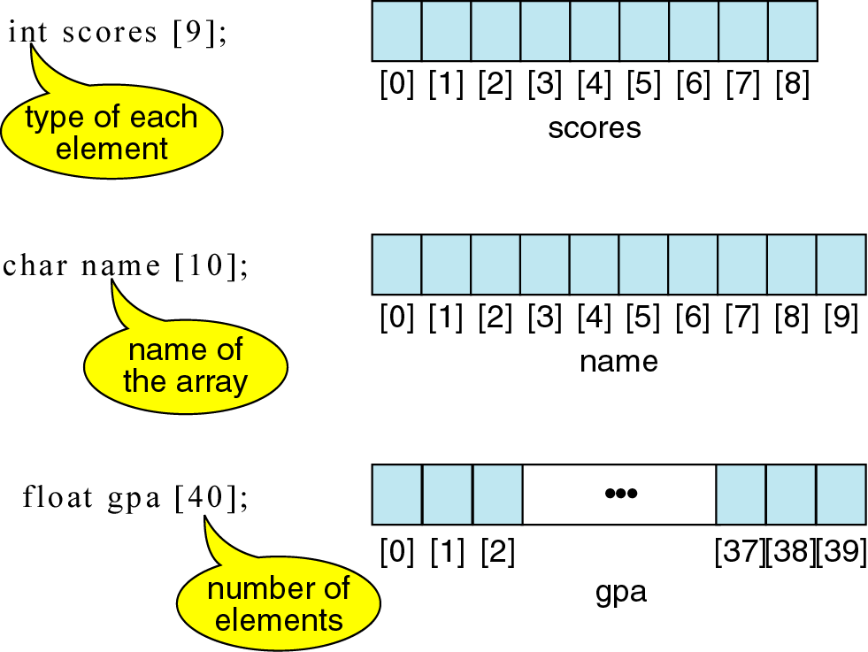
Review: 1-D Array Variable

Slide 3
2-D Array Variable
2-D array variable declaration is just like declaring 1-D array variable, except that we need to define the size of 2nd dimension
We need to define the size of array in rows and columns
type variable-name[rows][columns] ;
type : array variable data type variable-name : array variable name rows : number of rows that array can hold columns : number of columns that array can hold

Slide 4
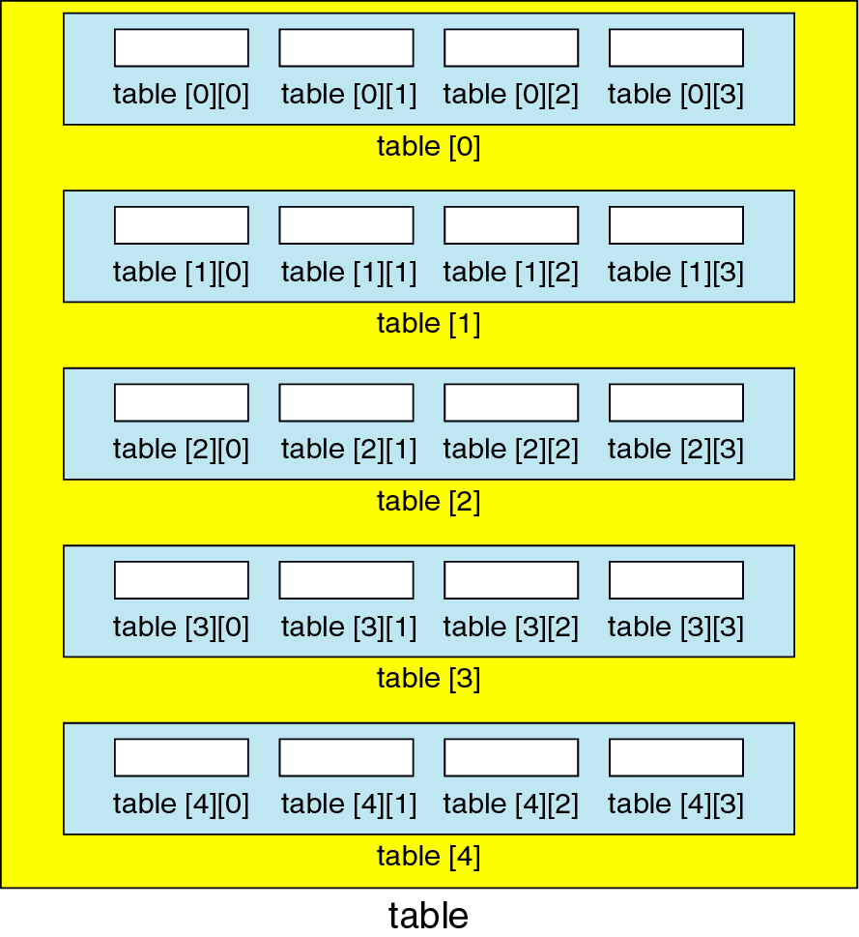
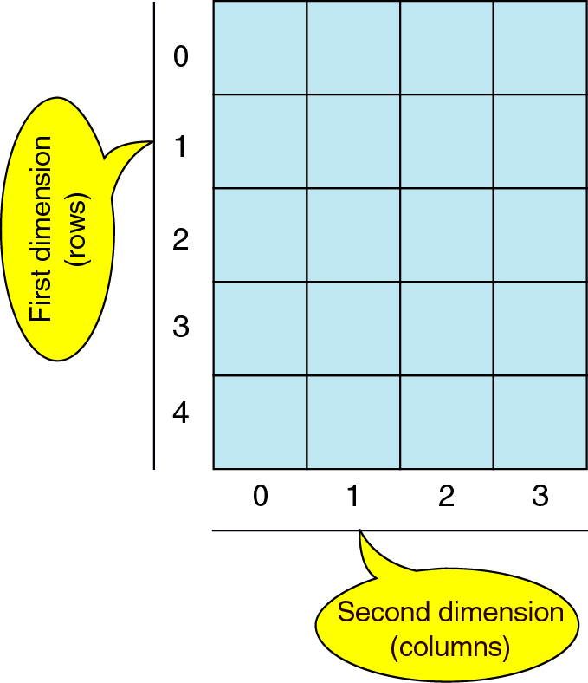
2-D Array Structure
int table[5][4];

Slide 5
2-D Array Value Initialization
int xy [3] [3] = {
{10 , 20 , 30},
{40 , 50 , 60},
{70 , 80 , 90}
};
อาร์เรย์ xy จะมีค่าต่าง ๆ ดังนี้
xy [0] [0] = 10 xy [0] [1] = 20 xy [0] [2] = 30
xy [1] [0] = 40 xy [1] [1] = 50 xy [1] [2] = 60
xy [2] [0] = 70 xy [2] [1] = 80 xy [2] [2] = 90

Slide 6
QUIZ 1
int A[2][3] = { {1, 2, 3} , {4, 5, 6} };
A[0][2] = 20;
A[1][0] = A[0][0] + A[1][0];
A[1][1] = A[0][2] + A[0][1];
From this partial of code, find the value in each element of array variable A
A[0][0] =
A[0][1] =
A[0][2] =
A[1][0] =
A[1][1] =
A[1][2] =

Slide 7
QUIZ 2
Find the output of this program
#include <stdio.h>
int main(int argc, char **argv) {
int student[3][3], i, j, sum = 0;
for(i = 0; i < 3; i++) {
for(j = 0; j < 3; j++) {
printf(“student[%d][%d] = “, i, j);
scanf(“%d”, &student[i][j]);
}
printf(“\n”);
}
for(i = 0; i < 3; i++)
sum += student[2][i];
printf(“The number of students = %d\n”, sum);
}
If user input the following number in order.
10
20
30
40
20
30
15
25
45

Slide 8
3-D Array Variable
Syntax for declaring an 3-D array variable
type variable-name[planes][rows][columns] ;
type : array variable data type variable-name : array variable name planes : number of planes that array can hold rows : number of rows that array can hold columns : number of columns that array can hold

Slide 9
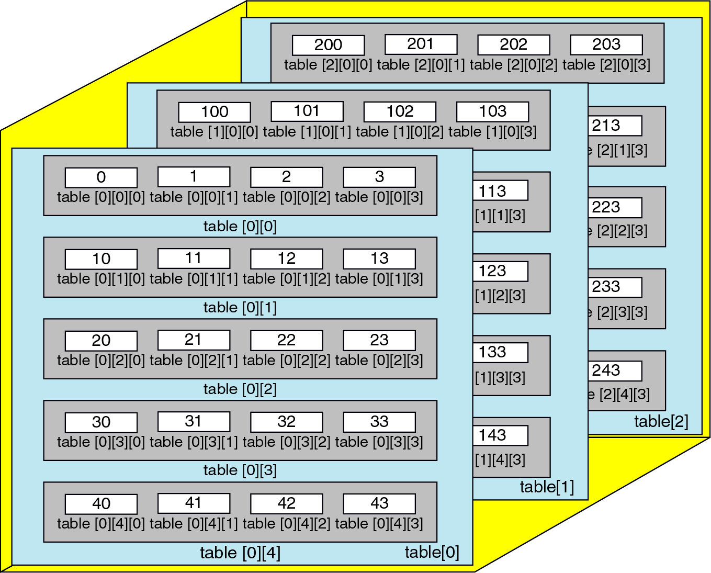
Example : Declare an 3-D array variable
int table[3][5][4];

Slide 10
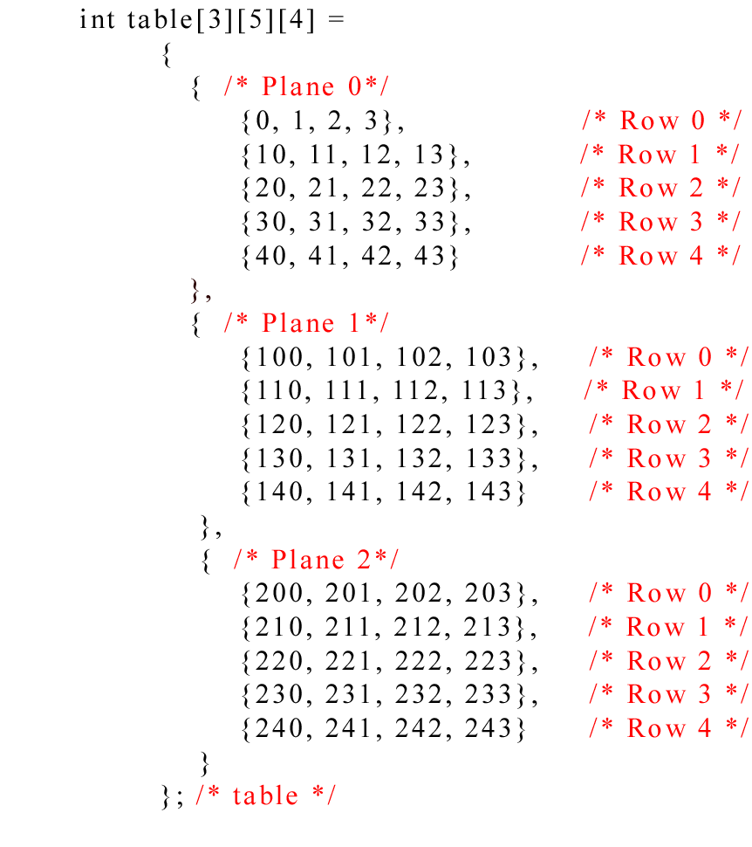
3-D Array Value Initialization
What is the value of
table[1][2][3]
table[2][1][0]
table[0][3][3]

Slide 11
Array of Characters & String
In C, there is no string data type
But we can create string data type by using array of characters
We need to declare the size of array that is bigger than the size of string that we want to store at least 1 byte
Because C needs to store ‘\0’ (zero) at the end of string
String initialization
char a[3] = {‘a’, ‘b’, ‘c’}; ← NOT STRING
char a[ ] = “abc”; ← STRING
char a[20] = “abc”; ← STRING

Slide 12
Array variable & String Comparison
int power [ ] = { 10 , 20 , 40 } ;
power [0] = 10
power [1] = 20
power [2] = 40
char message [ ] = “COMPUTER”;
message[0] = C
message[1] = O
message[2] = M
message[3] = P
message[4] = U
message[5] = T
message[6] = E
message[7] = R
message[8] = \0

Slide 13
How to output string on monitor
We can use C standard functions
printf (with %s)
puts
char a[ ] = “Hello”;
char b[ ] = “World”;
printf(“%s”, a);
printf(“%s”, b);
char a[ ] = “Hello”;
char b[ ] = “World”;
puts(a);
puts(b);
Output :
HelloWorld
Output :
Hello
World

Slide 14
How to input data to string variable
We can use C standard functions
scanf (with %s)
gets
char a[16];
scanf(“%s”, a); // no & need
printf(“%s”, a);
char a[16];
gets(a);
printf(“%s”, a);
Input :
Hello World
Input :
Hello World
Output :
Hello
Output :
Hello World
While taking an input from user by using scanf
string value must not contain any whitespace

Slide 15
Array of String
char city [3][10] = { “Bangkok”, “Ayuthaya”, “Chiengmai” };
What is the output of
printf(“%c”, city[0][4]);
printf(“%s”, city[0]);

Slide 16
C Standard Functions for String
There are some important functions in C used for string
We should add #include <string.h> to use these functions
function | description
strlen(str) | Take a string as input and return the length of string
strcpy(str1, str2) | Copy the string data from str2 to str1
strcat(str1, str2) | Concatenate the string data of str2 to str1
strcmp(str1, str2) | Compare the string data of str1 and str2

Slide 17
strlen Function
#include <stdio.h>
#include <string.h>
int main(void) {
char name[32];
printf(“Enter name :”);
scanf(“%s”, name);
count = strlen(name);
printf(“%d”, count);
return 0;
}
What is the output of this program, if user input the following string :
Somchai
Suphot
Choopan Rattanapoka

Slide 18
strcpy Function
If we don’t initialize data in string at the declaration step. We can’t use “=“ to assign string value
Example:
char str[32];
//WRONG
str = “Hello World”;
//CORRECT
strcpy( str, “Hello World”);
#include <stdio.h>
#include <string.h>
int main(void) {
char src[32] = “Hello”;
char dst[32];
strcpy(dst, src);
printf(“%s”, dst);
return 0;
}

Slide 19
strcat Function
char b[8] = “Guys”;
char a[12 ] = “Hello”;
strcat(a, b)
b
G
u
y
s
\0
G
u
y
s
\0
a
H
e
l
l
o
\0

Slide 20
strcmp Function
If we want to compare the similarity of stored data between 2 strings. We can’t use “==“
char a[16] = “Hello”;
char b[16] = “Hello”;
if( a == b) WRONG!!
We need to use strcmp function
strcmp return 0 if 2 strings store same data
Otherwise return non zero value
Warning : don’t forget 0 means False

Slide 21
QUIZ 3
Find the output of this program
char str1[] = “C Language”; //1 space between C and L
char str2[] = “c language”; // 1 space between c and l
if(!strcmp(str1, str2)) {
printf(“str1 = str2\n”);
} else {
printf(“str1 != str2\n”);
}
printf("Length of str1 = %d\n", strlen(str1));

