Slide 1
Array
350142 - Computer Programming
Asst. Prof. Dr. Choopan Rattanapoka and Asst. Prof. Dr. Suphot Chunwiphat

Slide 2
Variable Issue
Up until now, we’ve learnt that we need a variable to store data.
Thus, If we need to store 10 integer numbers. We need to define 10 integer variables !!
int a1,a2,a3,…, a10; → confuse
Or, If we want to take 10 integer numbers from user and store them in 10 integer variables ??
scanf(“%d”, &a1);
scanf(“%d”, &a2); ……. 10 times ??

Slide 3
Array Variable
Array variable is a variable that can store multiple data of the same type.
Array variable is like we envelop multiple variables into a single variable
We can access each data element by using an index within the symbol [ ] that follows a variable
index in C, start from number 0

Slide 4
1-Dimension Array
Syntax to define a 1-D array
Example :
int score[10];
Array data type => int
Array variable name => score
Number of element of this array => 10
type variable-name[n] ;
type : array variable data type variable-name : array variable name n : number of element that array can hold

Slide 5
Array and Normal Variable Comparison
int score0, score1, score2, score3, score4;
int score[5];

Slide 6
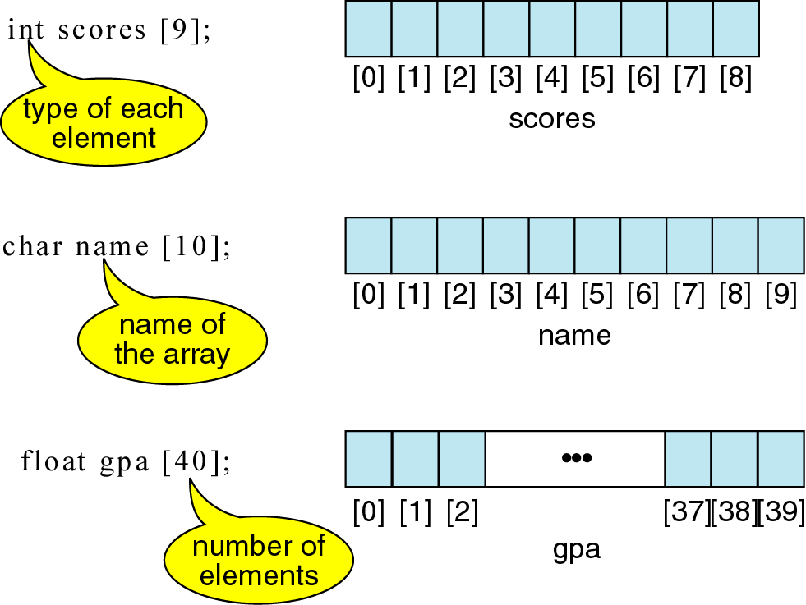
Example : Define an array variable

Slide 7
Assign value to each element in array variable
int data[4];
data[0] = 5;
data[1] = 4;
data[2] = 1;
data[3] = 8;
?
5
?
4
?
1
?
data
8
data[0]
data[1]
data[2]
data[3]

Slide 8
QUIZ 1
Find the output of this program
#include <stdio.h>
int main(int argc, char **argv) {
int a[3];
a[0] = 1;
a[1] = 2;
a[2] = 3;
printf(“a[0] = %d”, a[0]);
printf(“a[1] = %d”, a[1]);
printf(“a[2] = %d”, a[2]);
}

Slide 9
QUIZ 2
Find the output of this program
#include <stdio.h>
int main(int argc, char **argv) {
int a[3], i;
for(i = 0; i < 3; i++)
a[i] = i * 5;
for(i = 0; i < 3; i++)
printf(“a[%d] = %d”, i, a[0]);
}

Slide 10
Define the Initialize Data for Array (1)
There are 4 ways to initialize data for an array variable
Basic initialization
Initialization without size
Partial initialization
Initialization to all zeros

Slide 11
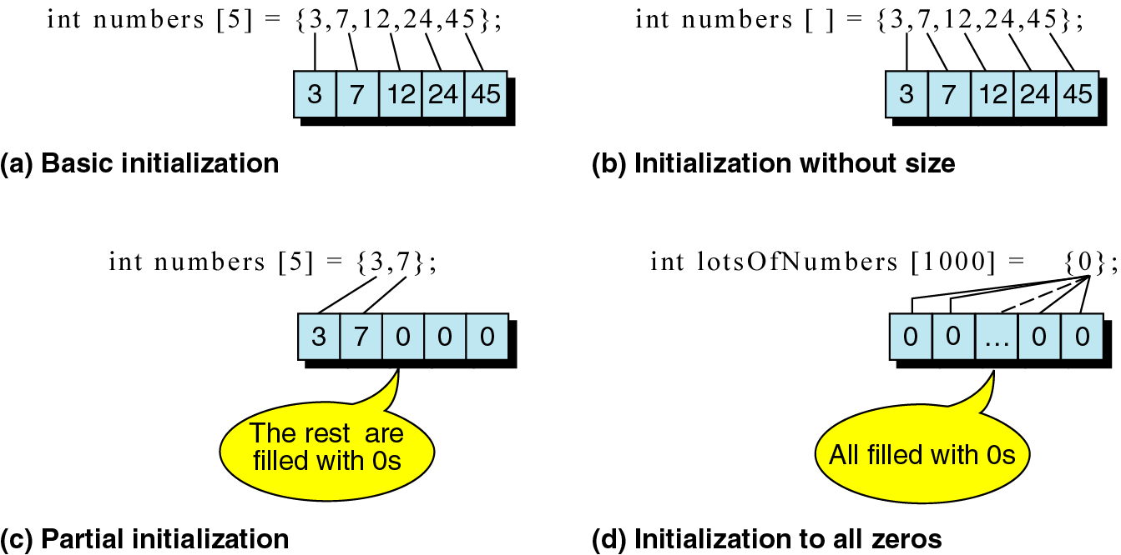
Define the Initialize Data for Array (2)

Slide 12
QUIZ 3
Find the output of this program
#include <stdio.h>
int main(int argc, char **argv) {
int number[5] = { 10, 20, 30, 40, 50 };
int i;
for(i = 0; i < 5; i++)
printf(“number[%d] = %d\n”, i, number[i]);
}

Slide 13
Array Usage Issue
If we make an array variable int a[5];
Array index can only be 0, 1,2, 3 and 4
int a[5];
a[5] = 100;
Compiling Step:
Compiler does not warn us about this issue
Executing Step:
It will cause the error, sometimes OS will shut down our program or maybe our program will hang the OS

Slide 14
Swap data between 2 variables
Let’s think about how can we swap stored data between variable A and B
int A = 5;
int B = 10;
At last, Data in A must be 10 and Data in B must be 5
Can we do
A = B;
B = A;

Slide 15
Swap data between 2 variables (2)
int A = 5;
int B = 10;
TMP = A;
A = B;
int TMP;
B = TMP;
?
5
5
10
10
5
TMP
A
B

Slide 16
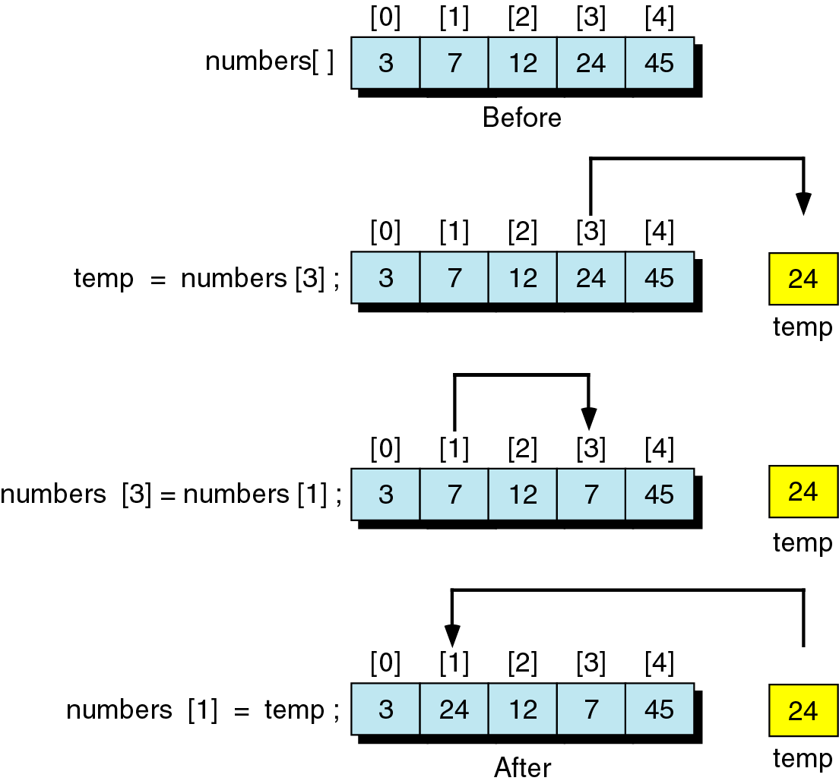
Swap data between 2 elements of array
Example: swap data between numbers[3] and numbers[1]

Slide 17
QUIZ 4
#include <stdio.h>
int main(int argc, char **argv) {
int a[4] = {10, 5, 30, 12};
int temp, i, j;
for(i = 0; i < 3; i++) {
for(j = i+1; j < 4; j++) {
if (a[i] < a[j]) {
temp = a[ i ];
a[ i ] = a[ j ];
a[ j ] = temp;
}
}
}
for(i = 0; i < 4; i++) printf(“a[%d] = %d\n”, i, a[i]);
}
Find the output of this program

