Slide 1
Iteration Statement for
350142 - Computer Programming
Asst. Prof. Dr. Choopan Rattanapoka and Asst. Prof. Dr. Suphot Chunwiphat

Slide 2
Repetition Control Structures
Repetition Control Structures
Iteration Statements
for(…) Statement
while(…) Statement
do…while (…) Statement
Repetition Control Statement
break Statement
continue Statement

Slide 3
Review: do-while Statement
do-while Statement is similar to while Statement
The difference is do-while Statement will execute statements in do-while block before checking the condition
If condition is true, program will jump back to do Statement and executes statement in do-while block again, otherwise program leaves do-while block
do statement; while (condition);
do { statement-1; statement-2; … statement-n; } while (condition);

Slide 4
Review: while Statement
while Statement
Check the condition of while statement
If condition is true
Execute statements in while block
And then jump back to check condition again
If condition is false, ignore statements in while block
while (condition) statement;
while (condition) { statement-1; … statement-n; }

Slide 5
for Statement
for Statement also control over the iteration flow of program just like while and do-while Statements.
for Statement is more special than others. It is suitable in the case that we know exactly how many time, we want to repeat the statements in for block
for(expr1; expr2; expr3) statement;
for(expr1; expr2; expr3) { statement-1; statement-2; … statement-n; }

Slide 6
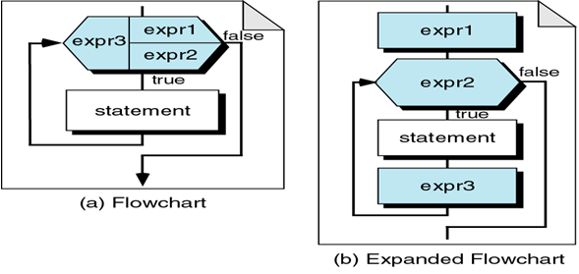
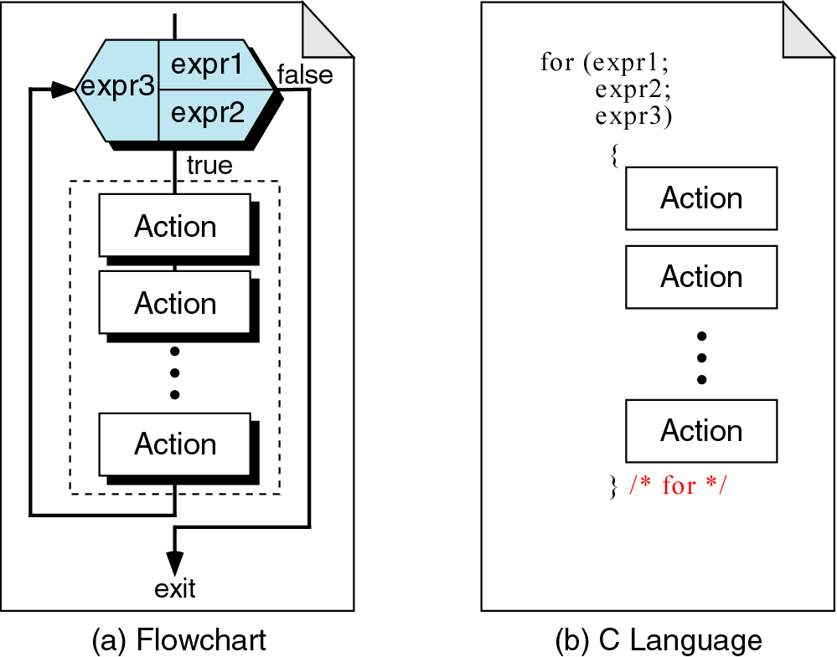
for Statement: Flow chart

Slide 7
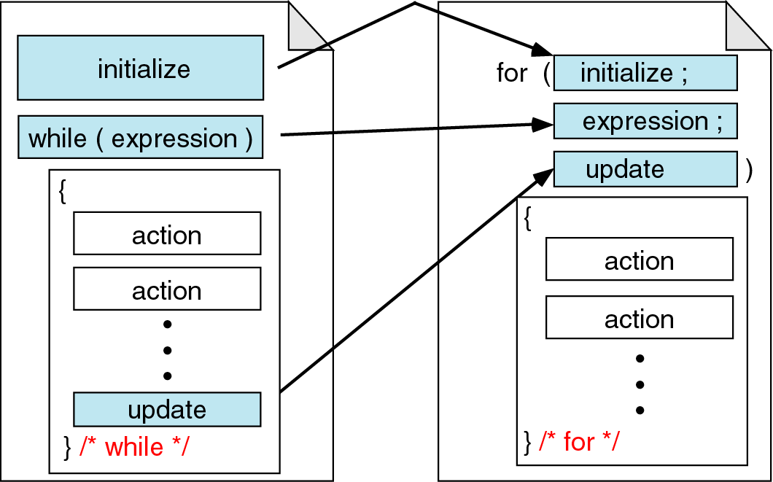
while and for Statement Comparison

Slide 8
while Statement to for Statement Transformation
i = 0;
while( i < 10) {
printf(“%d\n”, i);
i++;
}
for( ; ; ) {
printf(“%d\n”, i);
}
i = 0
i < 10
i++

Slide 9
Example 1
#include <stdio.h>
int main(int argc, char **argv)
{
int i;
for( i = 3; i >= 1; i--) {
printf(“%d “, i);
}
}
i
?
3
2
1
0
Output:
3
2
1

Slide 10
QUIZ 1
Find the output of this program
#include <stdio.h>
int main(int argc, char **argv)
{
int i;
for( i = 0; i <= 50; i+=5) {
printf(“%d “, i);
}
}

Slide 11
QUIZ 2
Find the output of this program
#include <stdio.h>
int main(int argc, char **argv)
{
int i, sum;
sum = 0;
for( i = 1; i <= 5; i++) {
sum += i;
}
printf(“summation of 1-5 = %d\n”, sum);
}

Slide 12
Nested loop
#include <stdio.h>
int main(int argc, char **argv)
{
int i, j;
for( i = 1; i <= 2; i++ ) {
for( j = 1; j <= 2; j++) {
printf(“C is very easy\n”);
}
}
}
i
?
1
2
3
j
?
1
2
3
Output :
C is very easy
C is very easy
C is very easy
C is very easy

Slide 13
QUIZ 3
Find the output of this program
#include <stdio.h>
int main(int argc, char **argv)
{
int i, j;
for( i = 1; i < 5; i++) {
for( j = 0; j < i; j++)
printf(“*”);
printf(“\n”);
}
}

Slide 14
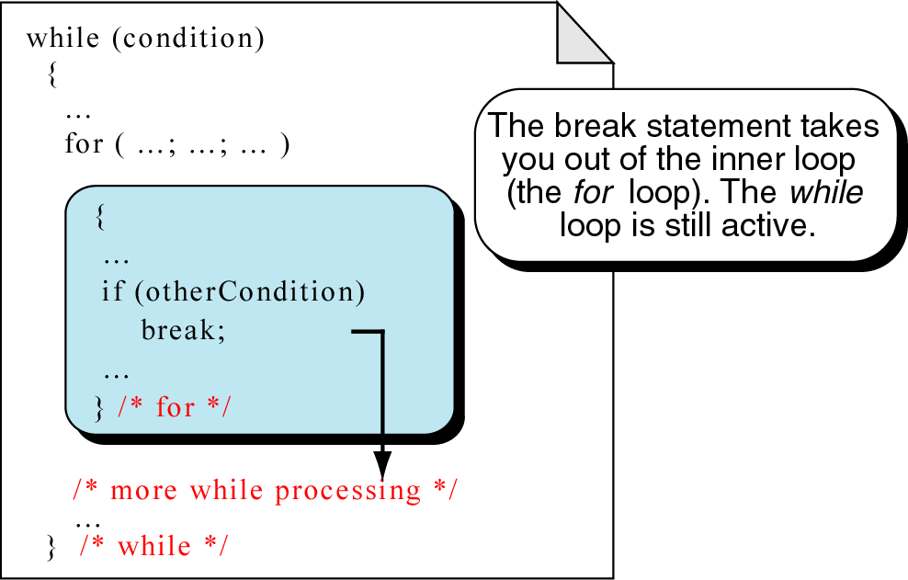
break Statement

Slide 15
Example 1
#include <stdio.h>
int main(int argc, char **argv)
{
int i;
for (i = 0; i < 5; i++) {
printf("<");
if (i == 2)
break;
printf(“%d >“, i);
}
}
i
?
0
1
2
ผลการรัน :
<
1>
<
0>
<

Slide 16
QUIZ 4
#include <stdio.h>
int main(int argc, char **argv) {
int i, j;
for (i = 0; i < 5; i++) {
printf(“i = %d\n”, i);
for(j = 0; j < 5; j++) {
if (j >= 2)
break;
printf(“j = %d\n”, j);
}
}
}
Find the output of this program

Slide 17
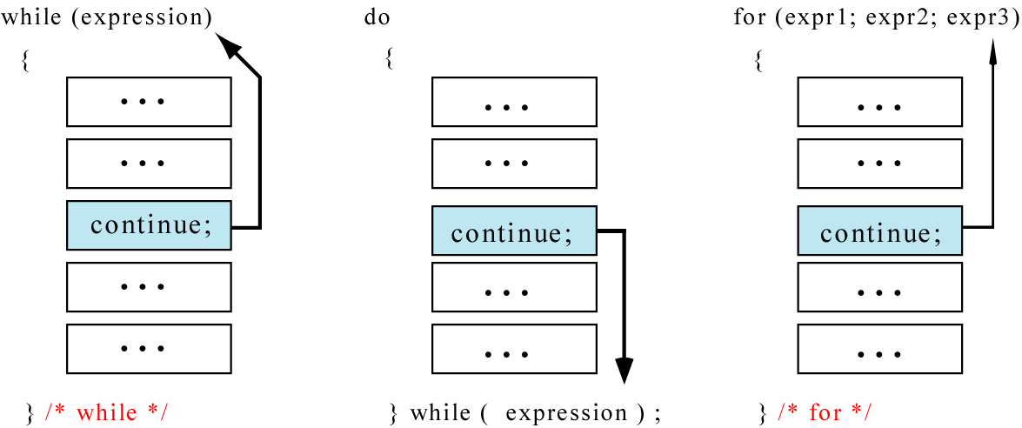
continue Statement

Slide 18
QUIZ 5
Find the output of this program
#include <stdio.h>
int main(int argc, char **argv) {
int i;
for (i = 0; i < 5; i++) {
printf("<");
if (i == 2)
continue;
printf(“%d >“, i);
}
}

