Slide 1
Iteration statement while do-while
350142 - Computer Programming
Asst. Prof. Dr. Choopan Rattanapoka and Asst. Prof. Dr. Suphot Chunwiphat

Slide 2
Repetition Control Structures
Repetition Control Structures
Iteration Statements
for(…) Statement
while(…) Statement
do…while (…) Statement
Repetition Control Statement
break Statement
continue Statement

Slide 3
Repetition Control Statements
Problem: If you need to print the message “Hello, world” 10 messages onto the monitor screen. How will you do?
main()
{
repetition statement
{
printf(“Hello, world\n”);
}
}
main()
{
printf(“Hello, world\n”);
…
printf(“Hello, world\n”);
}
An easier way to do that is
using a repetition control
statement.
Use 10 printf() functions
What about 100 messages!

Slide 4
Repetition Control Statements (cont.)
In some situation, programs require the ability to execute a set of statements repeatedly.
There are three repetition statements in C language: for, while, do…while statements.
The for, while, do…while statements each have a Logic expression determining whether the loop should continue or terminate.
Main sequence
Loop (or Repeated)
Statements
Loop

Slide 5
while Statement
while Statement (Step-by-Step)
Check the condition of while statement
If condition is true
Execute statements in while block
And then jump back to check condition again
If condition is false, ignore statements in while block
while (condition) statement;
while (condition) { statement-1; … statement-n; }

Slide 6
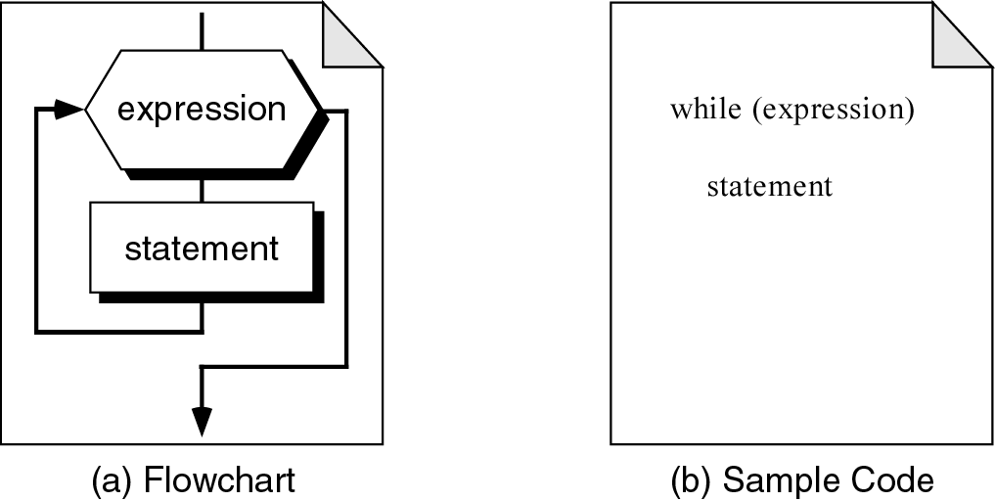
while Statement: Flow chart(1)
false
true

Slide 7
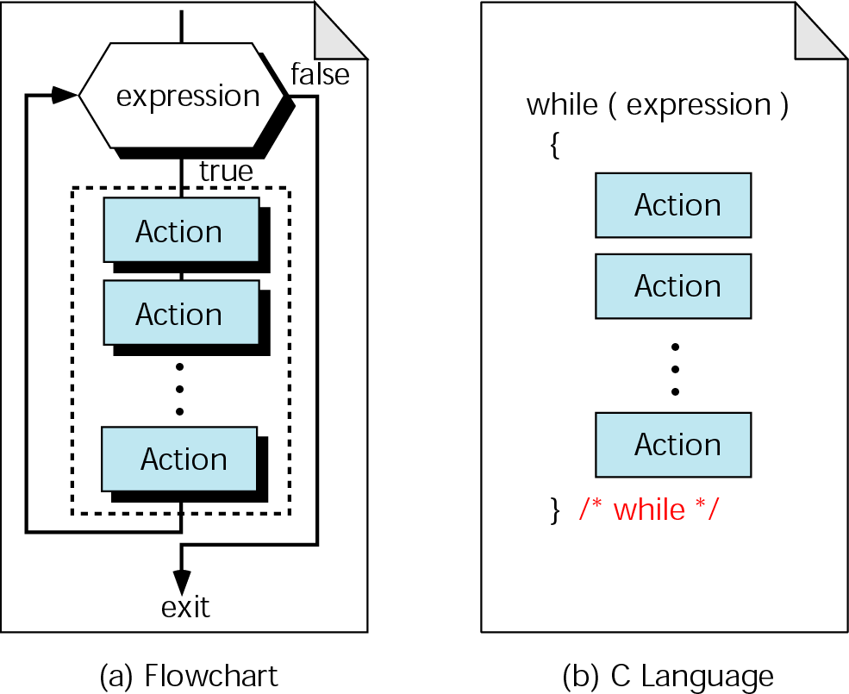
while Statement: Flow chart (2)

Slide 8
Example 1
#include <stdio.h>
int main(int argc, char **argv)
{
int count = 0;
printf(“Show number from zero to three.\n”);
while (count <= 3)
{
printf(“%d ”, count);
count++;
}
}
0
1
2
3
count
4
What will be happened if we forget to write “count++” in this program ?
Output :
Show number from zero to three.
0
1
2
3

Slide 9
Example 2
#include <stdio.h>
int main(int argc, char **argv)
{
int begin = 0, sum = 0, end;
printf(“Enter end number : ”);
scanf(“%d”, &end);
while(begin <= end) {
sum = sum + begin;
begin++;
}
printf(“Sum = %d”, sum);
}
0
1
2
begin
3
?
end
2
0
0
1
sum
3
Output :
Enter end number :
2
Sum = 3

Slide 10
QUIZ 1
Find the output of this program
#include <stdio.h>
int main(int argc, char **argv)
{
int count = 3;
while (count >= 0) {
printf(“%d ”, count);
count--;
}
printf(“count = %d\n”, count);
}

Slide 11
do-while Statement
do-while Statement is similar to while Statement
The difference is do-while Statement will execute statements in do-while block before checking the condition
If condition is true, program will jump back to do Statement and executes statement in do-while block again, otherwise program leaves do-while block
do statement; while (condition);
do { statement-1; statement-2; … statement-n; } while (condition);

Slide 12
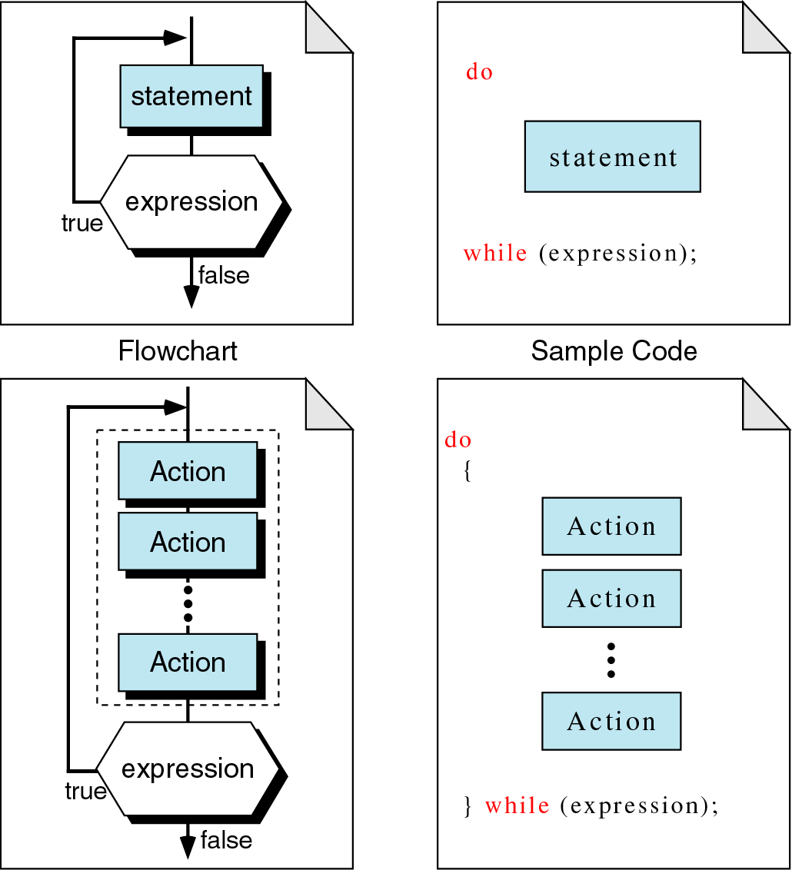
do-while Statement: Flow chart

Slide 13
Example 3
#include <stdio.h>
int main(int argc, char **argv)
{
int num = 2;
do {
printf(“%d “, num);
num--;
} while(num >= 0);
}
2
1
0
num
-1
Output :
2
1
0

Slide 14
QUIZ 2
Find the output of this program
#include <stdio.h>
int main(int argc, char **argv) {
float sum = 0.0;
int k = 1;
do {
sum = sum + k;
k++;
} while(k <= 10);
printf(“Average = %.4f\n”, sum/10);
}

Slide 15
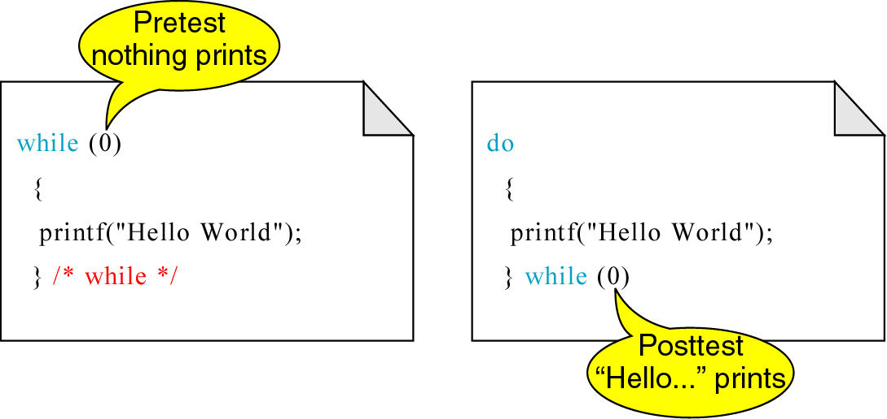
The Difference between while and do-while Statement

Slide 16
break Statement
This statement causes an immediate exit from the current loop structure
#include <stdio.h>
int main(int argc, char **argv) {
int k = 1;
while (k <= 10) {
printf(“k = %d\n”, k);
k++;
break;
}
printf(“Bye Bye\n”);
}
Output of this
program ?

Slide 17
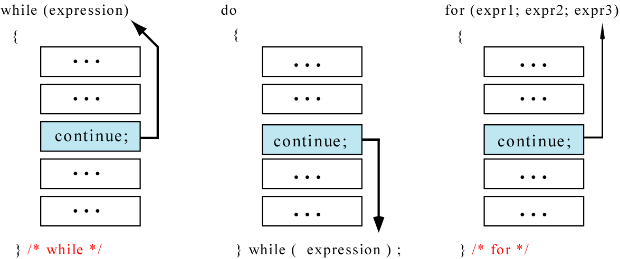
continue Statement
Sometimes, we want to skip the rest of statements and back to the condition checking of iteration process again
continue Statement is used to jump back immediately to condition checking statement
#include <stdio.h>
int main(int argc, char **argv) {
int k = 1;
while (k <= 10) {
if (k < 9) { k++;
continue; }
printf(“k = %d\n”, k);
}
printf(“Bye Bye\n”);
}
Output of this program ?

Slide 18
QUIZ 3
#include <stdio.h>
int main(int argc, char **argv)
{
int i = 0;
do {
printf("< ");
if (i == 2)
break;
printf(“%d >“, i);
i++;
} while (1);
}
Find the output of this program.

Slide 19
QUIZ 4
Find the output of this program
#include <stdio.h>
int main(int argc, char **argv) {
int i = 0;
do {
i++;
printf("<");
if (i == 2)
continue;
printf(“%d >“, i);
} while (i <= 3);
}

