Slide 1
If-ELSE IF-ELSE Statement SWITCH-CASE STATEMENT
350142 - Computer Programming
Asst. Prof. Dr. Choopan Rattanapoka and Asst. Prof. Dr. Suphot Chunwiphat

Slide 2
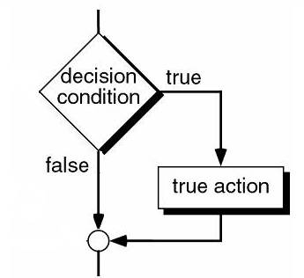
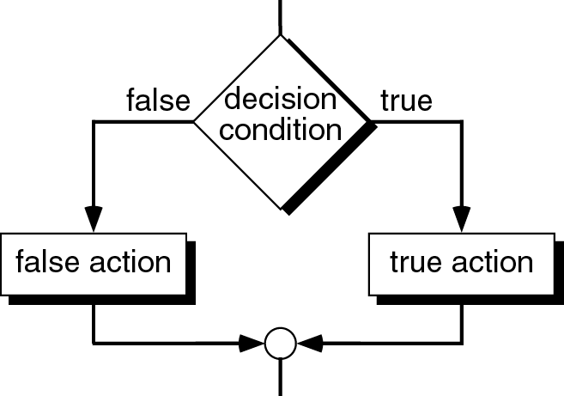
Review: If and If-Else Statement
if (condition) statement;
OR
if (condition) {
statement-1;
…
statement-n;
}
Do statement(s) only condition is TRUE, otherwise skip them
if (condition) {
statement-1;
…
statement-n;
} else {
statement-1;
…
statement-n;
}
Do statements in if block when condition is TRUE, otherwise do statements in else block

Slide 3
Grading Program
Let’s say we want to implement a program that take a score as input and the output of program is grade
For score
0 – 50 → Grade = ‘F’
51-60 → Grade = ‘D’
61-70 → Grade = ‘C’
71-80 → Grade = ‘B’
81-100 → Grade = ‘A’
Just ignore numbers that are not in range of 0-100 for now.

Slide 4
Step-by-Step (1)
#include <stdio.h>
int main(int argc, char **argv) {
int score;
printf(“Enter your score : ”);
scanf(“%d”, &score);
}
Declare a variable score as an integer.
Display some message to let user understand what to input in (printf)
Take input from user and store it in the score variable. (scanf)

Slide 5
Step-by-Step (2)
#include <stdio.h>
int main(int argc, char **argv) {
int score;
printf(“Enter your score : ”);
scanf(“%d”, &score);
if(score >= 0 && score <= 50)
printf(“Grade = F”);
}
First Condition:
IF
score is greater than or equals to 0
AND
score is less than or equals to 50
THEN
GRADE is F

Slide 6
Step-by-Step (3)
#include <stdio.h>
int main(int argc, char **argv) {
int score;
printf(“Enter your score : ”);
scanf(“%d”, &score);
if(score >= 0 && score <= 50)
printf(“Grade = F”);
if(score >= 51 && score <= 60)
printf(“Grade = D”);
if(score >= 61 && score <= 70)
printf(“Grade = C”);
if(score >= 71 && score <= 80)
printf(“Grade = B”);
if(score >= 81 && score <= 100)
printf(“Grade = A”);
}
Add all the conditions to our program
Our program runs fine. However, we can do it better.
Problems of this program:
If we want to change output display from “Grade = …” to “Your grade is …” we need to make change in our code 5 places.
This program need to evaluate 5 conditions all the time.

Slide 7
Be a good programmer (1)
Let’s solve the first problem. We need to write a program that can easily to change.
int main(int argc, char **argv) {
int score; char grade;
printf(“Enter your score : ”);
scanf(“%d”, &score);
if(score >= 0 && score <= 50)
grade = ‘F’;
if(score >= 51 && score <= 60)
grade = ‘D’;
if(score >= 61 && score <= 70)
grade = ‘C’;
if(score >= 71 && score <= 80)
grade = ‘B’;
if(score >= 81 && score <= 100)
grade = ‘A’;
printf(“Grade = %c”, grade);
}
int main(int argc, char **argv) {
int score;
printf(“Enter your score : ”);
scanf(“%d”, &score);
if(score >= 0 && score <= 50)
printf(“Grade = F”);
if(score >= 51 && score <= 60)
printf(“Grade = D”);
if(score >= 61 && score <= 70)
printf(“Grade = C”);
if(score >= 71 && score <= 80)
printf(“Grade = B”);
if(score >= 81 && score <= 100)
printf(“Grade = A”);
}
Define a character variable (grade) that will hold the grade output value

Slide 8
Be a good programmer (2)
int main(int argc, char **argv) {
int score; char grade;
printf(“Enter your score : ”);
scanf(“%d”, &score);
if(score >= 0 && score <= 50)
grade = ‘F’;
if(score >= 51 && score <= 60)
grade = ‘D’;
if(score >= 61 && score <= 70)
grade = ‘C’;
if(score >= 71 && score <= 80)
grade = ‘B’;
if(score >= 81 && score <= 100)
grade = ‘A’;
printf(“Grade = %c”, grade);
}
This code still need to evaluate all 5 conditions for any inputs.
Let’s see if we input 0
We know that grade is F from the first condition
However, with the flow of our program, program still test all of the rest conditions
IF – ELSE IF – ELSE statement can help

Slide 9
Condition: IF- ELSE IF - ELSE statement
if (condition-1) statement; else if (condition-2) statement; . . . else if (condition-n) statement; else statement;
true
Condition 1
false
true
Condition 2
false
True action
Condition N
True action
true
false
True action
False action

Slide 10
QUIZ 1
int A, B;
if ( (A + 5) <= 6 ) {
B = A + 10;
} else if ( A == 2 || A == 5 ) {
B = A – 10;
} else if (A == 3 || A > 7) {
B = A * 2;
} else if (A == 4) {
B = A / 4;
} else {
B = (A + 2) * 3;
}
B = B + 1;
What is the value stored in the variable B at the end of program
If A =
-1
1
2
4
5
7
10

Slide 11
Be a good programmer (3)
Make change of our code by using if-else if instead of all if statements.
int main(int argc, char **argv) {
int score; char grade;
printf(“Enter your score : ”);
scanf(“%d”, &score);
if(score >= 0 && score <= 50)
grade = ‘F’;
if(score >= 51 && score <= 60)
grade = ‘D’;
if(score >= 61 && score <= 70)
grade = ‘C’;
if(score >= 71 && score <= 80)
grade = ‘B’;
if(score >= 81 && score <= 100)
grade = ‘A’;
printf(“Grade = %c”, grade);
}
int main(int argc, char **argv) {
int score; char grade;
printf(“Enter your score : ”);
scanf(“%d”, &score);
if(score >= 0 && score <= 50)
grade = ‘F’;
else if(score >= 51 && score <= 60)
grade = ‘D’;
else if(score >= 61 && score <= 70)
grade = ‘C’;
else if(score >= 71 && score <= 80)
grade = ‘B’;
else if(score >= 81 && score <= 100)
grade = ‘A’;
printf(“Grade = %c”, grade);
}

Slide 12
Be a good programmer (4)
Now with if-else if statements, we can compact more on our condition.
int main(int argc, char **argv) {
int score; char grade;
printf(“Enter your score : ”);
scanf(“%d”, &score);
if(score >= 0 && score <= 50)
grade = ‘F’;
else if(score >= 51 && score <= 60)
grade = ‘D’;
else if(score >= 61 && score <= 70)
grade = ‘C’;
else if(score >= 71 && score <= 80)
grade = ‘B’;
else if(score >= 81 && score <= 100)
grade = ‘A’;
printf(“Grade = %c”, grade);
}
int main(int argc, char **argv) {
int score; char grade;
printf(“Enter your score : ”);
scanf(“%d”, &score);
if(score <= 50)
grade = ‘F’;
else if(score <= 60)
grade = ‘D’;
else if(score <= 70)
grade = ‘C’;
else if(score <= 80)
grade = ‘B’;
else if(score <= 100)
grade = ‘A’;
printf(“Grade = %c”, grade);
}

Slide 13
Be a good programmer (5)
Good program needs to take care of invalid input
Now, make change of our program that if user input a number of score out of range 0 – 100, we will display “Score is only 0 – 100”
int main(int argc, char **argv) {
int score; char grade;
printf(“Enter your score : ”);
scanf(“%d”, &score);
if(score >= 0 && score <= 100) {
if(score <= 50) grade = ‘F’;
else if(score <= 60) grade = ‘D’;
else if(score <= 70) grade = ‘C’;
else if(score <= 80) grade = ‘B’;
else if(score <= 100) grade = ‘A’;
printf(“Grade = %c”, grade);
} else {
printf(“Score is only 0-100”);
}
}
int main(int argc, char **argv) {
int score; char grade;
printf(“Enter your score : ”);
scanf(“%d”, &score);
if(score <= 50) grade = ‘F’;
else if(score <= 60) grade = ‘D’;
else if(score <= 70) grade = ‘C’;
else if(score <= 80) grade = ‘B’;
else if(score <= 100) grade = ‘A’;
printf(“Grade = %c”, grade);
}

Slide 14
Be a good programmer (6)
If you look carefully in if-else if condition, the last else if condition doesn’t really need to be evaluated.
We can just remove that condition
int main(int argc, char **argv) {
int score; char grade;
printf(“Enter your score : ”);
scanf(“%d”, &score);
if(score >= 0 && score <= 100) {
if(score <= 50) grade = ‘F’;
else if(score <= 60) grade = ‘D’;
else if(score <= 70) grade = ‘C’;
else if(score <= 80) grade = ‘B’;
else if(score <= 100) grade = ‘A’;
printf(“Grade = %c”, grade);
} else {
printf(“Score is only 0-100”);
}
}
int main(int argc, char **argv) {
int score; char grade;
printf(“Enter your score : ”);
scanf(“%d”, &score);
if(score >= 0 && score <= 100) {
if(score <= 50) grade = ‘F’;
else if(score <= 60) grade = ‘D’;
else if(score <= 70) grade = ‘C’;
else if(score <= 80) grade = ‘B’;
else grade = ‘A’;
printf(“Grade = %c”, grade);
} else {
printf(“Score is only 0-100”);
}
}

Slide 15
The switch-case statement
The switch statement may also be used in C to select one of several alternatives.
The switch statement is especially useful when the selection is based on the value of a single variable or of an integer expression.
In C, switch-case statement operation is faster than if-else if-else statement operation.

Slide 16
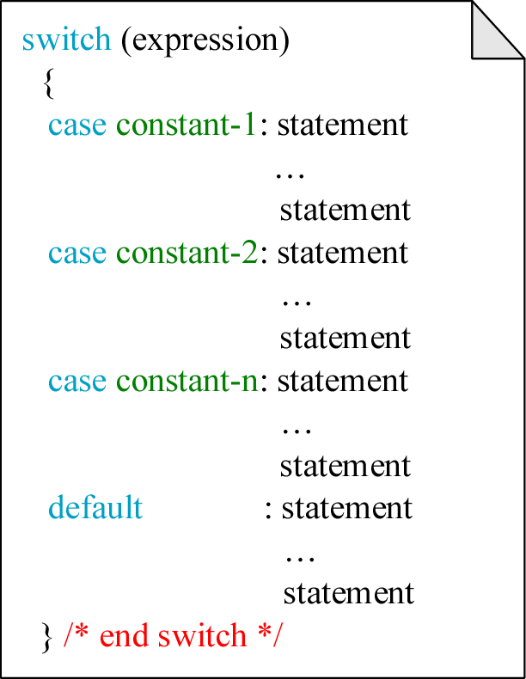
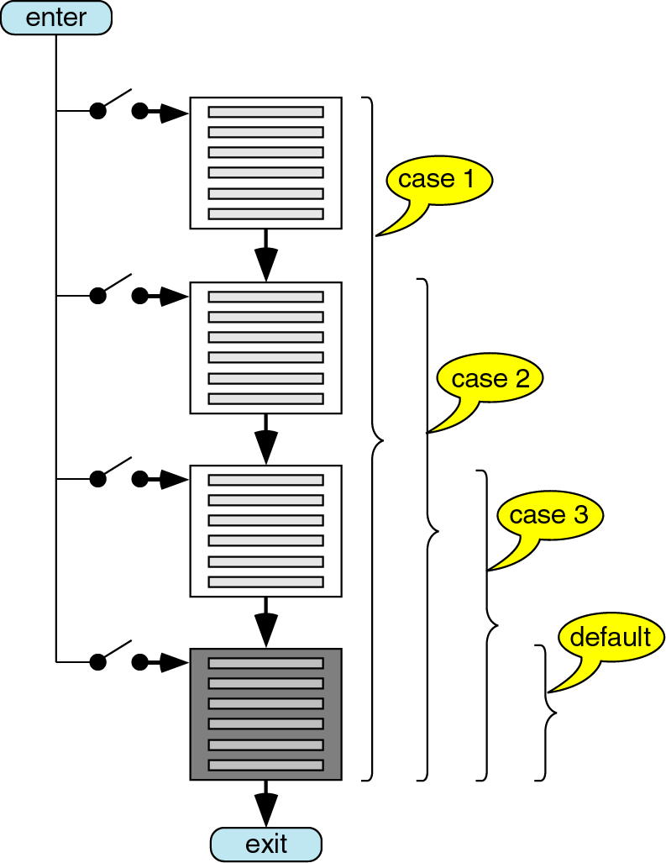
The switch-case Syntax

Slide 17
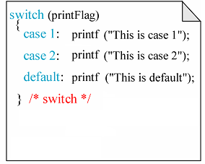
Example: switch - case

Slide 18
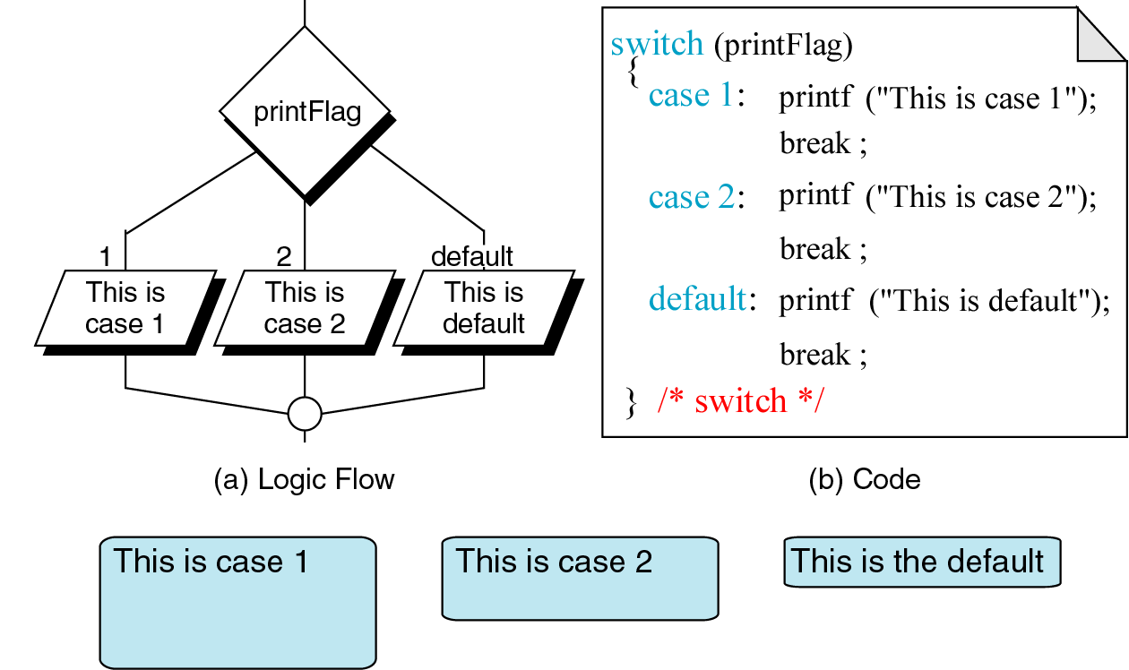
Using break in switch-case

Slide 19
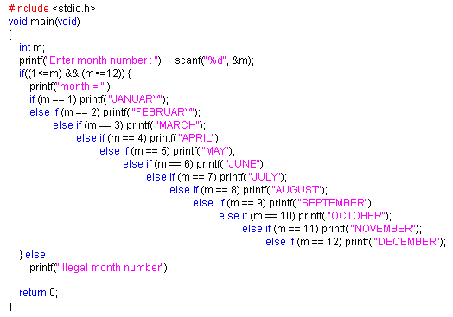
Example: Month Display Program using if

Slide 20
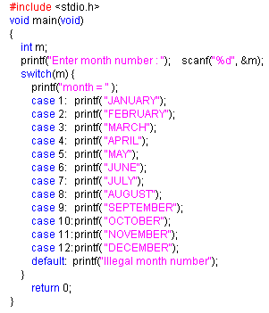
Example: Month Display Program using switch-case
Is it correct ?

Slide 21
Last example ☺
Easy program that take a character from user and
Display “YES” if user input ‘Y’ or ‘y’
Display “NO” if user input ‘N’ or ‘n’
Otherwise display “???”
int main(int argc, char **argv) {
char ch;
printf(“[Y]es or [N]o:”);
scanf(“%c”, &ch);
if(ch == ‘Y’ || ch == ‘y’)
printf(“YES”);
else if(ch == ‘N’ || ch == ‘n’)
printf(“NO”);
else
printf(“???”);
}
int main(int argc, char **argv) {
char ch;
printf(“[Y]es or [N]o:”);
scanf(“%c”, &ch);
switch( ch ) {
case ‘Y’ :
case ‘y’ : printf(“YES”); break;
case ‘N’ :
case ‘n’ : printf(“NO”); break;
default : printf(“???”);
}
}

