Slide 1
Relational operators Logical operators CONDITION
350142 - Computer Programming
Asst. Prof. Dr. Choopan Rattanapoka and Asst. Prof. Dr. Suphot Chunwiphat

Slide 2
Relational Operators
Relational operators are used to test the relation between two values. All C relational operators are binary operators and hence requires two operands.
The output of this expression is either TRUE or FALSE
Symbol | Definition
== | Equal
!= | Not equal
> | Greater than
>= | Greater than or equal to
< | Less than
<= | Less than or equal to
Warning:
A = 5; and A == 5; are not the same
A = 5 means assigning the value 5 to A
A == 5 means comparing the value of A and 5.

Slide 3
QUIZ 1
What is the truth value of these expressions?
10 > 8
-9 < -3
13 != 13
2 < -5
5 + 3 == 16 / 2

Slide 4
Character Comparison
We can also test the value of 2 characters by using its ASCII value
‘C’ < ‘c’ ASCII code of C is 67
ASCII code of c is 99
‘P’ > ‘M’ ASCII code of P is 80
ASCII code of M is 77

Slide 5
True and False representation in C
In C, actually there are no TRUE and FALSE value
C language uses integer number to represent the truth value
0 for FALSE
1 for TRUE
Thus,
5 > 2 → True → C will return 1
-5 < -10 → False → C will return 0

Slide 6
Logical Operators
You can join 2 or more comparison expressions by using logical operators
In C, there are 3 logical operators
Symbol | Meaning | Type
! | NOT | Unary Operator
&& | AND | Binary Operator
|| | OR | Binary Operator
In C language, any numeric values are considered as TRUE except 0 (zero) as false

Slide 7
Boolean Table for NOT (!)
! (logical NOT) returns 1 (true) when its operand result is 0 (false) and false otherwise.
Ex. int a = 10;
!a; /* the result is 0 (false) */
!(a < 5); /* the result is 1 (true) */
Logical Operation | Result
!false | 1 (true)
!true | 0 (false)

Slide 8
Boolean Table for AND (&&)
&& (logical AND) returns 1 (true) when both of its operands are true and returns 0 (false) otherwise.
Ex. int a = 5, b = 10;
(a >= 5) && (b > 20); /* the result is 0 (false) */
(a != 15) && b /* the result is 1 (true) */
Logical Operation | Result
true && true | 1 (true)
false && true | 0 (false)
true && false | 0 (false)
false && false | 0 (false)

Slide 9
Boolean Table for OR (||)
|| (logical OR) returns 1 (true) when either of its operands are true and returns 0 (false) if both the operands are false.
Ex. int a = 5, b = 10;
(a != 5) || (b <= 5); /* the result is 0 (false) */
(b > 20) || (a == 5); /* the result is 1 (true) */
Logical Operation | Result
true || true | 1 (true)
false || true | 1 (true)
true || false | 1 (true)
false || false | 0 (false)

Slide 10
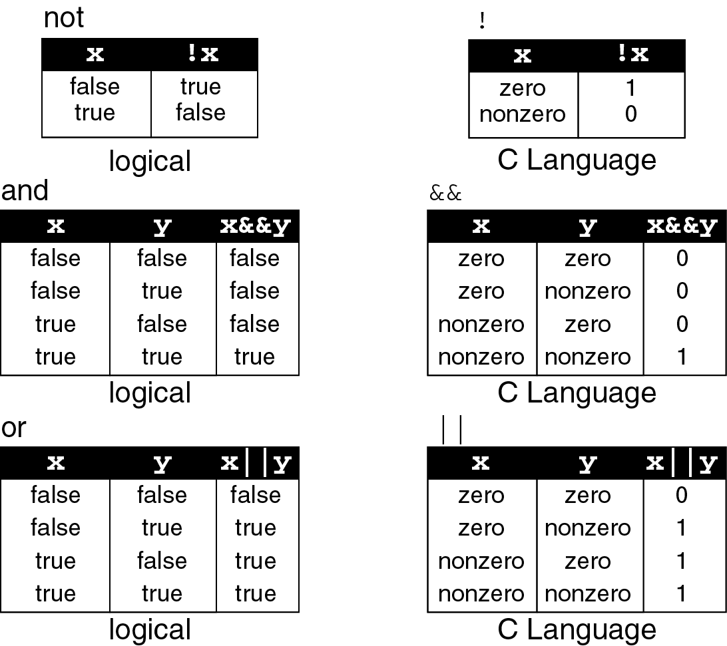
Summary: Boolean Table

Slide 11
Operator Ordering
Order | Operator
1 | Arithmetic Operators
2 | !
3 | >, >=, <, <=
4 | ==, !=
5 | &&
6 | ||
What are the output of the following expressions?
!(2 < 3) && (5 == 5)
!(2*5 >= 3) || (5 != (15/3))
0 || (2 – 2) && 5

Slide 12
Conditional Control Statement
Usually the C language statements are executed sequentially. But in some environments, this sequential flow of execution might have to be changed and the control should be transferred to another part of the program.
C provides 3 kinds of conditional control statement that help you make change to the flow of your program
if statement
if - else statement
if – else if – else statement → next week

Slide 13
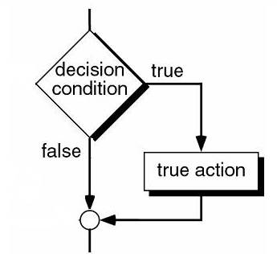
The if statement
1
if (condition) statement;
condition: the expression that programmer defined to consider either true or false statement: this statement will be executed if the condition is true, otherwise just skip this statement
2
if (condition) { statement-1; statement-2; statement-3; … statement-n; }
condition: the expression that programmer defined to consider either true or false statements: these statements will be executed if the condition is true, otherwise just skip all of these statements.

Slide 14
Example: IF statement
true
A == 5 ?
A == 5 ?
false
true
false
A = A + 5
A = A + 5
A = A * 10
int main(void) {
int A = 5;
if ( A == 5 ) {
A = A + 5;
A = A * 10;
}
}
int main(void) {
int A = 5;
if ( A == 5 )
A = A + 5;
}

Slide 15
Example
#include <stdio.h>
int main(int argc, char **argv)
{
int point;
printf(“Enter your examination point : ”);
scanf(“%d”, &point);
if (point >= 50)
printf(“You passed, congratulation\n”);
}

Slide 16
QUIZ 2
int main(int argc, char **argv)
{
int X;
printf(“Enter a number: ”);
scanf(“%d”, &X);
if (X <= 5)
X += 10;
if (X >= 13) {
X -= 5;
X++;
}
printf(“X = %d\n”, X);
}
What is the output of this program, if user enter the following numbers as an input to X variable :
1
2
3
4
5
6

Slide 17
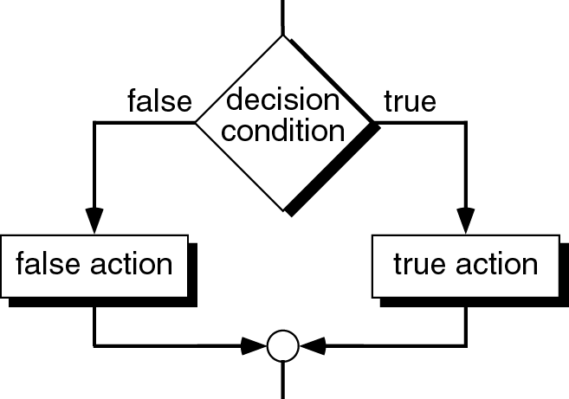
The if-else Statement
1
if (condition) statement; else statement;
2
if (condition) { statement 1; statement 2; statement 3; ….. } else { statement 1; statement 2; statement 3; ….. }

Slide 18
Condition: IF-ELSE statement
A == 5 ?
true
A == 5 ?
false
true
false
A = A + 10
A = A - 10
A = A + 10
A = A - 10
A = A * 10
A = A / 10
int main(void) {
int A = 5;
if ( A == 5 ) {
A = A + 10;
A = A * 10;
} else {
A = A – 10;
A = A / 10;
}
}
int main(void) {
int A = 5;
if ( A == 5 )
A = A + 5;
else
A = A – 10;
}

Slide 19
Example
#include <stdio.h>
int main(int argc, char **argv)
{
int point;
printf(“Enter your examination point : ”);
scanf(“%d”, &point);
if (point >= 50)
printf(“You passed, congratulation\n”);
else
printf(“Sorry, you didn’t pass\n”);
}

Slide 20
QUIZ 3
#include <stdio.h>
int main(int argc, char **argv) {
int num;
printf(“Enter number : ”);
scanf(“%d”, &num);
if (num % 2 == 0)
printf(“Even number\n”);
else
printf(“Odd number\n”);
}
What is the output of this program, if user input the following numbers:
10
28
33

Slide 21
Nested If
if (condition-1) { if (condition-2) { … if (condition-n) statement; } }
#include <stdio.h>
int main(int argc, char **argv) {
int num;
printf(“Enter your number : ”);
scanf(“%d”, &num);
if (num >= 30) {
if (num <= 40) {
if (num % 2 == 1)
printf(“Right number\n”);
else
printf(“Wrong number\n”);
} else printf(“Large number\n”);
} else printf(“Small number\n”);
}
Find the output of the program when user input the following numbers:
20
50
30
35

