Slide 1
Arithmetic Operators and Casting
350142 - Computer Programming
Asst. Prof. Dr. Choopan Rattanapoka and Asst. Prof. Dr. Suphot Chunwiphat

Slide 2
Review: Arithmetic Operators
Last week, we studied about basic arithmetic operators
* / + - %
Assignment operator =
In C programming language, there is a way to let programmers express the expression in short format
++, --
+=, -=, *=, /= , %=

Slide 3
++, and -- Operators
++ operator is used with a variable to increase the value of that variable by 1
-- operator is used with a variable to decrease the value of that variable by 1
Usage : ++var or var++
--var or var--
Example :
int a = 5, b = 10;
a++; // a = a + 1 → a = 6
++a; // a = a + 1 → a = 7
b--; // b = b – 1 → b = 9
a + b; // 7 + 9 → 16
Why C language doesn’t provide operator: ** and // ??

Slide 4
More complex on ++ and -- Operators
If we just simply want to increase and decrease the value of variable by 1, it’s easy
Eg. a++, b--
Thing becomes more complicate when we use assignment operator = with ++,-- operators
Example : Guess what is the value of A and B ?
int A, B, X = 10;
A = X++;
B = ++X;
Notes:
A = 10
B = 12

Slide 5
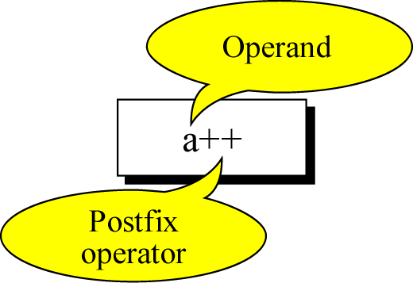
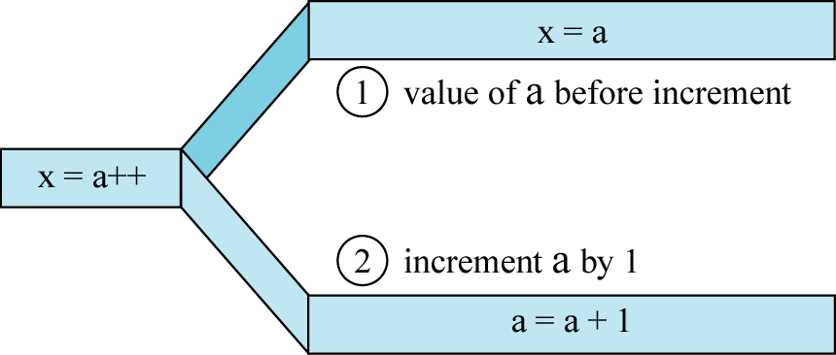
++ as Postfix operator

Slide 6
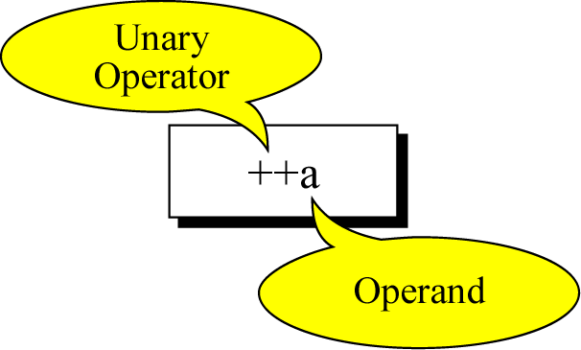
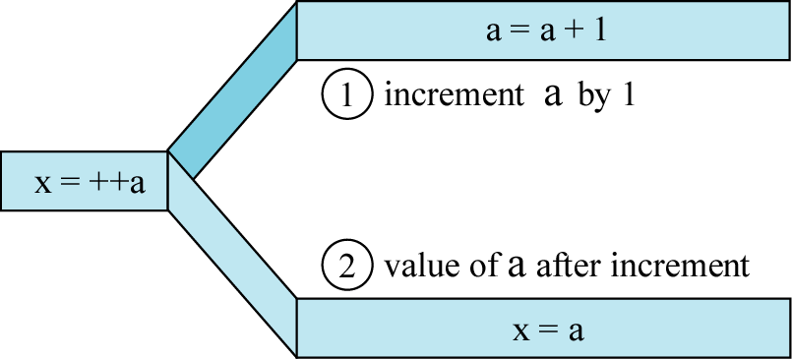
++ as Prefix Operator

Slide 7
-- Operator and Example
-- operator works just like ++ operator but it will decrease the value of variable by 1 instead of increasing
Example:
int i=1, j=2;
i++;
--j;
j = i++;
j = ++i;
i
j
1
2

Slide 8
Review: Arithmetic Operators’ Order
When you write an arithmetic expression, there is the order on which operator must be executed first
If the arithmetic operators are in the same order, the expression will be executed from left to right
Order | Arithmetic Operator
1 | ( ) parenthesis
2 | ++, --
3 | - of negitive numbers
4 | *, /, %
5 | +, -

Slide 9
QUIZ 1
Find the value of i, j, m and n after executing these code.
(1)
int i=1, j=2, m, n;
m = i++ + ++j;
n = ++i + j++;
(3)
int i=1, j=2, m, n;
++i;
i++;
m = i + --j;
n = i++ - ++j;
i = ++m;
j = n++;
(2)
int i=1, j=2, m, n;
m = --i + j++;
n = --i + --j;
Notes:
I =3, j = 4, m = 4, n = 6
I = -1, j = 2, m =2, n = 1
I = 5, j = 1, m = 5, n = 2

Slide 10
Short format for Updating Assignment
Same name of variable
VAR = VAR Operator Expression
Warning:
No space between operator and = symbol
Operator can be +, -, *, /, and %
VAR Operator= Expression

Slide 11
QUIZ 2
Find the value of x and y after executing each expression.
x
y
int x=1, y=2;
x += 9;
x /= y;
y *= (x + 5);
y -= (x % 3);
1
2

Slide 12
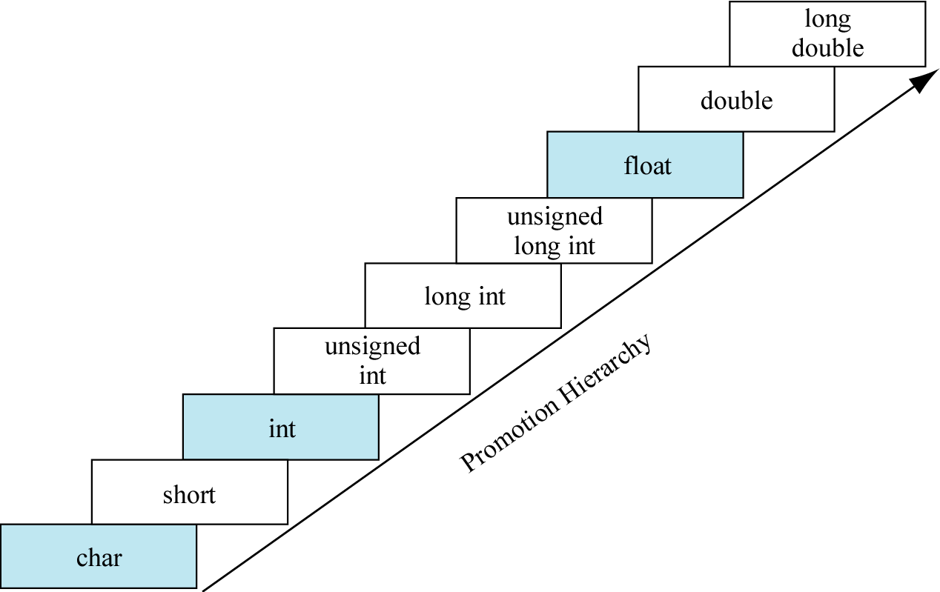
Review: Automatic Data type promotion
When you do the arithmetic operations in C between variables with different data type. C will promote the data type of variable in the lower rank to be the same as the higher rank
The data type of the output of the expression will be the same as the higher rank variable

Slide 13
Example 1
int main(void) {
int x = 10;
float y = 20.5, z;
z = x + y;
}
x (int)
y (float)
z (float)
10
20.5
?
Promote its temporary data type to float
10.0
+
20.5
30.5

Slide 14
Example 2
int main(void) {
float x = 7.3;
float y = 3.5;
int z;
z = x + y;
}
x (float)
y (float)
z (int)
7.3
3.5
?
+
10.8
10
Datatype of the variable z is int
It can not hold the fractional part of the number
C compiler will eliminate the fractional part and store only positional part in the variable Z

Slide 15
QUIZ 3
What is the output of the following program?
float width = 6, height = 2.5;
float area_of_triangle;
area_of_triangle = (1/2) * height * width;
printf(“Area of Triangle = %.2f\n”, area_of_triangle);

Slide 16
How to fix QUIZ 3 ?
There are several ways to fix it
area_of_triangle = (1.0/2) * height * width;
area_of_triangle = (1/2.0) * height * width;
area_of_triangle = (1.0/2.0) * height * width;
area_of_triangle = 0.5 * height * width;
1/2 → need to output floating point number
But if we can’t just add “.” in the number, let’s say we use variables of int data type instead.
int m = 1, n = 2;
area_of_triangle = (m/n) * height * width;

Slide 17
Manually data type promotion or demotion
Instead of letting C compiler automatically promote the data type of your variable, you can also do it “Manually”
We call this method “casting”
Usage :
(Data type) expression
Example :
(float)a //temporary convert value a to float
(float)(x+y) //temporary convert value of x+y to float
Warning:
(int)(a/10) is not the same as (int)a/10
(int)(a/10) → temporary convert value of a/10 to integer
(int)a / 10 → temporary convert value of a to integer and divide it by 10

Slide 18
Solve our problem
float width = 6, height = 2.5;
float area_of_triangle;
int m = 1, n = 2;
area_of_triangle = (m/n) * height * width;
area_of_triangle = (float)(m/n) * height * width;
area_of_triangle = ((float)m/n) * height * width;
area_of_triangle = (m/(float)n) * height * width;
area_of_triangle = ((float)m/(float)n) * height * width;
All of 4 statements are correct ??

Slide 19
QUIZ 4
Find the value of a, b, c, d and e
float a; a = (int)5.5 + (float)10.4;
int b; b = (int)5.5 + 10.4;
int c; c = (int)(5.5/1.1);
int d; d = (int)5.5/1.1;
int e; e = 5.5/(int)1.1;

