Slide 1
INPUT and Basic Arithmetic operators in C
350142 - Computer Programming
Asst. Prof. Dr. Choopan Rattanapoka and Asst. Prof. Dr. Suphot Chunwiphat

Slide 2
Input Functions
Through input functions, the information can be fed to the computer. Input data can be user’s data entry through the standard input device key board.
C language supports many input functions, such as:
scanf ( )
getchar ( )
getche ( )
getch ()

Slide 3
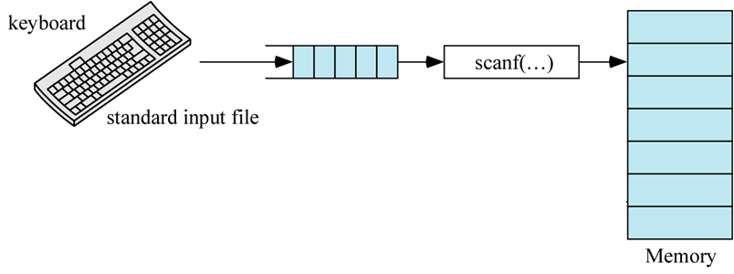
scanf( ) function
With this function call all types of values can be read. This function should have at least two parameters.
First one is the control string which has the conversion specification characters. This control string determines the number of parameters that follows it.
The other parameters can only be variable names. At least one variable name should be present if this function is called

Slide 4
Usage of the scanf() function
scanf (“control string” , &var);
Control string: This contains the conversion characters and determines the number of arguments that follows it. It should be given within double quotes.
var is the variable name. An ampersand (&) symbol should precede each numeric and character type variables by which the address of the variables are denoted.

Slide 5
scanf(): Control String
Control String | Description
%c | Use to take a value of a single character (char)
%s | Use to take a value of string
%d | Use to take a value of a integer number (short, int, long)
%f | Use to take a value of a single precision floating point number (float)
%lf | Use to take a value of a double precision floating point number (double)
Warning
For a double precision floating point number (double)
When you want to display by using printf() → format code is %f
But when you want to take the value by using scanf() → control string is %lf

Slide 6
Example 1
Memory
int a;
scanf(“%d”, &a)
printf(“Hello %d”, a);
10
a
A user type 10 on keyboard
and press enter
A monitor displays
Hello 10

Slide 7
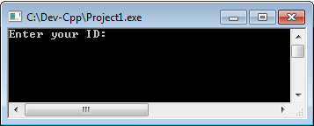
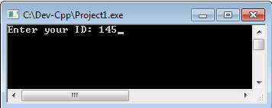
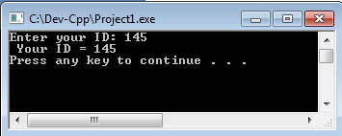
Example 2
#include<stdio.h>
int main(int argc, char **argv)‏ {
int x;
printf("Enter your ID: ");
scanf("%d”, &x);
printf(" Your ID = %d\n”, x);
system(“pause”);
return 0;
}

Slide 8
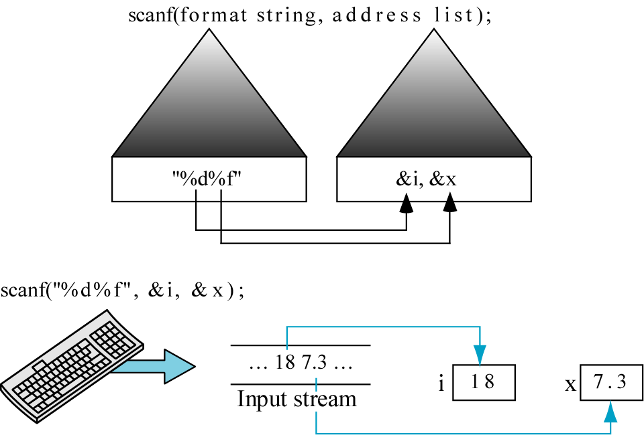
scanf(): Multiple input data

Slide 9
Example 3
#include<stdio.h>
int main(int argc, char **argv)‏ {
int a, b, c;
printf("Enter three integer number: ");
scanf("%d %d %d”, &a, &b, &c);
printf("a = %d b = %d c = %d\n“, a, b, c);
system(“PAUSE”);
return 0;
}

Slide 10
Example 4
#include<stdio.h>
int main(int argc, char **argv) {
int a, b, c;
printf("Enter three integer number: ");
scanf("%d/%d/%d", &a, &b, &c);
printf("a = %d b = %d c = %d\n", a, b, c);
system("pause");
return 0;
}

Slide 11
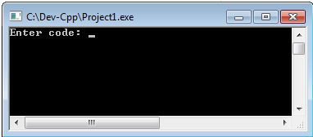
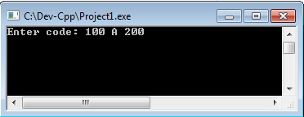
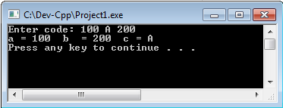
Example 5
#include<stdio.h>
int main(int argc, char **argv)‏ {
int a, b;
char c;
printf("Enter code: ");
scanf("%d %c %d”, &a, &c, &b);
printf("a = %d b = %d c = %c\n“, a, b, c);
system(“PAUSE”);
return 0;
}

Slide 12
QUIZ 1
If a program declare the following variables:
double d;
int x;
float f;
Write a scanf() function to take values of the following formats.
10.5:99
10.5 will be stored in d, 99 will be stored in x
12.5#70.8#100
12.5 will be stored in f, 70.8 will be stored in d, and 100 will be stored in x

Slide 13
getchar( ), getche(), getch() functions
3 of these functions take only a single character from keyboard
getchar()
Usage: ch = getchar( );
Display user’s input on monitor. User need to press enter to finish the input process.
getche()
Usage: ch = getche();
Display user’s input on monitor. User doesn’t need to press enter to finish the input process.
getch()
Usage: ch = getch();
Not display user’s input on monitor. User doesn’t need to press enter to finish the input process.

Slide 14
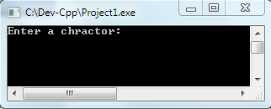
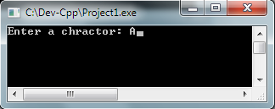
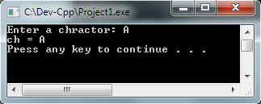
Example: getchar()
#include<stdio.h>
int main(int argc, char **argv) {
char ch;
printf("Enter a charactor: ");
ch = getchar( );
printf(“ch = %c\n", ch);
system("pause");
return 0;
}

Slide 15
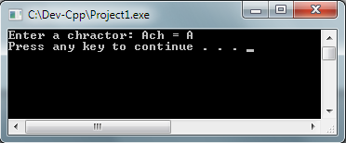
Example: getche()
#include<stdio.h>
int main(int argc, char **argv) {
char ch;
printf("Enter a charactor: ");
ch = getche( );
printf(“ch = %c\n", ch);
system("pause");
return 0;
}

Slide 16
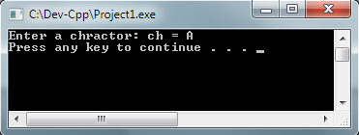
Example: getch()
#include<stdio.h>
int main(int argc, char **argv) {
char ch;
printf("Enter a charactor: ");
ch = getch( );
printf(“ch = %c\n", ch);
system("pause");
return 0;
}

Slide 17
Basic Arithmetic Operators in C
Arithmetic Operator | Name | Meaning | Examples
+ | Plus | Addition | 9 + 5 → 14 23.8 + 12.1 → 35.9
- | Minus | Subtraction | 9 – 5 → 4 23.8 – 12.1 → 11.7
* | Times | Multiplication | 9 * 5 → 45 23.8 * 12.1 → 287.98
/ | Slash | Division | 8 / 2 → 4 23.5 / 11.5 → 2.0434…
% | Percent | Remainder (Modulo) | 9 % 2 → 1
Division of 2 integer numbers yield the integer number as a result
Ex: 10/3 → 3
Modulo operator can be used only with integer numbers

Slide 18
Assignment Operator (1)
“=” in C means assignment
VariableName = Expression
C compile will calculate the expression in RHS and then store the output value of the expression into the variable on LHS
Example :
int a;
a = 5 + 10; //a stores a value of 10
Left hand side (LHS)
Right hand side (RHS)

Slide 19
Assignment Operator (2)
More than one variable can be assigned with single value or expression. This is one of the distinct features of C.
Example:
int k, m, n;
k = m = n = 5; //k, m, and n stored the value of 5

Slide 20
QUIZ 2
Find the value of variables i, j, and k after execute these instructions in order.
int i = 1, j = 2 , k;
k = i + j;
i = i + (k * j);
j = i / 2;
k = i % 2;
i = (j + k) * 3;
i
j
k
1
2
?

Slide 21
QUIZ 3
Find the value of variables x and y after execute these instructions in order.
double x=1.0, y=2.0;
x = y + 5.0;
y = x / 2.0;
y = (x * 3.0) + 4.0;
x = -0.5 - y;
x
y
1.0
2.0

Slide 22
QUIZ 4
Find the value of variables x and y after execute these instructions in order.
int x = 10, y = 5;
x = x + 4;
x = x / (y – 1);
y = (y + x) % (y - x);
x
y
10
5

Slide 23
Loss of precision
Remind you that if you choose incorrect variable’s data type to store value, it may cause you the loss of precision of your result
Example:
int result;
double x = 5, y = 2;
result = 5 / 2; // result = ?
Notes:
Stop here first

Slide 24
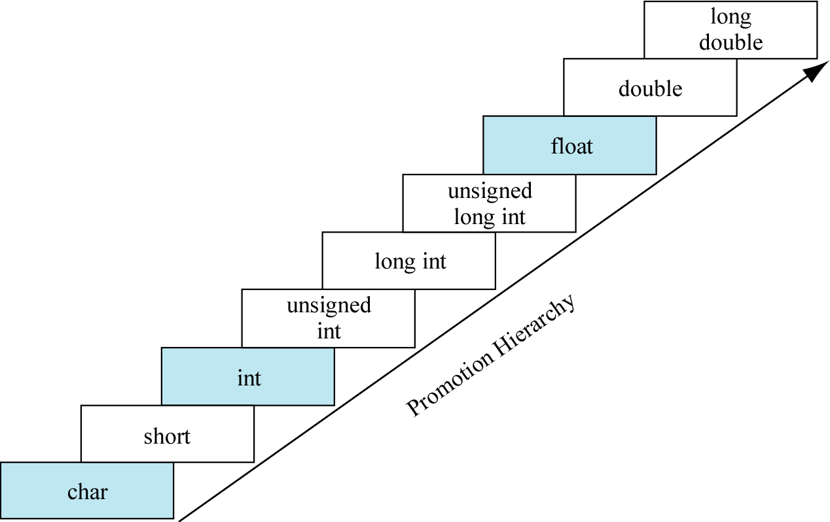
Automatic Data type promotion
When you do the arithmetic operations in C between variables with different data type. C will promote the data type of variable in the lower rank to be the same as the higher rank
The data type of the output of the expression will be the same as the higher rank variable

Slide 25
QUIZ 5
int a = 10, x;
float b = 3, y;
x = a / b; x = _______________
y = a / b; y = _______________
x = (a + 3) / 2; x = _______________
y = (a + 3) / 2; y = _______________
x = (a + b) / 2; x = _______________
y = (a + b) / 2; y = _______________

Slide 26
Arithmetic Operators’ Order
When you write an arithmetic expression, there is the order on which operator must be executed first
If the arithmetic operators are in the same order, the expression will be executed from left to right
Order | Arithmetic Operator
1 | ( ) parenthesis
2 | - of negative numbers
3 | *, /, %
4 | +, -

Slide 27
Example
5 + 2 * 3
* is higher order than + then * will be executed first
5 + 6 → 11
5 * 2 + 10 / 2
* and / are the higher order than + and both of them are in the same order
Then, we calculate from the left side (* is executed first)
10 + 10 / 2
Now the / is in higher order than +, thus / is executed
10 + 5 → 15

Slide 28
QUIZ 6
Find the output of these expressions :
-2 + 5 * 2
10/2 * 3
6 / 2 + 3 * (4 % 2)
(5+2) * 15 % 4
6 + 2 * 2 – 6 / 2

