Slide 1
Data Type and Display
350142 -Computer Programming
Asst. Prof. Dr. Choopan Rattanapoka and Asst. Prof. Dr. Suphot Chunwiphat

Slide 2
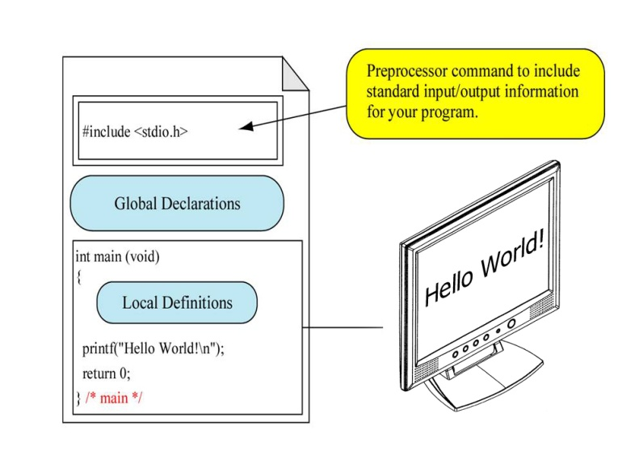
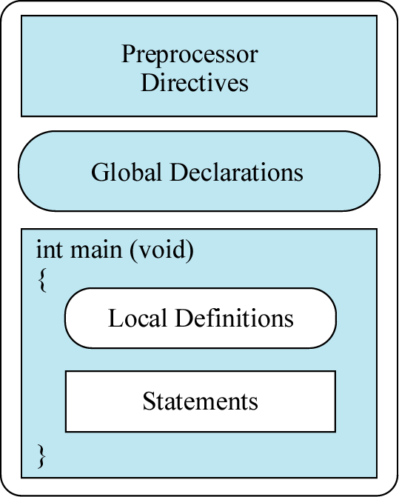
Structure of C Programming Language

Slide 3
Preprocessor Directives
Normally, we use this part for referencing files with .h extension
In C, standard function definitions locate in .h files For example, printf function definition locates in stdio.h file
We can reference .h file with a preprocessor directive #include

Slide 4
Main Function
C program starts at main function
There are many way to write a main function
void main(void)‏
void main(int argc, char **argv);
int main(void)‏
int main( )
int main(int argc, char **argv);
recommend

Slide 5
C Language Syntax
Number of { and } must be the same
We call statements inside { and } a block
Every statements that don’t follow by a block, need to end up with semicolon “;”
Remember that All of C standard functions name are lowercase

Slide 6
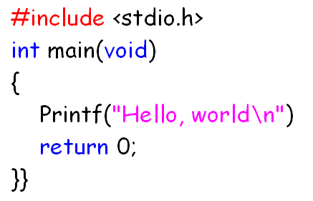
Example: Error in C Program
Must be
a lowercase p
Add ;
Remove
one }

Slide 7
C Data types
7 basic data types
Integer number: short, int, long
Floating point number: float, double, long double
character: char
Complex data types (based on basic data types)
array
structure
union
enumerate

Slide 8
Data Types and Sizes
Type | Memory Size | Remarks
char | 1 byte | can hold a single character or an integer value ranging from (-128 to 127)
short | 2 bytes | can hold an integer value ranging from (-32768 to 32767)
int | 4 bytes | can hold an integer value range from (-2,147,483,648 to 2,147,483,647)
long | 4 bytes | can hold an integer value range from (-2,147,483,648 to 2,147,483,647)
float | 4 bytes | Single precision floating point value (-3.4x10⁻³⁸ to 3.4x10⁺³⁸)
double | 8 bytes | Double precision floating point value (-1.7x10⁻³⁰⁸ to 1.7x10⁺³⁰⁸)

Slide 9
Character (char) data type
When we store data on memory, we can store only in the form of binary number (0 and 1)
Thus, we can’t store any character (a, b, c, etc.) in memory directly
We need a standard that can convert character into a number that can store on memory and that standard is ASCII
ASCII : American Standard Code for Information Interchange

Slide 10
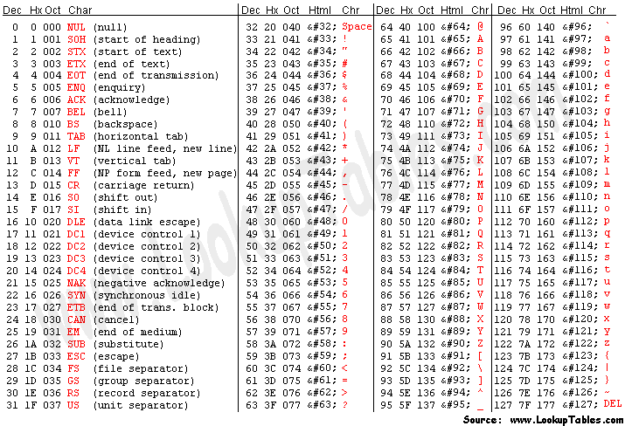
ASCII Table

Slide 11
Special Character in C (Escape sequence)
Character | Meaning | Result
\a | Alert or bell | Produces an audible alert
\b | Backspace | Moves the active position to the previous position on the current line
\f | Form-feed | Moves the active position to the initial position on the next line
\n | New-line | Moves the active position to the initial position of the next line
\r | Return | Moves the active position to the initial position of the current line
\t | Horizontal tab | Moves the active position to the next horizontal tabulation position
\v | Vertical tab | Moves the active position to the next vertical tabulation position
\\ | Backslash | Displays a backslash (\)
\’ | Single quote | Displays a single quote (‘)
\’’ | Double quote | Displays the double quote (“)
\xff | A character corresponding to ASCII (ff) | Displays a character by using ASCII code (ff) * Though there are two or more characters in an escape sequence, they are considered as a single character.

Slide 12
Variables in C
These are names of language objects. These can take many values, but one at a time. Once assigned, their values can be changed during the program execution. Values can be stored in a symbolic name (variable) in the computer memory. Usually variables are named with the description that transmits the idea of what value it hold.
For example,
if a root of a quadratic eq. is to be calculated, the variable in which the value of root should be stored can be named as ‘root’.

Slide 13
Naming a variable
Any variable should be named so as to distinguish one from the other. The following are the rules to name a variable.
It can be of letters, digits, dollar($) and underscores( _ ).
No other special characters are allowed.
First character should be a letter, dollar($) or an underscore.
Upper and lower case letters are significant.
Eg. RESULT, Result and result are considered to be three different variables.
Reserved words cannot be identifier names.

Slide 14
Reserved words
auto break case
char const continue
default do double
else enum extern
float for goto
if inline int
long register restrict
return short signed
sizeof static struct
switch typedef union
unsigned void volatile
while _Bool _Complex
_Imaginary

Slide 15
QUIZ 1
Each of the following variable names is correct or not ?
_Hello123
A_T_o_m
50cities
In$ide
CO2_Ho2
I..Love..U
break
Hi!!
Power#3
float

Slide 16
Variable Declaration (1)
Through the declaration statements, C interprets the identifier in a specific format. A declaration also causes storage to be reserved for an identifier. All C variables should be declared before its usage, usually at the beginning of the functions, before any executable statement.
data_type variable_name = initial value ;
Optional

Slide 17
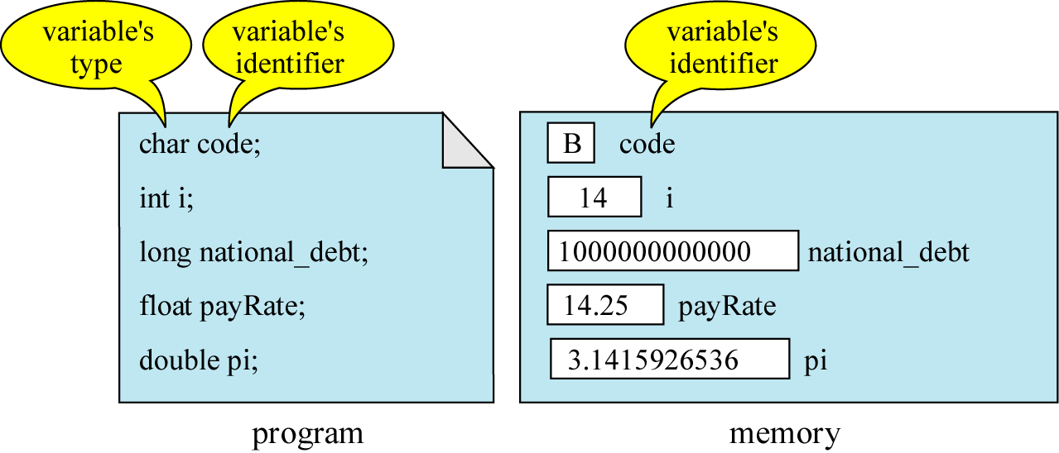
Variable Declaration (2)

Slide 18
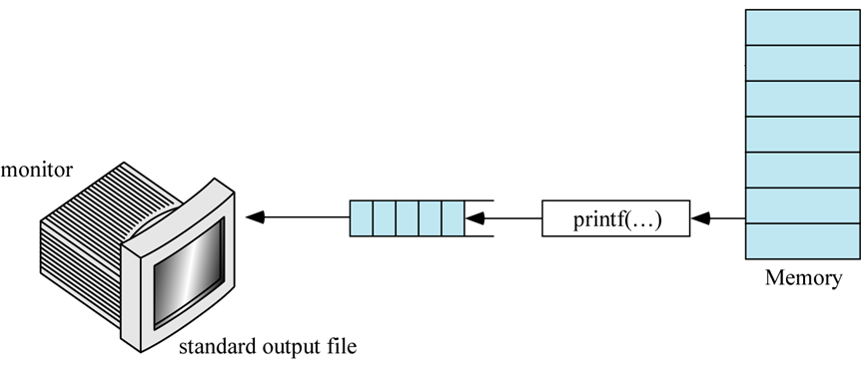
printf() function
printf function is used to display content of variable or string on the monitor
The content that will be displayed on the monitor is between the (“ and ”) symbols
The principle of printf function is to take data from memory and display them on the monitor

Slide 19
Example: printf
printf(“Hello World”);
Display Hello World on the screen
printf(“Hello World\n”);
Display Hello World and move cursor to a new line
printf(“Hello\tWorld\n”);
Display Hello and some space (tab width) and then follow by World and move cursor to a new line

Slide 20
How to display the contents of variables
We can use the printf() function to print the contents of variables to the monitor screen.
Following lists the characters that used for conversion specification and a percent (%) symbol should precede the conversion character in the printf() function.
Conversion Characters | Translate the content of a variable into
%d | A decimal integer
%f | Floating point number
%e | Floating point number in scientific notation Ex. 1.234e+02
%c | A single character
%s | A string of character
%x | An hexadecimal integer

Slide 21
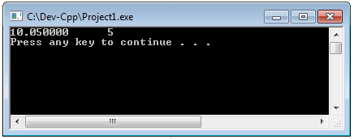
Example 1
#include <stdio.h>
#include <stdlib.h>
int main(int argc, char **argv)
{
int A = 5;
float B = 10.05 ;
printf(“%f %d”, B, A);
system(“PAUSE”);
return 0;
}

Slide 22
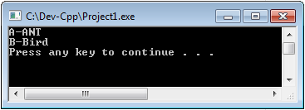
Example 2
#include <stdio.h>
#include <stdlib.h>
int main(int argc, char **argv)
{
char X = ‘A’, Y = ‘B’;
printf(“%c-ANT \n%c-Bird\n”, X, Y);
system(“PAUSE”);
return 0;
}

Slide 23
QUIZ 2
What is the output of the following program ?
int x = 123, y = 456;
float z = 3.14159;
char myChar = ‘x’;
printf(“x = %d and y = %d\n”, x, y);
printf(“x = %d, y = %d and z = %f\n”, x, y, z);
printf(“myChar is %c\n”, myChar);
printf(“myChar is %d\n”, myChar);
printf(“number = %d\n”, 150);

Slide 24
Field Width (1)
We can simply add a number between the % and the conversion character such as %5d. This number specifies the field width—the number of column to use for the display of the value.
Integer number (%d)
The positive number after % such as %5d means fill the blank with 5 spaces and then fill number from the right position to left position.
The negative number after % such as %-5d means fill the blank with 5 spaces and the fill the number from the left position to the right position.

Slide 25
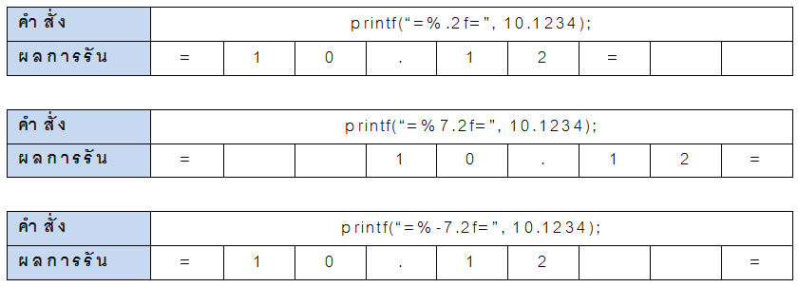
Field Width (2)
Floating point number (%f)
We can limit the number of digit of fractional number by using %. such as %.2f means we want to display only 2 digits of the fractional number.
We can also control the display field width just like integer number

Slide 26
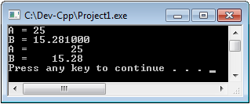
Example
int main(int argc, char **argv) {
int a;
float b;
a = 25;
b = 15.281;
printf("A = %d\n", a);
printf("B = %f\n", b);
printf("A = %8d\n", a);
printf("B = %8.2f\n", b);
system("PAUSE");
}

Slide 27
QUIZ 3
int main(int argc, char **argv) {
int a = 5, b = 50, c = 500;
float f = 5.121314;
printf(“a = %6d\n”, a);
printf(“b = %6d\n”, b);
printf(“c = %6d\n”, c);
printf(“f = %6.3f\n”, f);
system("PAUSE");
return 0;
}

