Slide 1
Introduction to C Programming Language
350142-Computer Programming
Asst. Prof. Dr. Choopan Rattanapoka and Asst. Prof. Dr. Suphot Chunwiphat

Slide 2
Technical Term in Software Development
Edit : edit or modify source code
Compile : translate source codes to machine code
Execute or Run : execute a machine code on computer
Debug : Find and eradicate bugs in source codes
Integrated Development Environment (IDE) : A software suite that integrates “edit-compile-execute-debug” program

Slide 3
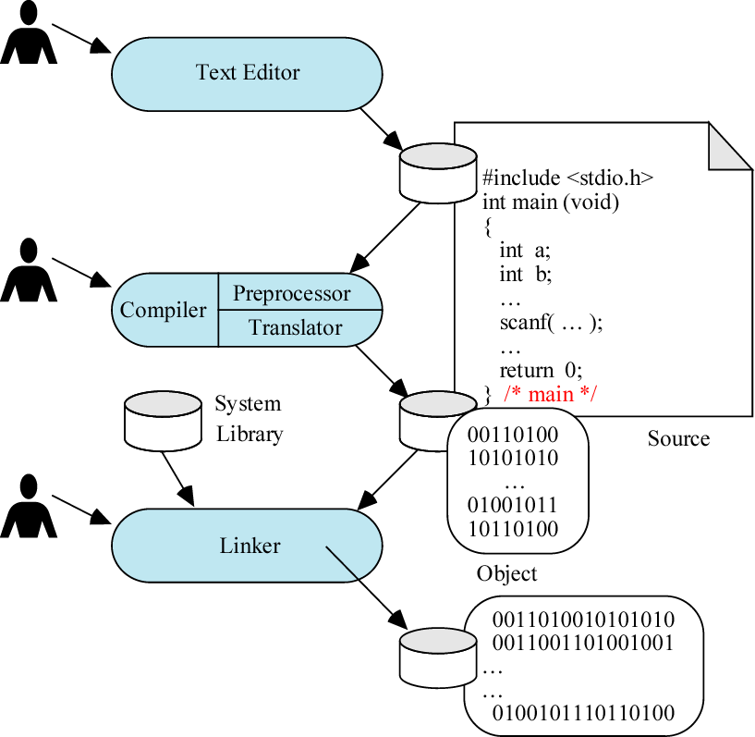
Software development on C

Slide 4
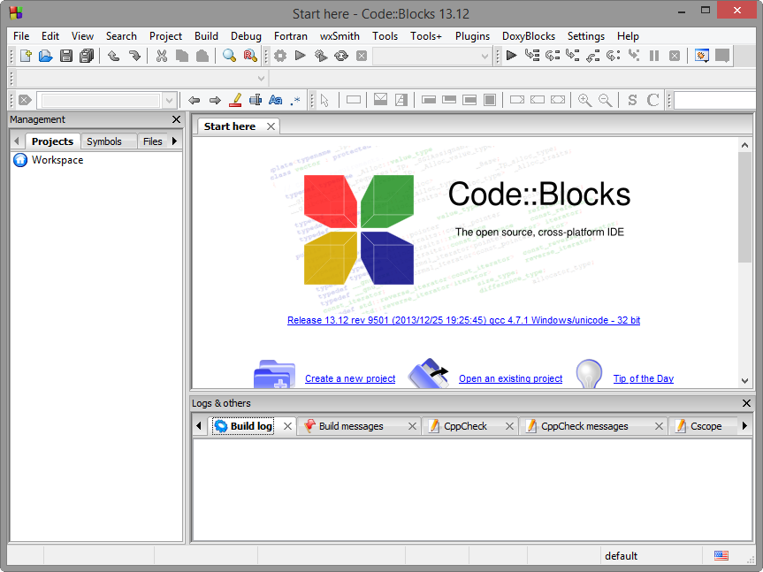
CodeBlocks IDE
Free IDE for developing software using C/C++ programming language
Site: http://www.codeblocks.org/

Slide 5
New Project
File → New → Project

Slide 6
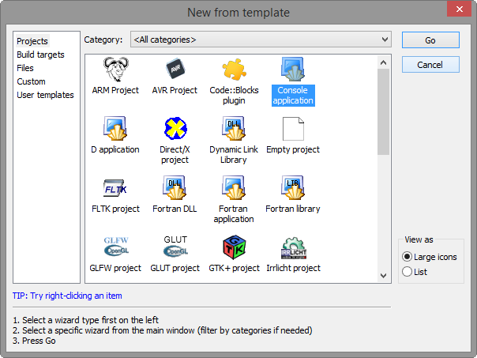
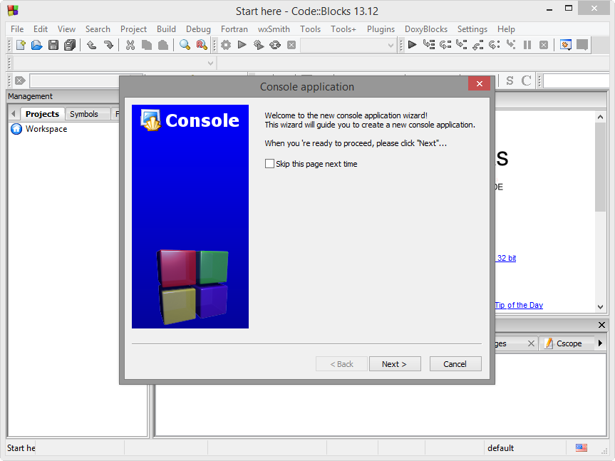
Choose Project Type
Choose Console Application
Click Go, Then click Next

Slide 7
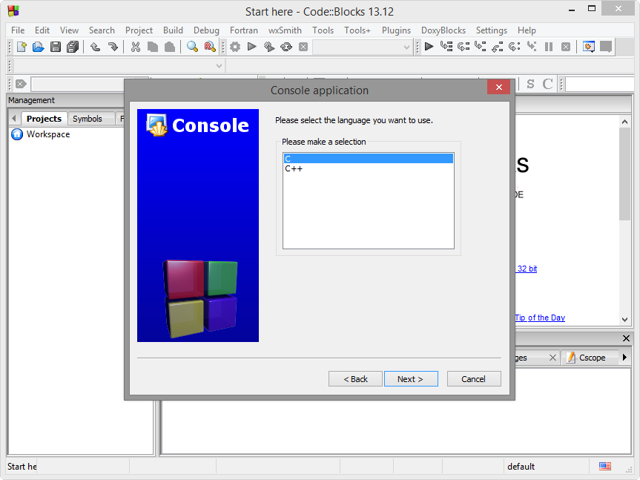
Select the language
Choose C and click Next

Slide 8
Project Location
Type “project title” name
Choose the location that will store source code files of your project

Slide 9
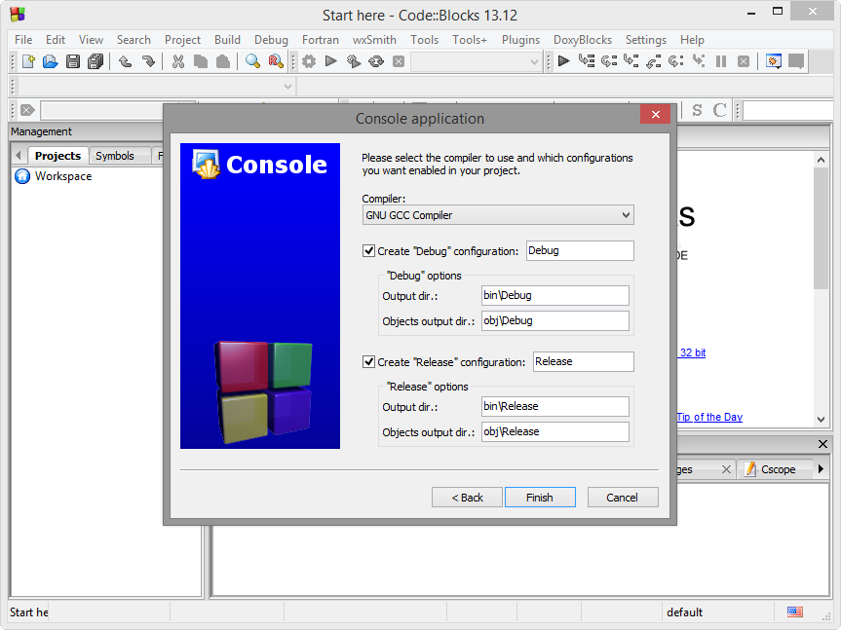
Choose Compiler
Just click Finish

Slide 10
Default Source Code

Slide 11
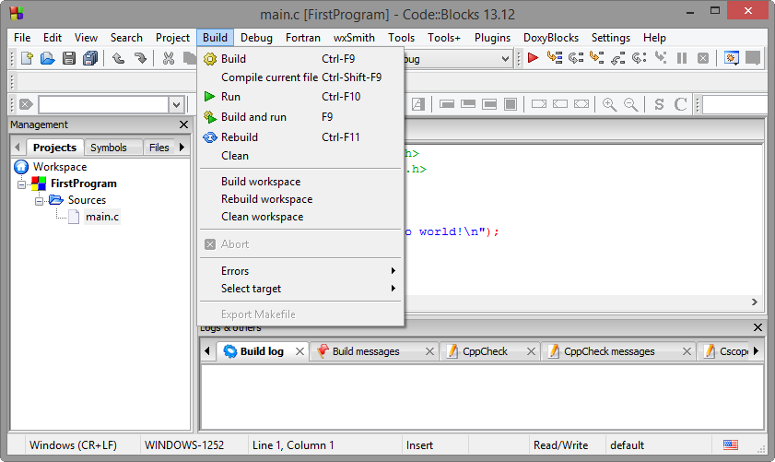
Run Menu
Build
Run
Build and Run (F9)

Slide 12
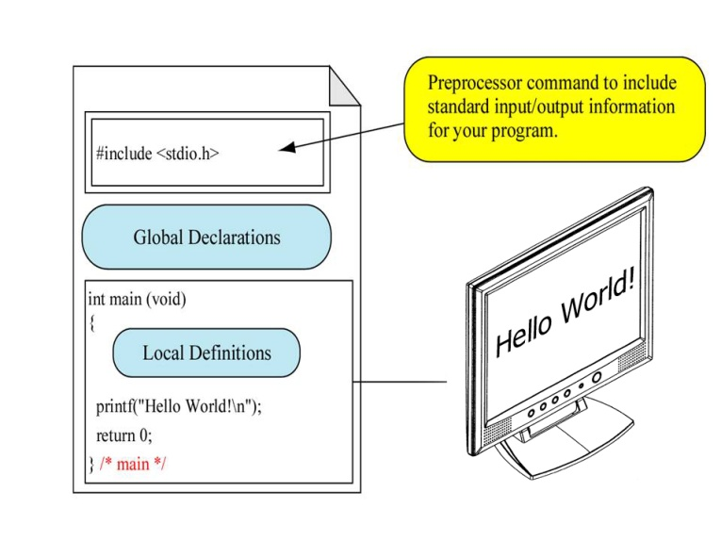
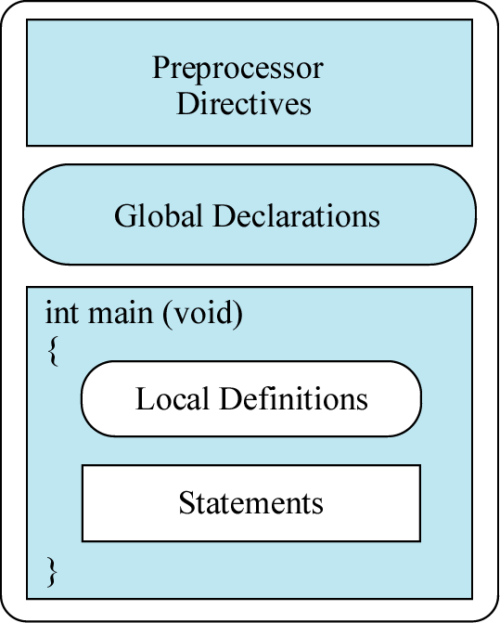
Structure of C programming language

Slide 13
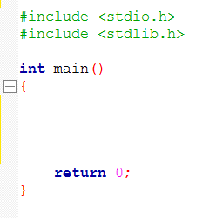
Sample C Source Code
Your code

Slide 14
Hello World
printf(“message”);
C standard function
that uses to display message on the monitor

Slide 15
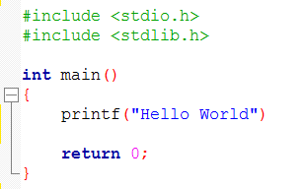
Let’s try
Remove a semicolon(;) from the line “printf(“Hello World”);”

Slide 16
Compile Error
Compiler shows you a red icon around the line of your first error.
At around the 9th line of your code
syntax error before “return”

Slide 17
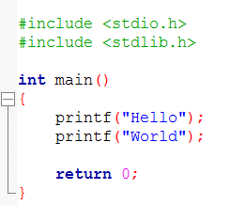
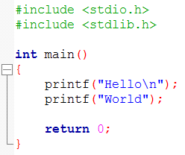
Hello World! (again)
\n is a special character to tell printf function make a new line

Slide 18
Quiz 1
What is the output of this program ?

Slide 19
Quiz 2
What is the output of this program ?

Slide 20
Comment in your source code
When you write a program, sometimes it is a good way to comment something to make you easy to understand your own code in the following days, months, or years
With comment, the compiler will pass and not compile your comment lines.
In original C programming language
We use /* your comment */
It can take comment on multiple line
/*
This is
my comment
*/

Slide 21
Example: How to use comment

Slide 22
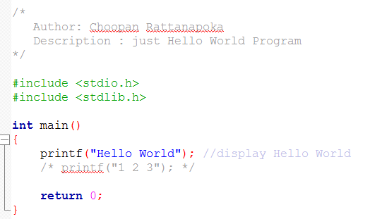
Comment (2)
Current C compiler has influent of C++ compiler, Thus now they can also take C++ style comment.
// (double slash)
String from // to the end of line will be commented

Slide 23
QUIZ 3
What is the output of this program ?

Slide 24
QUIZ 4
What is the output of this program ?

Slide 25
QUIZ 5
What is the output of this program ?

