Slide 1
Course Curriculum
350142 – Computer Programming
Asst. Prof. Dr. Choopan Rattanapoka and Asst. Prof. Dr. Suphot Chunwiphat

Slide 2
Asst. Prof. Dr. Choopan Rattanapoka
Education
Ph.D in Computer Science (2008)
Strasbourg University, France.
Master degree in Computer Science (2004)
Strasbourg University, France.
Bachelor degree in Computer Engineering (2000)
Kasetsart University, Thailand
Certificate in Technical Education
(Electrical and Electronics) [PET-6] (1996) KMUTNB, Thailand
Contact
E-mail: choopanr@kmutnb.ac.th
Homepage: http://choopanr.staff.kmutnb.ac.th
Office: 62 - 612

Slide 3
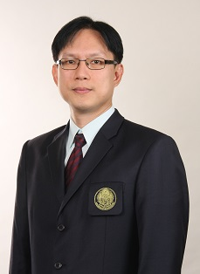
Asst. Prof. Dr. Suphot Chunwiphat
Education
Ph.D in Computer Science (2008)
Institut National Polytechnique de Grenoble, France.
Master degree in Electrical Engineering (1998)
King Mongkut’s Institute of Technology Ladkrabang, Thailand.
Bachelor degree in Telecommunication Engineering (1994)
King Mongkut’s Institute of Technology Ladkrabang, Thailand.
Contact
E-mail: spcp@kmutnb.ac.th
Office: 62 - 607

Slide 4
Course syllabus
Computer System
C Programming Language
Input/output functions
Variables and Data type
Arithmetical Operations
Logical Operations
Condition
Iteration (Loop)
String and Array
C Standard Functions
User-defined Functions

Slide 5
Grading System
Class attendant 10%
Worksheets 10%
Assignment 10%
Practical Examination 1 10%
Midterm examination 25%
Practical Examination 2 10%
Final examination 25%
Total score <= 35 → F

Slide 6
Introduction to Computer System
350142 –Computer Programming
Asst. Prof. Dr. Choopan Rattanapoka and Asst. Prof. Dr. Suphot Chunwiphat

Slide 7
Computer System
A computer is a device that accepts information (in the form of digitalized data) and manipulates it for some result based on a program or sequence of instructions on how the data is to be processed.
There are 2 main parts of the Computer System
Hardware : Physical devices
Software : Programs that are developed in order to control hardware as users’ need.
Computer System
Hardware
Software

Slide 8
Unit of Measurement in Computer System
Normally, we use International System of Units (SI : Système international d'unités) as unit of measurement. But in computer system, we use binary prefix.
Name | Abbr | Factor | SI size
Kilo | K/k | 2¹⁰ = 1,024 (K) | 10³ = 1,000 (k)
Mega | M | 2²⁰ = 1,048,576 | 10⁶ = 1,000,000
Giga | G | 2³⁰ = 1,073,741,824 | 10⁹ = 1,000,000,000
Tera | T | 2⁴⁰ = 1,099,511,627,776 | 10¹² = 1,000,000,000,000
Peta | P | 2⁵⁰ = 1,125,899,906,842,624 | 10¹⁵ = 1,000,000,000,000,000
Exa | E | 2⁶⁰ = 1,152,921,504,606,846,976 | 10¹⁸ = 1,000,000,000,000,000,000
Zetta | Z | 2⁷⁰ = 1,180,591,620,717,411,303,424 | 10²¹ = 1,000,000,000,000,000,000,000
Yotta | Y | 2⁸⁰ = 1,208,925,819,614,629,174,706,176 | 10²⁴ = 1,000,000,000,000,000,000,000,000

Slide 9
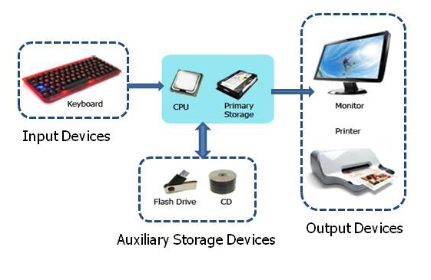
Computer Hardware
Computer hardware components can be classified into 4 main categories
Central processing unit (CPU)
Memory
Primary storage
Auxiliary storage
Input Devices
Output Devices

Slide 10
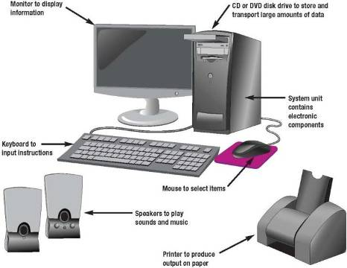
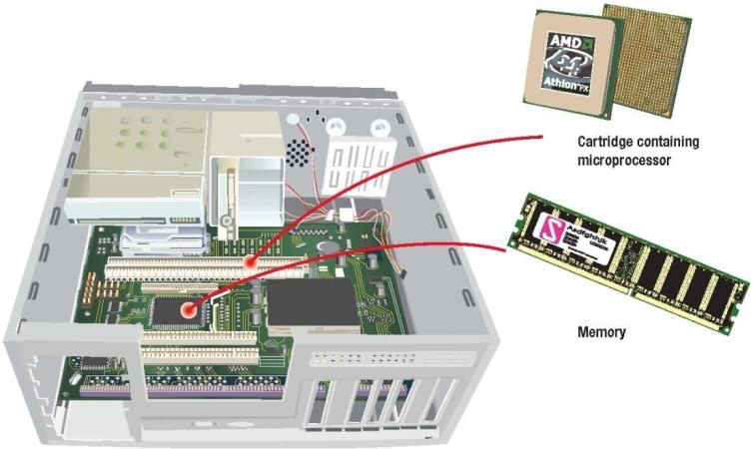
Desktop Computer (Personal Computer)

Slide 11
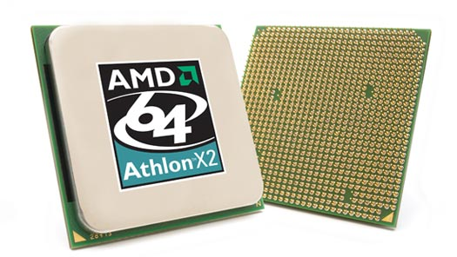
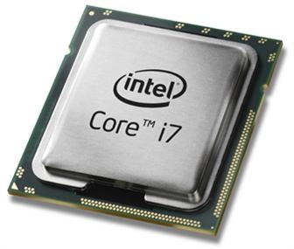
Central processing unit (CPU)
The central processing unit (CPU) is the portion of a computer system that carries out the instructions of a computer program, to perform the basic arithmetical, logical, and input/output operations of the system.
The CPU plays a role somewhat analogous to the brain in the computer.

Slide 12
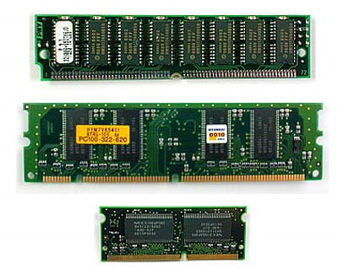
Memory (1)
Computer memory can be classified into 2 types
Primary Storage
Auxiliary Storage (Secondary storage)
Primary Storage
Store instructions and data
CPU can only read instructions and data from main memory
Main memory in computer is called RAM (Random Access Memory)

Slide 13
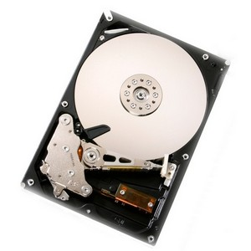
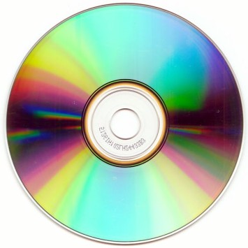
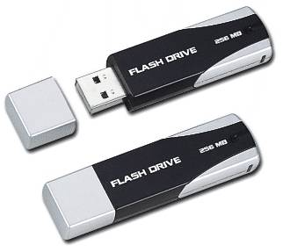
Memory (2)
Auxiliary Storage
Sometime called secondary storage
Unlike memory, secondary storage holds data and programs even if electrical power is not available
The most important types of secondary media are hard and optical disks

Slide 14
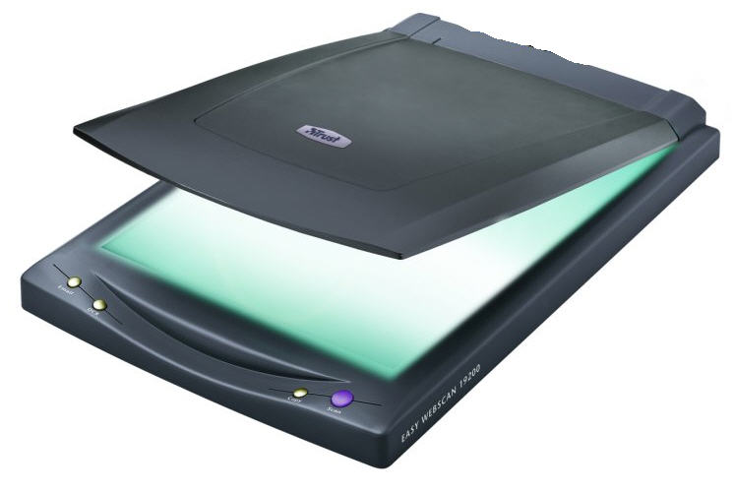
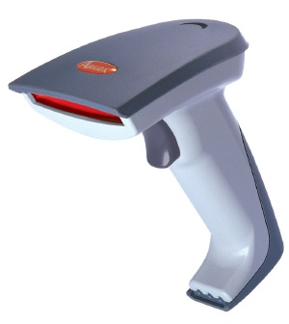
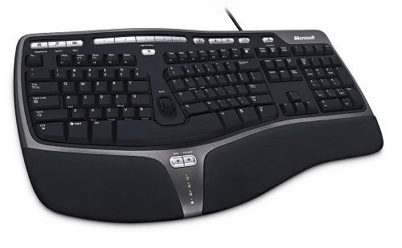
Input Devices
Input devices are used to take external data and convert them to the format that computer can understand
Scanner
Barcode Reader
Keyboard
Mouse
Joystick , etc.

Slide 15
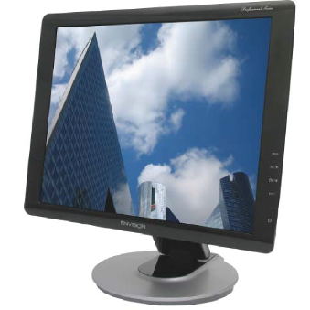
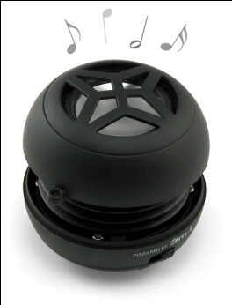
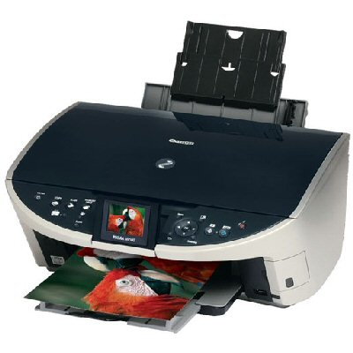
Output Devices
Output devices take the data from computer and convert them into the specific format that user can understand
Printer
Speaker
Monitor

Slide 16
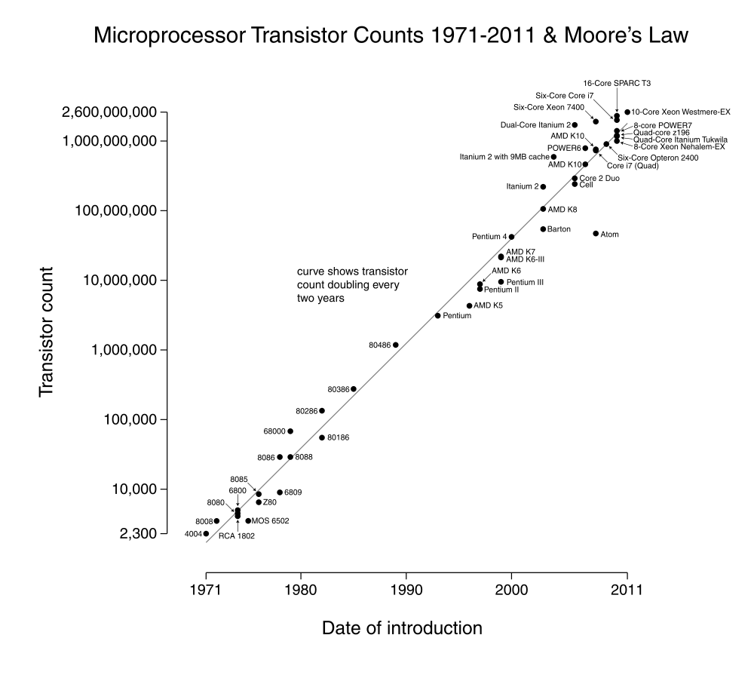
Computer Evolution (1)
Processor speed increases 2x
every 18 months

Slide 17
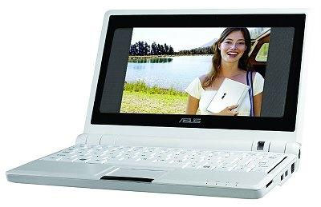
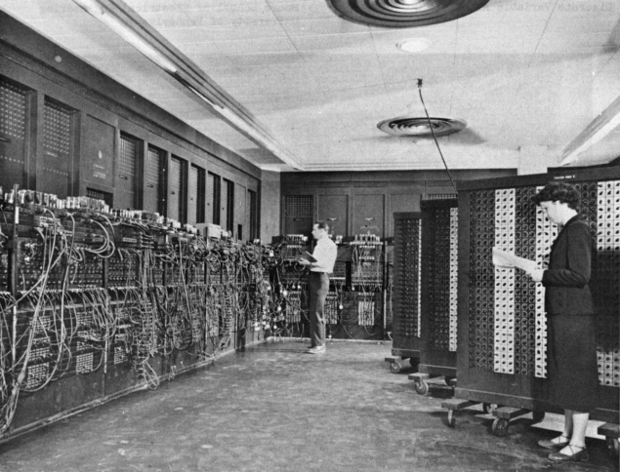
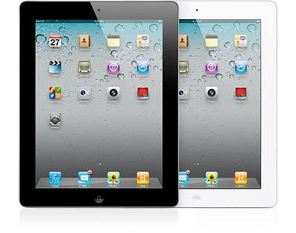
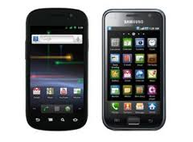
Computer Evolution (2)
Netbook
Tablet
ENIAC
Weight : ~27 tons
Size : ~ 63 m²
Smart phone

Slide 18
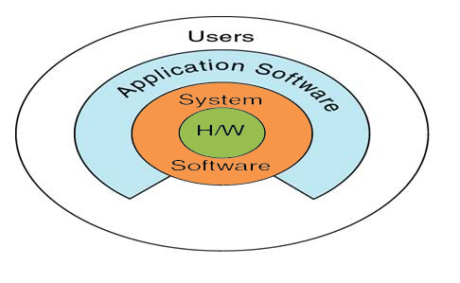
Software
Also known as Program
Two major kinds of software
System software
Application software
Software
System Software
Application Software

Slide 19
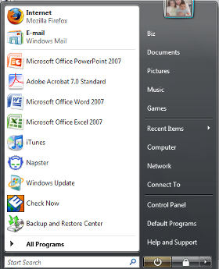
System Software
A collection of programs (not a single program)
Enables the application software to interact with the hardware
“Background software” that helps the computer manage its own resources
Notes:
System
Not a single program
A collection of programs
Two best known Operating systems are:
Windows XP
Mac OS X
Utilities
Service programs (key term)
Performs tasks related to managing computer resources
Device drivers
Application

Slide 20
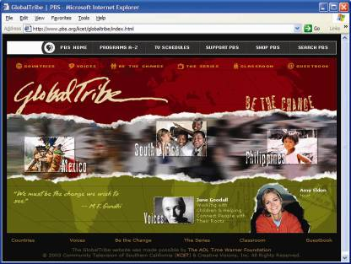
Application Software
End-user software
Two major categories
Basic Application or General purpose
Specialized applications
Notes:
“End-user” software – these are the types of programs you have to know to be considered computer competent
An example of a basic application is a browser to navigate, explore and find information (Key Term) on the Internet
Two major categories
General purpose - basic programs; “off-the-shelf”
Specialized application – narrow focus on specific disciplines and occupations
Screen capture to be replaced.

Slide 21
Computer Programming Languages
Computer programming language can be classified into 3 categories :
Low-level Programming Language
High-level Programming Language
Very High-level Programming Language

Slide 22
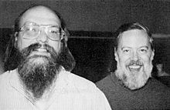
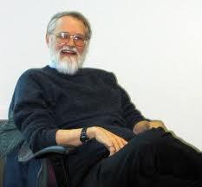
Introduction to C (1)
The initial development of C occurred at AT&T Bell Labs between 1969 and 1973 by Dennis Ritchie and Ken Thompson; It was named C because its features were derived from an earlier language called B
In 1978, Brain Kernighan and Dennis Ritchie published the first edition of The C Programming Language. This book, known to C programmers as "K&R"
C is an imperative (procedural) systems implementation language. It was designed to be compiled using a relatively straightforward compiler, to provide low-level access to memory, to provide language constructs that map efficiently to machine instructions, and to require minimal run-time support.

Slide 23
Introduction to C (2)
Despite its low-level capabilities, the language was designed to encourage cross-platform programming. A standards-compliant and portably written C program can be compiled for a very wide variety of computer platforms and operating systems with few changes to its source code.
Why C ?
Most of the operating systems are developed by C
Windows XP, Linux, UNIX, MAC OS X, etc.
Most of current programming languages are developed by C
PHP, Perl, Ruby, Python, etc.
Syntax of popular programming languages inherits from C
C++, Java, PHP, etc.

Slide 24
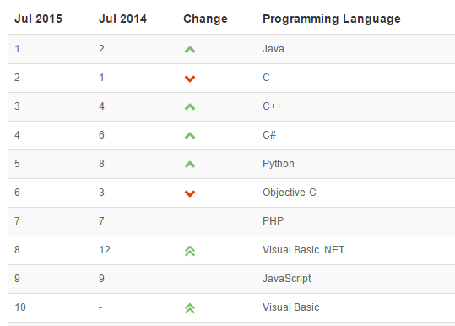
TIOBE Programming Community Index for July 2015

Slide 25
Computer Programming Languages

